Slide 1
Python3 Tutorial
Sri Pramodh Rachuri
CSE 357: Statistical Methods for Data Science
Fall 2023
Instructor: Dr. Anshul Gandhi

Slide 2
Outline
Installation
HelloWorld Example
Basics
Data Structure – Strings, Lists etc.
Built-in functions
Control flow – Loops, Conditionals
Standard Library
Random Numbers
Math and statistics
File Input and Output
Matplotlib - Plotting
Numpy – Faster arrays, matrices

Slide 3
How to get Python?
Windows
Other ways
Download and install from website:
www.python.org/downloads
Start Menu -> IDLE (Python 3.x)
Interactive Shell
CTRL+N -> Create new .py Script File
Google Colab
colab.research.google.com
“New Notebook”
Jupyter Notebook (Local version of Colab)
VS Code with python extensions
Usually built-in – GNU/Linux Windows Subsys for Linux

Slide 4
Hello World on Python

Slide 5
Python Basic Data Structures
Variables
Numeric – integers, floats
Strings (Immutable) “helloworld”
Lists
Arrays, collection of Variables
Can have mixed types
Indexing starts at 0, ends at length-1, Slicing by index
Dictionaries
Key-Value pairs, HashMap
Key is the Index
Sets, Tuples

Slide 6
Python Hello World
Keywords (Don’t use as variable names)
and, in, for, with, or, is, import, global, class, break, return etc.
Identifiers, Variable names
Uppercase, lowercase, underscore, digits
Case-sensitive
Indentation is important in python

Slide 7
Useful built-in Functions
print() – Print to stdout (console/terminal/cell output).
len() – Get length of string, array, dictionary etc.
type() – Get data structure type of variable/object.
sum() – Summing a list of numbers (any iterable in general).
min(), max() – Get max or min value.
range(a,b,i) – Generate values from [a,b) with i interval.
list() – Create a list, can take a generator like range().
sorted() – Return a sorted list, can take list or generator
reversed() – Return reversed list

Slide 8
Control Flow Statements
For loop
for i in X:
for i in range(1, n+1):
While loop
while condition:
If-elif-else condition
if condition:
elif condition2:
else:
Don’t forget the colon, and indentation

Slide 9
Random Numbers
import random
random.randint(a,b)
Return a random integer N such that a <= N <= b
random.choice(seq)
Return a random element from the non-empty sequence seq
random.choices(population, k)
List of length k, containing unique elements chosen from population
random.sample(population, k=1)
List of length k, elements chosen from population with replacement
random.shuffle(seq)
Shuffle the list seq in place

Slide 10
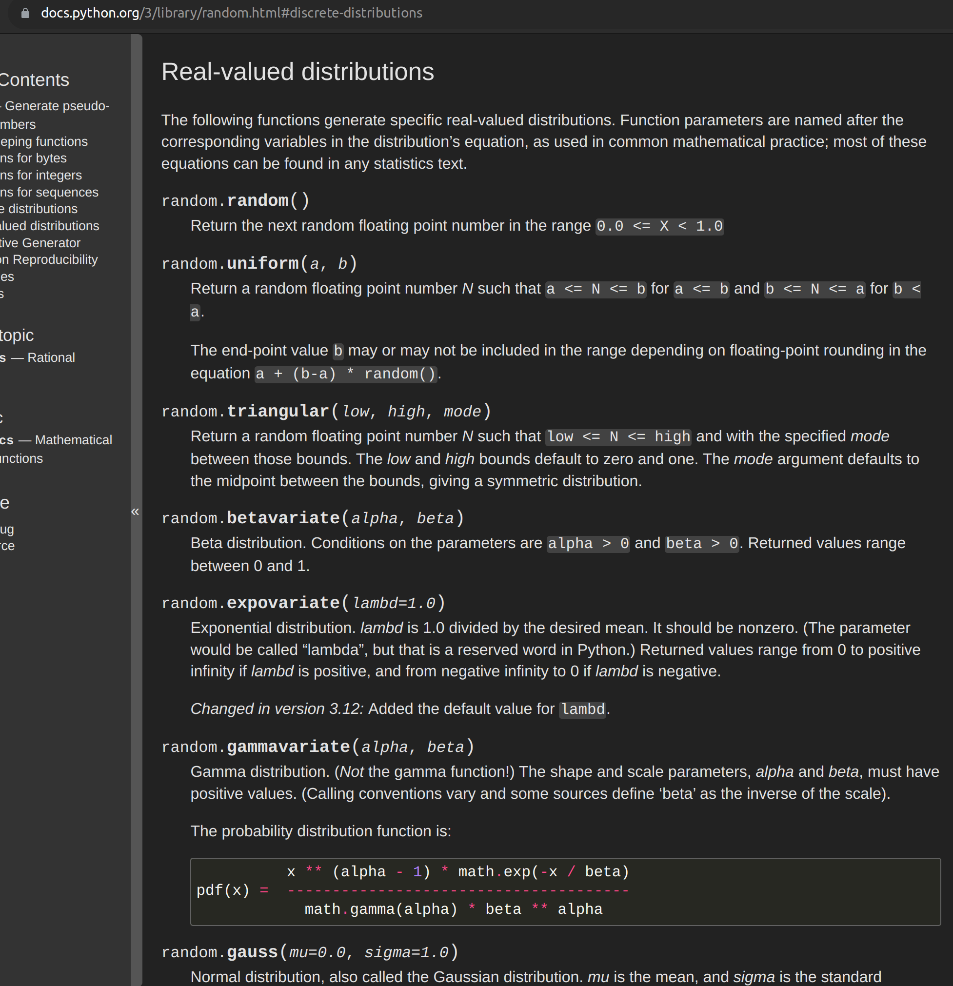
Random Numbers
More of distributions like uniform, normal, exponential
docs.python.org/3/library/random.html

Slide 11
Math and Statistics Library
import math
math.sqrt(x) – Return sqrt of x
math.pow(a,b) – Return a^{b} - can also use a**b
import statistics
statistics.mean(data) – Average, equivalent to sum(data)/len(data)
statistics.median(data)
statistics.mode(data)
statistics.stdev(data) – Standard deviation
statistics.variance(data)

Slide 12
File Input Output
Opening Files for Reading or Writing
f = open('filename.txt', ‘w’) – ‘r’ for read, ‘w’ for write
Using with keyword is a better practice. No need to call close()
Reading the file
f.readline() – reads one line (includes the special endline character ‘\n’ )
for line in f: using loop, better, cleaner
Writing to file
f.write(line) – writes string line to file, make sure to add endline character

Slide 13
Plotting
import matplotlib.pyplot as plt
Simple plots:
plt.plot(x, y, color='green', marker='o', linestyle='dashed’, linewidth=2, markersize=12)
Can also give a format string in format: '[marker][line][color]’ e.g. ‘bo’
plt.scatter(x,y) – for a scatter plot
If X,y are in a dictionary object
plt.plot('xlabel', 'ylabel', data=nums) x = nums[‘xlabel’] , y = nums[‘ylabel’]
Multiple plots on same figure:
Call plot multiple times
Call plot with y as a 2d-array
Don’t forget to call plt.show()

Slide 14
Numpy
Useful for n-dimensional arrays e.g. matrices, faster than normal lists
Linear algebra, random number, statistics stuff.
import numpy as np
Array creation
a = np.array([1,2,3,4])
a = np.array([[1, 2], [3, 4]]) a_matrix = np.asmatrix(a)
Indexing: [i,j]
Random numbers
np.random.randn(d0..dn) – n-dimensional array of random numbers from Normal Dist.
np.random.permutation(x) – return a random permutation of list x
Statistics
np.median(), np.mean(), np.percentile()

Slide 15
Resources
Python: The Ultimate Beginner's Guide!
Python Library Reference
https://docs.python.org/3/library/index.html
Plotting in Python: matplotlib
https://matplotlib.org/tutorials/introductory/pyplot.html
PyCharm: Python IDE
https://www.jetbrains.com/pycharm/
Transforming code into Beautiful, Idiomatic Python
https://www.youtube.com/watch?v=OSGv2VnC0go&t=1861s

