Slide 1
CSE 391: Special Topics: Probability & Statistics for Data Science Lecture 1: Intro and Logistics
Anshul Gandhi
347, New CS building
anshul@cs.stonybrook.edu
anshul.gandhi@stonybrook.edu

Slide 2
CSE 391 Probability & Statistics for Data Science
What is Data Science?
Analysis of data (using several tools/techniques)
Statistics/Data Analysis + CS

Slide 3
CSE 391 Probability & Statistics for Data Science
Who is a Data Scientist
Statistics/Data Analysis + CS
Someone who is better at stats than the average CS person
and
someone who is better at CS than an average statistician.

Slide 4
Anshul Gandhi
347, New CS building
anshul@cs.stonybrook.edu
anshul.gandhi@stonybrook.edu

Slide 5
Outline
Logistics
Course info
Lectures
Course webpage
Office hours
Grading
Syllabus

Slide 6
Course Info
New course (almost)
Deals with probs and stats for DS
Probability theory
Statistical inference
DS techniques
UG level course
Probability Theory
Random Variables
Statistical Inference
Hypothesis Testing
Regression Analysis

Slide 7
Course Info
Prerequisites:
Probability and Statistics
Recommended (not necessary)
Basic CS background
Python (not necessary, but will help)
This is NOT a systems course
More of a theory + algorithms course

Slide 8
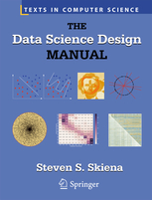
Course Info
Recommended texts:
Software:
Available from DoIT

Slide 9
Lectures
Mon Wed: 4:00pm – 5:20pm
Frey 217
On echo (should be available)
5-min break at the halfway point
Whiteboard + maybe slides
Occasionally some programming (Python/MATLAB)
Interactive (please)
Carry a book, a real one!

Slide 10
Example 1: Simple stats
X is a collection of 99 integers (positive and negative)
Mean(X) > 0
How many elements of X are > 0?
Same question but now Median(X) > 0?
Notes:
At least 1
At least 50

Slide 11
Course webpage
www.cs.stonybrook.edu/~cse391 (will redirect)
Please bookmark this page
This is your best resource!
Will be regularly updated

Slide 12
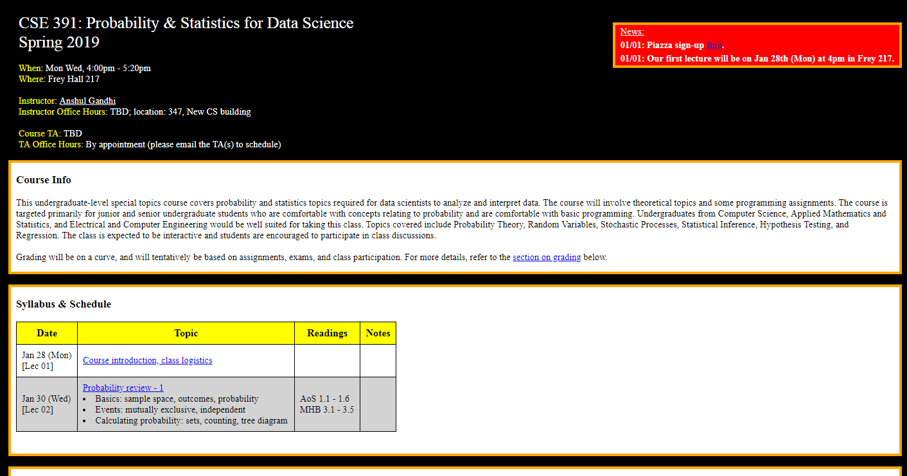
Course webpage
www.cs.stonybrook.edu/~cse391

Slide 13
Course webpage
Piazza (link on website)
Blackboard for assignments, solutions, and grades

Slide 14
Office hours
Just before or after class?
CS 347
Will re-visit after add/drop date
Will have OH today till 6:30pm
TA and TA Office hours: TBA

Slide 15
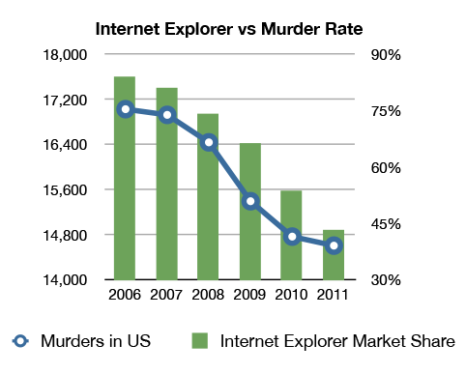
Example 2: Correlation v/s Causation
Q1: Are A and B correlated?
A
B

Slide 16
Example 2: Correlation v/s Causation
Q2: Which of the following is true (i) A causes B
(ii) B causes A
(iii) Either (i) or (ii)
(iv) None of the above
A
B

Slide 17
Example 2: Correlation v/s Causation
Q2: Which of the following is true (i) A causes B
(ii) B causes A
(iii) Either (i) or (ii)
(iv) None of the above
A
B

Slide 18
Example 2: Correlation v/s Causation

Slide 19
Grading (also on website)
50% assignments
5-6 assignments. Expect 5-7 questions/assignment.
Later assignments will have more programming.
Build on material taught in class, more challenging.
40% exams (2 exams)
Similar to assignment questions, but shorter and simpler
Mid-term 1: 15%, Mid-term 2: 25%
10% class participation Exact %ages are somewhat tentative

Slide 20
Grading - assignments
50% assignments
5-6 assignments
5-7 problems per assignment
Collaboration is allowed (groups of at most 3 students)
One write-up per group.
DO NOT COPY across groups
Assignments due at the beginning of class
NO LATE SUBMISSIONS
Hard-copies only (typed/hand-written)
Some programming required for later assignments

Slide 21
Grading - exams
40% exams
Mid-terms 1 and 2
15% mid-term 1
25% mid-term 2
Non-overlapping
Roughly mid-way and at the end of the semester
Written exams
Closed-book exams
No programming questions
Somewhat easier than assignments
No collaborations, obviously
75 mins

Slide 22
Grading – class participation
10% class participation
Starts after add/drop date
Contribute to class discussions
Interactive
Very helpful for bumping your grade if you are on the border

Slide 23
Grading
50% assignments
40% exams (two exams)
10% class participation

Slide 24
Example 3: Simpson’s Paradox
☺
☹
Earns below-average income in B
Earns above-average income in A
Developed Nation (B)
Developing Nation (A)
Average income of A+B goes up!!
Average income of A goes down ☹
Average income of B goes down ☹

Slide 25
Example 3: Simpson’s Paradox
Earns below-average income in B
Earns above-average income in A
Developed Nation (B)
Developing Nation (A)
Average income of A+B Before: 160K/3 = 53.3K
After: 200K/3 = 66.7K
Person 1: 20K
Person X: 40K
Person 2: 100K
Person X: 80K

Slide 26
Example 3: Simpson’s Paradox
Since 2000, the median US wage has risen about 1% (adjusted)
But over the same period, the median wage for:
high school dropouts,
high school graduates with no college education,
people with some college education, and
people with Bachelor’s or higher degrees
have all decreased. In other words, within every educational subgroup, the median wage is lower now than it was in 2000.
How can both things be true??

Slide 27
Syllabus
www.cs.stonybrook.edu/~cse391

Slide 28
Next class
Probability review - 1
Basics: sample space, outcomes, probability
Events: mutually exclusive, independent
Calculating probability: sets, counting, tree diagram

