Slide 1
CSE 531: Performance Analysis of Systems Lecture 1: Intro and Logistics
Anshul Gandhi
1307, CS building
anshul@cs.stonybrook.edu
anshul.gandhi@stonybrook.edu

Slide 2
Outline
Logistics
Course info
Lectures
Course webpage
Office hours
Grading
Resources
Syllabus

Slide 3
Course Info
New course, almost
Analysis of computer systems
Design options
Optimizations
Performance (response time, throughput); cost; energy
Data centers, cloud systems, databases, Hadoop
Analytical tools
Markov chains
Operational Laws
Queueing theory
Predictive models, control theory, simulations, etc.

Slide 4
Course Info
Prerequisites:
Basic CS background
Distributed systems, Databases, Networking
Probability and Statistics
This is NOT a systems course
This is NOT a theory course

Slide 5
Example 1
1-server queue
Deterministic service times
Deterministic inter-arrival times

Slide 6
Example 1 (continued)
1-server queue
Deterministic service times
Exponential inter-arrival times

Slide 7
Example 1 (continued)
1-server queue
Exponential service times
Exponential inter-arrival times
M/M/1 queue

Slide 8
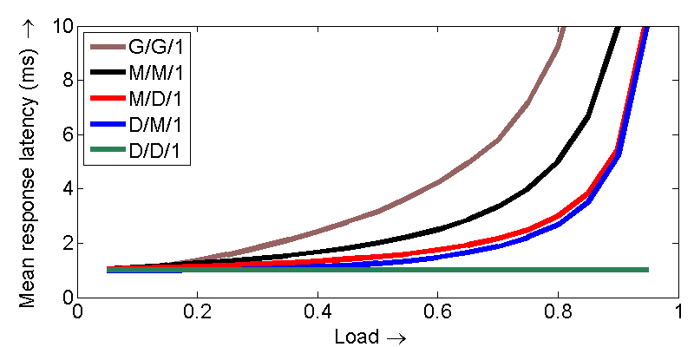
Example 1 (continued)

Slide 9
Lectures
Tu, Th: 11:30am – 12:50pm
5-min break at the halfway point
Slides + whiteboard
Interactive (please)
Carry a book, a real one!

Slide 10
Course webpage
www.cs.stonybrook.edu/~cse531
Regularly updated
Please check periodically!
Slides will be posted
Contains all course info and logistics

Slide 11
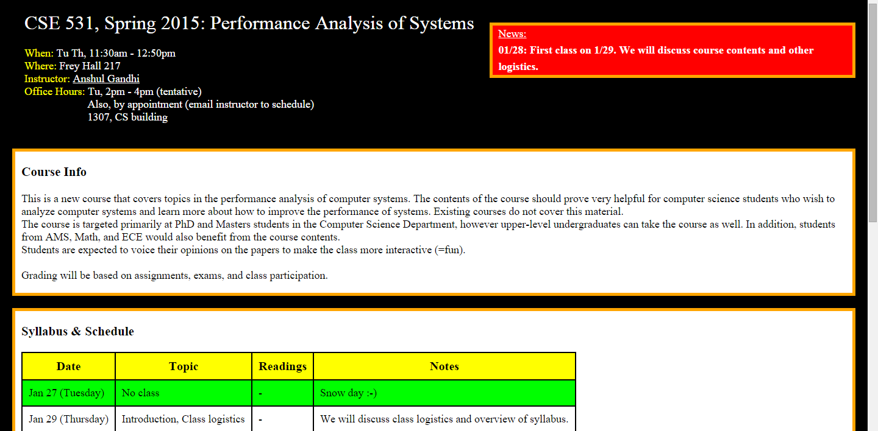
Course webpage
www.cs.stonybrook.edu/~cse531

Slide 12
Office hours
Tuesday 2pm-4pm
Any time with prior appointment (email me)
CS 1307
Tentative
Will re-visit after add/drop date

Slide 13
Example 2
Queueing policies

Slide 14
Example 2 (continued)
Service policies

Slide 15
Grading
40% assignments
20% mid-term 1
20% mid-term 2
10% class participation
10% help in grading
Tentative!

Slide 16
Grading - assignments
40% assignments
Roughly 1 every 2 weeks
5-8 problems per assignment
Collaboration is allowed (groups of 3 max)
One write-up per group.
DO NOT COPY!
Assignments due in class
NO LATE SUBMISSIONS
Hard-copies only (typed/hand-written)
Some programming/MATLAB required

Slide 17
Grading - exams
40% exams
Mid-terms 1 and 2
Non-overlapping
One before Spring break, one at the end
In-class exams
Roughly as hard as assignments
No collaborations, obviously

Slide 18
Grading – class participation
10% class participation
Contribute to class discussions
Interactive
Very helpful for bumping your grade if you are on the border

Slide 19
Grading – help with grading
10% class participation
Help grade one assignment as part of a group of graders
2-3 hour commitment for one evening
Tentative

Slide 20
Resources
Lectures
Slides posted online
Recommended text:
1 copy in library
3 personal copies
Other texts:
Ross, Introduction to Probability Models
Kleinrock: Queueing Systems, Vol. I and II
Wolff: Stochastic Modeling and the Theory of Queues
Jain: The Art of Computer System Performance Analysis
Ross, Stochastic Processes

Slide 21
Example 3
RightScaling for M/M/k

Slide 22
Example 3 (continued)
AutoScaling for M(t)/M/k

Slide 23
Example 4
Performance modeling for Databases

Slide 24
Syllabus
Probability and Statistics
Review, Random variables, Distributions
Markov chains
Discrete-time, Continuous-time
Supply chain, Operations Research, Web Search
Queueing theory
Basics, Operational laws
M/M/1, M/M/k, M/G/1, Network of queues
Scheduling policies
Power management, Load balancing, Databases, MapReduce
Useful tools
Predictive models, Control theory, Simulations
Autoscaling, Cloud computing
Research problems
1-2 weeks
1-2 weeks
7 weeks
2 weeks
1-2 weeks

Slide 25
Next class

