Slide 1
CSE 544, Spring 2018 Probability and Statistics for Data Science Lecture 1: Intro and Logistics
Anshul Gandhi
347, New CS building
anshul@cs.stonybrook.edu
anshul.gandhi@stonybrook.edu

Slide 2
CSE 544, Spring 2018 Probability and Statistics for Data Science
What is Data Science?
Analysis of data (using several tools/techniques)
Statistics/Data Analysis + CS

Slide 3
CSE 544, Spring 2018 Probability and Statistics for Data Science
Who is a Data Scientist
Statistics/Data Analysis + CS
Someone who is better at stats than the average CS person
and
someone who is better at CS than an average statistician.

Slide 4
Anshul Gandhi
347, New CS building
anshul@cs.stonybrook.edu
anshul.gandhi@stonybrook.edu

Slide 5
Outline
Logistics
Course info
Lectures
Course webpage
Office hours
Grading
Syllabus

Slide 6
Course Info
New course (almost)
Deals with probs and stats for DS
Probability theory
Statistical inference
DS techniques
MS and PhD level course
Probability Theory
Random Variables
Stochastic Processes
Statistical Inference
Hypothesis Testing
Regression and Time Series Analysis

Slide 7
Course Info
Prerequisites:
Probability and Statistics
Would help (not necessary)
Basic CS background
We will use Python
This is NOT a systems course
More of a theory + algorithms course

Slide 8
Course Info
REQUIRED All of Statistics (AoS)
RECOMMENDED Perf Modeling (MHB) DS Design Manual (DSD)
Software:
Available from DoIT

Slide 9
Course webpage
www.cs.stonybrook.edu/~cse544 (will redirect)
Please bookmark this page
This is your best resource!
Will be regularly updated

Slide 10
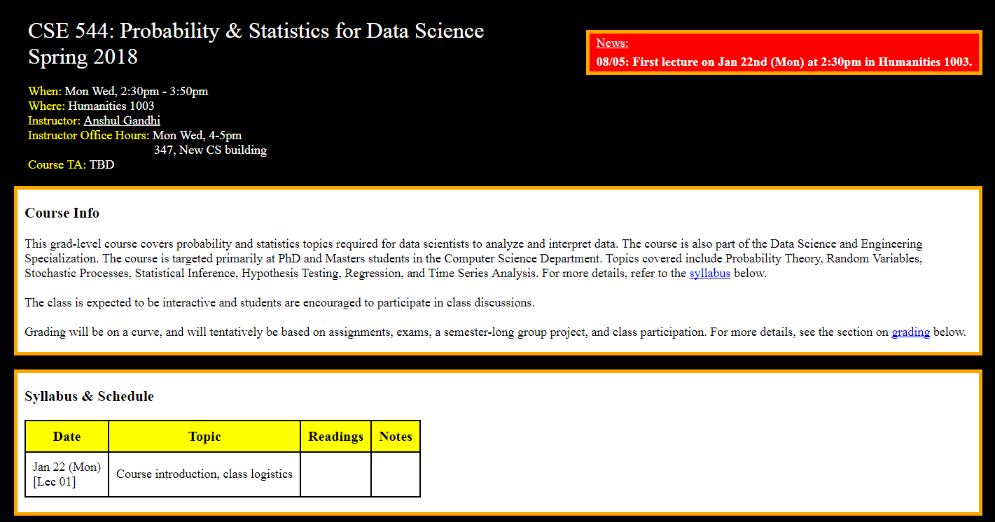
Course webpage
www.cs.stonybrook.edu/~cse544

Slide 11
Course webpage
Piazza??
Blackboard for grades

Slide 12
Example 1: Simple stats
X is a collection of 99 integers (positive and negative)
Mean(X) > 0
How many elements of X are > 0?
Same question but now Median(X) > 0?
Notes:
At least 1 (could be 99)
At least 50 (could be 99)

Slide 13
Lectures
Mon Wed: 2:30pm – 3:50pm
Humanities 1003
5-min break at the halfway point
Slides + annotations
Occasionally some programming (Python)
Posted on website after class
May have cancellations due to weather or unavailability
Will be emailed and updated on website

Slide 14
In-class
Interactive (please)
Carry a book, a real one!
Please mute your phones

Slide 15
Office hours
Mon Wed 4-5pm?? (right after class)
NCS 347
Tentative
Will re-visit after add/drop date
TA and TA Office hours: TBA

Slide 16
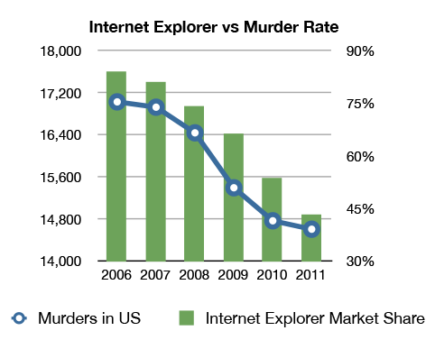
Example 2: Correlation v/s Causation
Q1: Are A and B correlated?
A
B

Slide 17
Example 2: Correlation v/s Causation
Q2: Which of the following is true (i) A causes B
(ii) B causes A
(iii) Either (i) or (ii)
(iv) None of the above
A
B

Slide 18
Example 2: Correlation v/s Causation
Q2: Which of the following is true (i) A causes B
(ii) B causes A
(iii) Either (i) or (ii)
(iv) None of the above
A
B

Slide 19
Example 2: Correlation v/s Causation

Slide 20
Grading
30% assignments
30% exams (in-class mid-terms)
30% Group project
10% class participation
Some parts are tentative!

Slide 21
Grading - assignments
30% assignments
5 assignments
5-8 problems per assignment
Later assignments will have more programming
Collaboration is allowed (groups of 3-5 students)
One write-up per group.
DO NOT COPY!
Assignments due at the beginning of class
NO LATE SUBMISSIONS
Hard-copies only (typed/hand-written)

Slide 22
Grading - exams
30% exams
Mid-terms 1 and 2
12% mid-term 1 (probs & stats), Feb end/early March
18% mid-term 2 (inference), mid-April
Non-overlapping
In-class exams
Somewhat easier than assignments
No collaborations, obviously
Closed-book, closed-notes
75 mins

Slide 23
Grading – group project
30% Group project
Data analysis project
Programming involved
Groups of 4-8 (need not be same as assignment groups)
In the 2nd half of the semester
Will discuss details as we go along

Slide 24
Grading – class participation
10% class participation
Starts after add/drop date
Contribute to class discussions
Interactive
Very helpful for bumping your grade

Slide 25
Grading - recap
30% assignments
30% exams (in-class mid-terms)
30% group project
10% class participation
Will provide mid-sem grades (after A1, A2, M1)
For self-evaluation purposes only

Slide 26
Example 3: Simpson’s Paradox
☺
☹
Earns below-average income in B
Earns above-average income in A
Developed Nation (B)
Developing Nation (A)
Average income of (A+B) goes up!!
Average income of A goes down ☹
Average income of B goes down ☹

Slide 27
Example 3: Simpson’s Paradox
Earns below-average income in B
Earns above-average income in A
Developed Nation (B)
Developing Nation (A)
Average income of (A+B) Before: 160K/3 = 53.3K
After: 200K/3 = 66.7K
Person 1: 20K
Person X: 40K
Person 2: 100K
Person X: 80K

Slide 28
Example 3: Simpson’s Paradox
Since 2000, the median US wage has risen about 1% (adjusted)
But over the same period, the median wage for:
high school dropouts,
high school graduates with no college education,
people with some college education, and
people with Bachelor’s or higher degrees
have all decreased. In other words, within every educational subgroup, the median wage is lower now than it was in 2000.
How can both things be true??

Slide 29
Syllabus

Slide 30
Next class
Probability review - 1
Basics: sample space, outcomes, probability
Events: mutually exclusive, independent
Calculating probability: sets, counting, tree diagram

