Slide 1
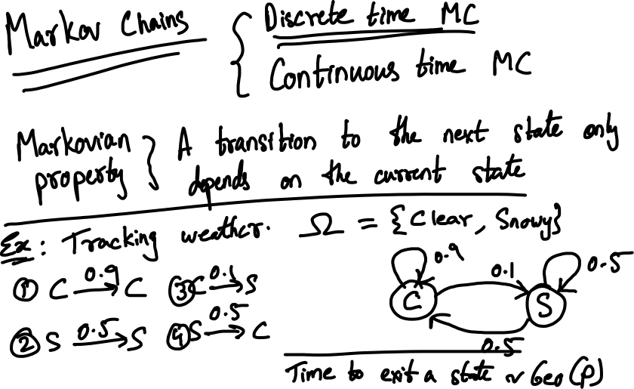

Slide 2
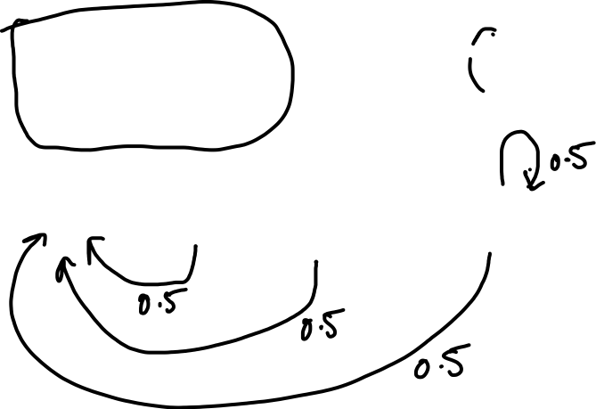

Slide 3
Stochastic Process (SP): A SP in discrete time t ε N = {0, 1, 2, …} is a sequence of time-indexed RVs X₀, X₁, X₂, …, with X = {X_{t}, t ≥ 0}.
Discrete-Time Markov Chain (DTMC): A SP, X = {X_{t}, t ≥ 0}, is a DTMC if, for all t, Pr(X_{t+1} = j | X_{t} = i, X_{t-1} = a, X_{t-2} = b, …) = Pr(X_{t+1} = j | X_{t} = i).
Pr(X_{t+1} = j | X_{t} = i, X_{t-1} = a, X_{t-2} = b, …) = Pr(X_{t+1} = j | X_{t} = i) = P_{ij}

