Slide 1
CSE 591: Energy-Efficient Computing Lecture 11 SLEEP: storage
Anshul Gandhi
347, CS building
anshul@cs.stonybrook.edu

Slide 2
Storage hierarchy
Device/tech | Latency | $/GB
SRAM | 1ns | 500-1000
DRAM | 50ns | 5-10
Flash | 50-100ns | 1
Disk | 5ms | 0.05
Tape | 5-10ms (or s) | 0.01

Slide 3
maid paper

Slide 4
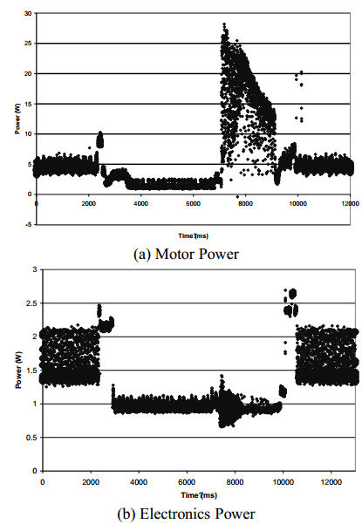
Power consumption

Slide 5
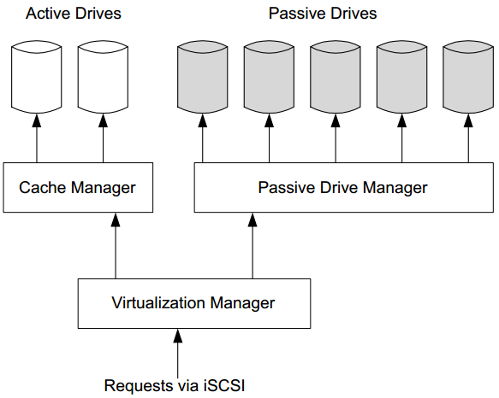
Cache drives

Slide 6
pdc paper

Slide 7
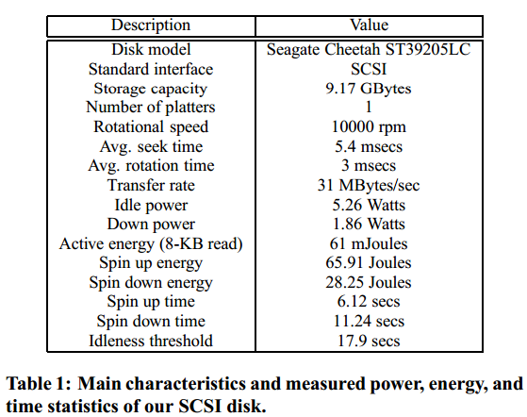
Power and latency

Slide 8
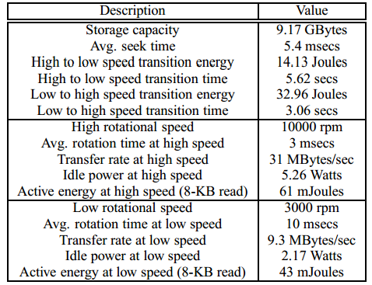
Two-speed disks

