Slide 1
CSE 591: Energy-Efficient Computing Lecture 15 SCALING: storage
Anshul Gandhi
347, CS building
anshul@cs.stonybrook.edu

Slide 2
rabbit paper

Slide 3
Objectives
Power-proportional storage system
PP in the presence of failures
Avoid interference between competing apps
Avoid writing unnecessary data blocks
Maintain only required replicas
Considers an HDFS-like FS where all data is important and equally accessed (mostly). This is unlike web data which has skewed popularity.

Slide 4
Simple policy
primary
(r-1) replicas
p nodes
B/p load
(N-p) nodes B/N load (N >> p)
Notes:
What is the problem with this policy?
Not “ideally” power-proportional since not all nodes can serve same load. Eg: p primary on and some of the (N-p) on. Clearly p can serve B/p load but others can only serve B/N.

Slide 5
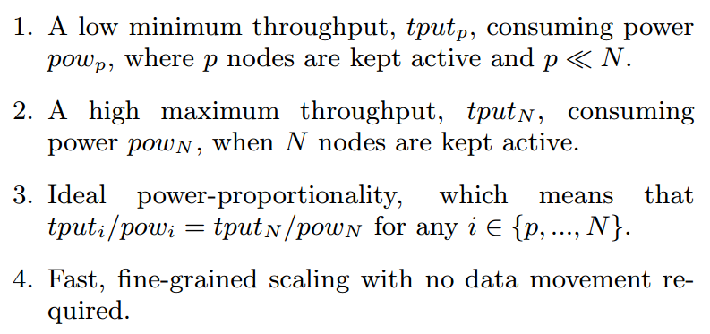
Requirements of layout policy
The equal-work policy ensures equal load sharing. Formally, the equal-work policy is the result of an optimization problem that minimizes p with the constraints, tputi = (i/p)tputp for all i = p + 1, ..., N for a given replication factor r.

Slide 6
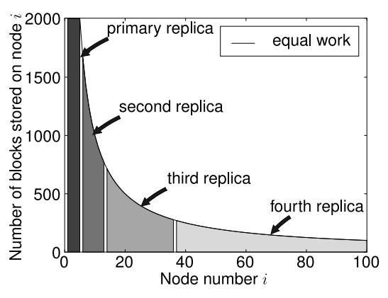
Equal work policy
Notes:
B/i blocks for ith node, i > p. B/p for first p.

Slide 7
Equal work policy – LB challenge
i^{th} node has B/i blocks, but how many requests to these blocks should it serve?
i^{th} node hosts more blocks than (i+j)^{th} node.

Slide 8
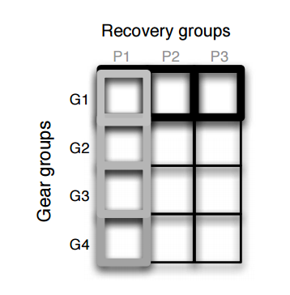
Fault tolerance

Slide 9
sierra paper

Slide 10
sierra = rabbit + writes

Slide 11
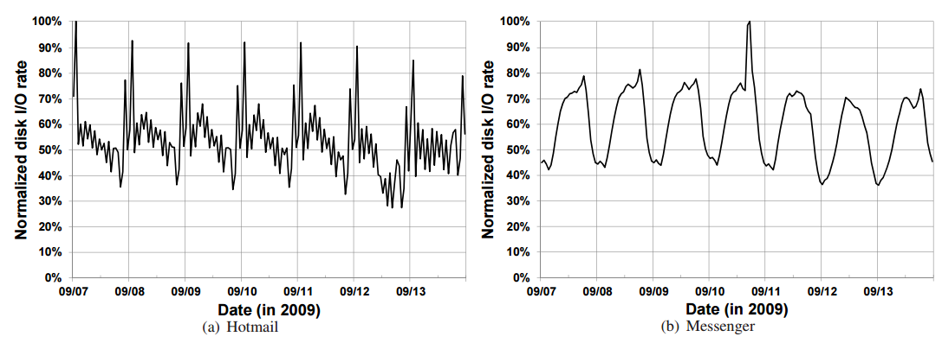
Motivation

Slide 12
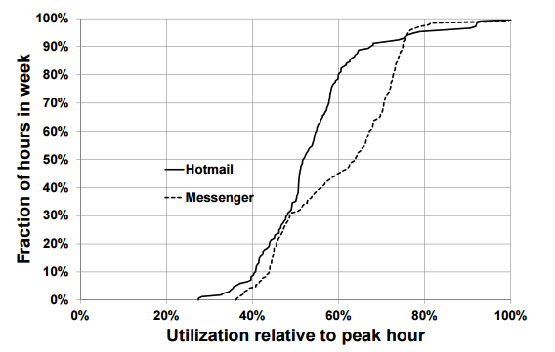
Motivation

Slide 13
Challenges
Data layout for power savings
Maintain read and write availability during failures
Predict needed capacity to sustain load

Slide 14
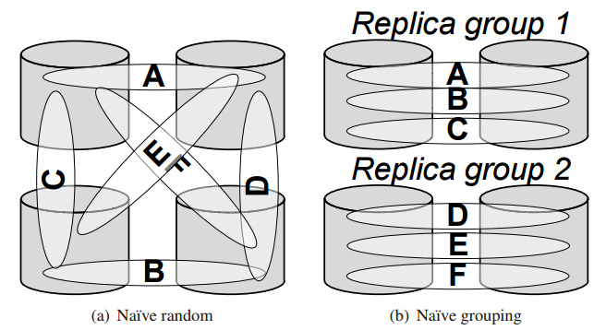
Simple policies

Slide 15
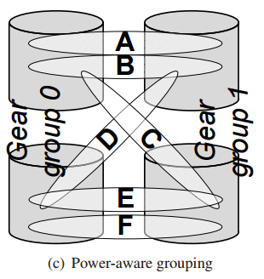
Sierra

