Slide 1
CSE 591: Energy-Efficient Computing Lecture 2: Energy-Efficiency Basics
Anshul Gandhi
347, CS building
anshul@cs.stonybrook.edu

Slide 4
EPA paper

Slide 5
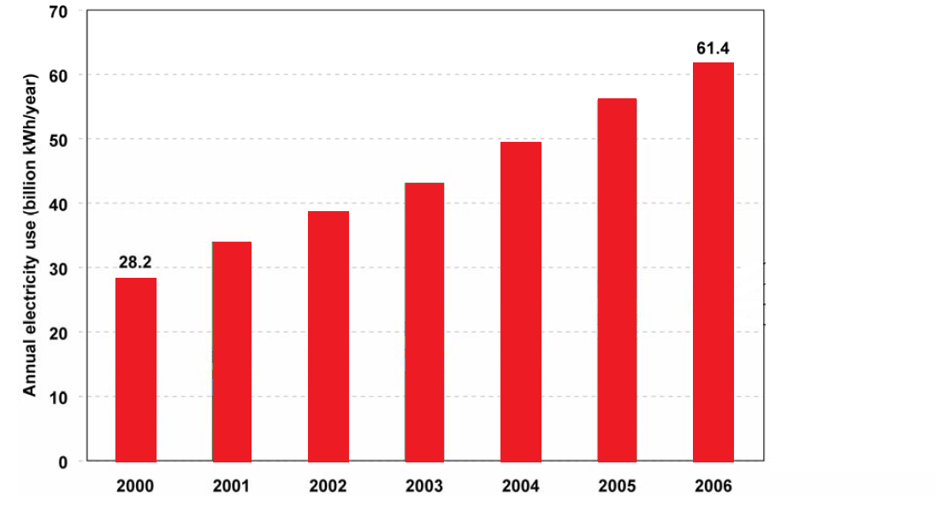
Why the increase?

Slide 6
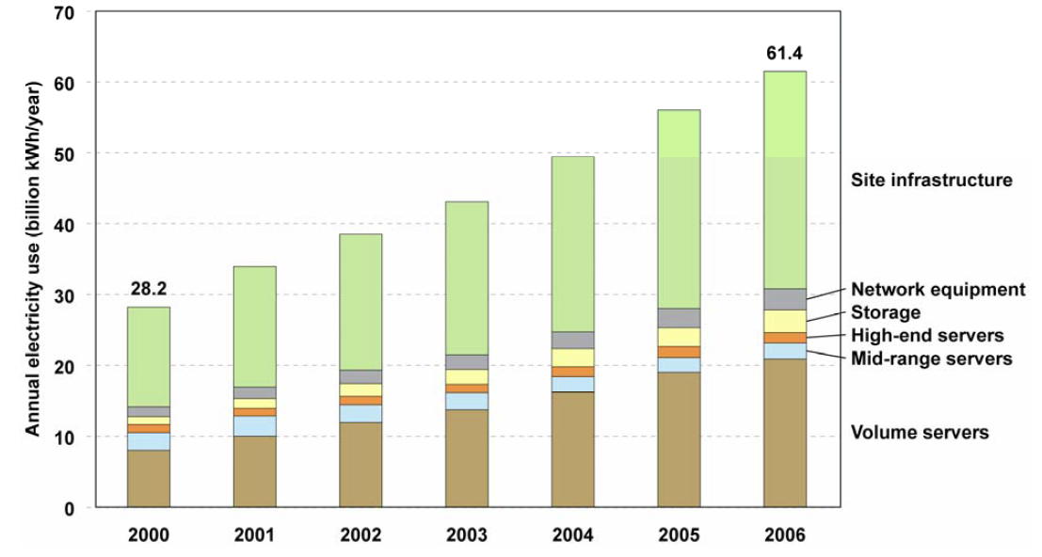
Power + Cooling

Slide 7
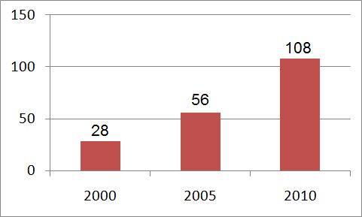
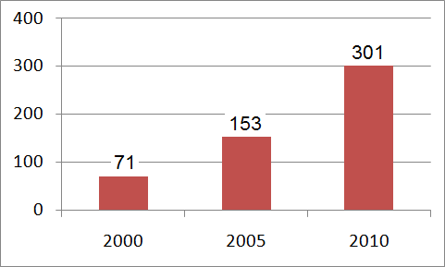
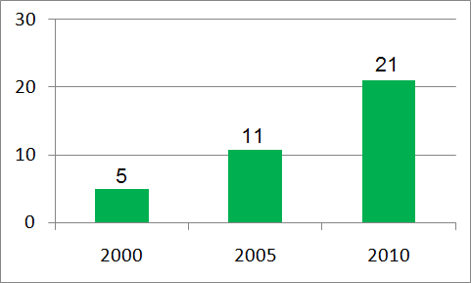
Billion kWh/year - US
*
*
*
Billion kWh/year - World
Billion $/year - World

Slide 8
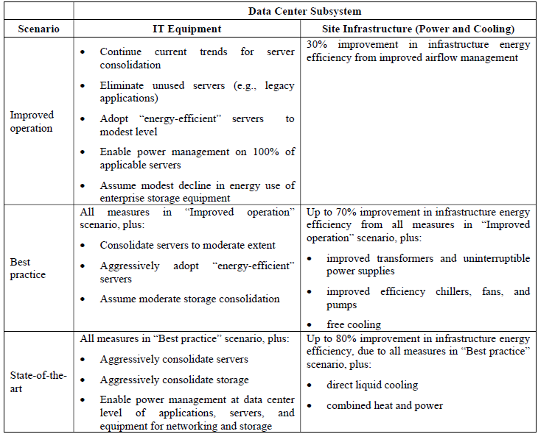

Slide 9
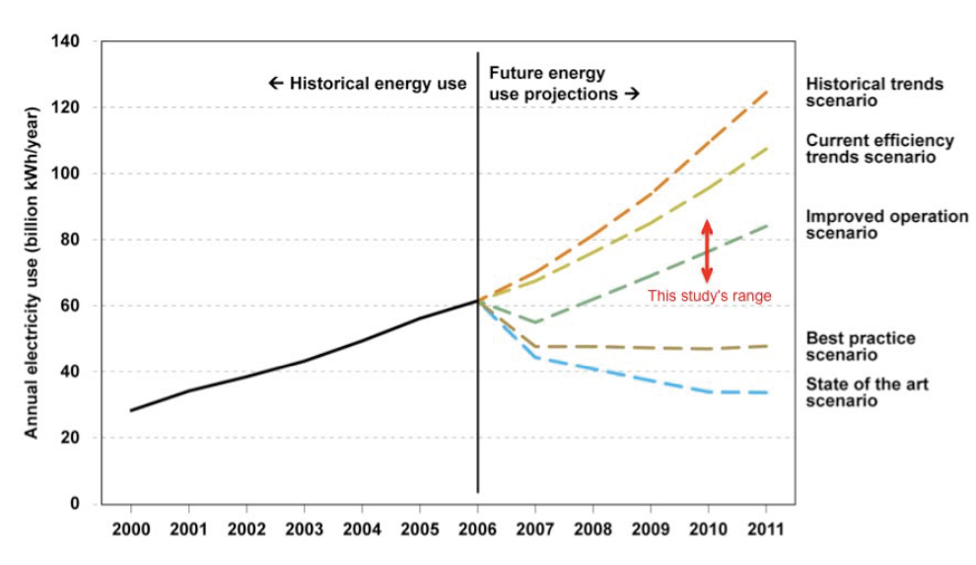
110
100
78
48
35
56
28

Slide 10
110
100
78
48
35
↑100%
28

Slide 11
↑100%
↑79%
↑39%
56
↑36%

Slide 12
energy_proportional paper

Slide 13
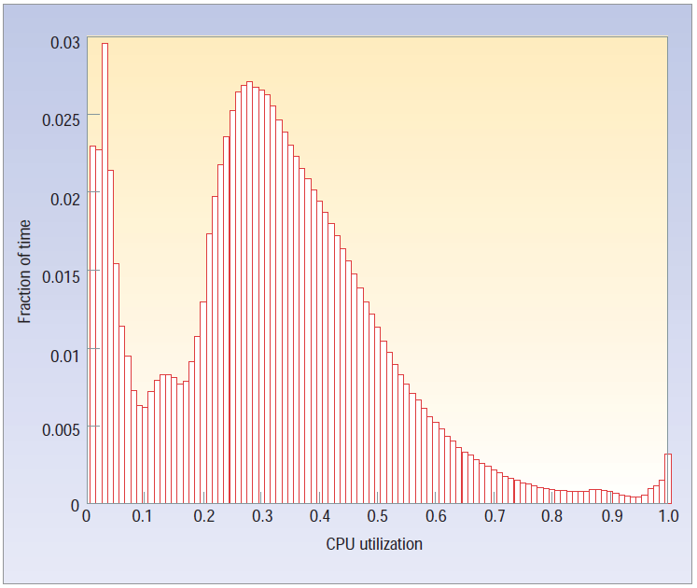
30%
Why?

Slide 14
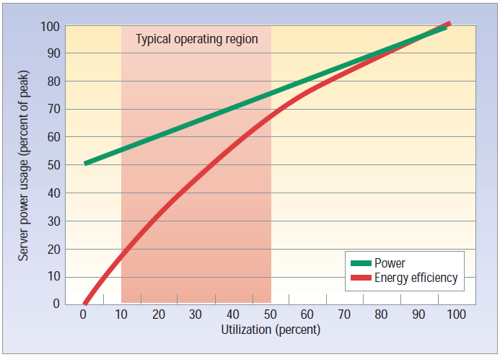

Slide 16
