Slide 1
CSE 591: Energy-Efficient Computing Lecture 20 SPEED: disks
Anshul Gandhi
347, CS building
anshul@cs.stonybrook.edu

Slide 2
disk_energy paper

Slide 3
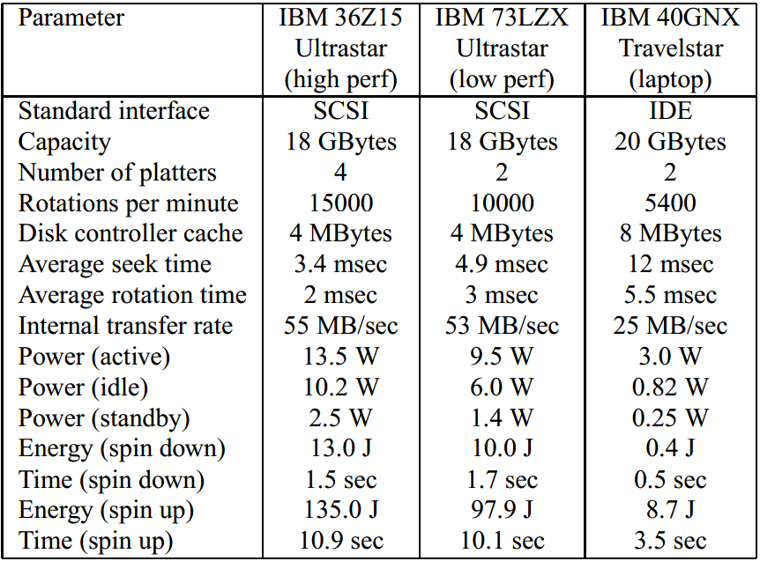
Disk power-performance

Slide 4
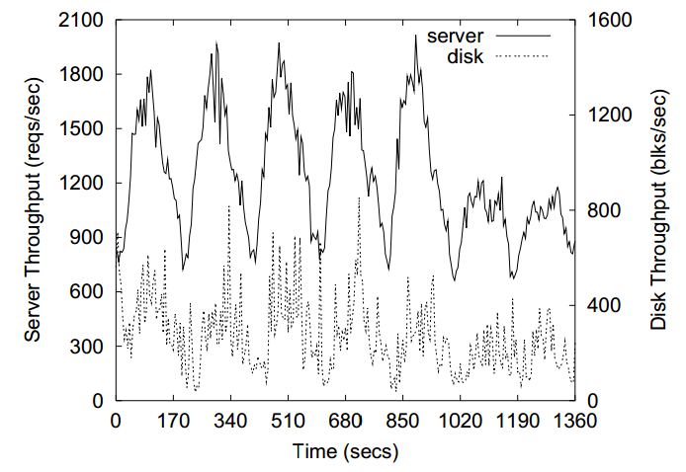
Load variation

Slide 5
Idle
Does not work well for networked disks
Why?

Slide 6
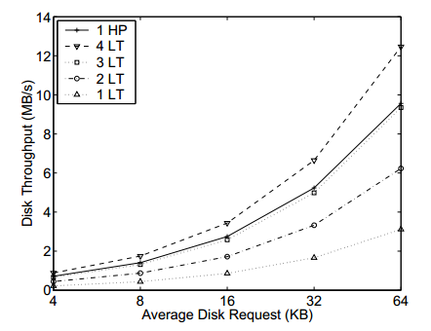
Replace
Notes:
Need 3 laptop disks to replace performance of 1 high perf disk.

Slide 7
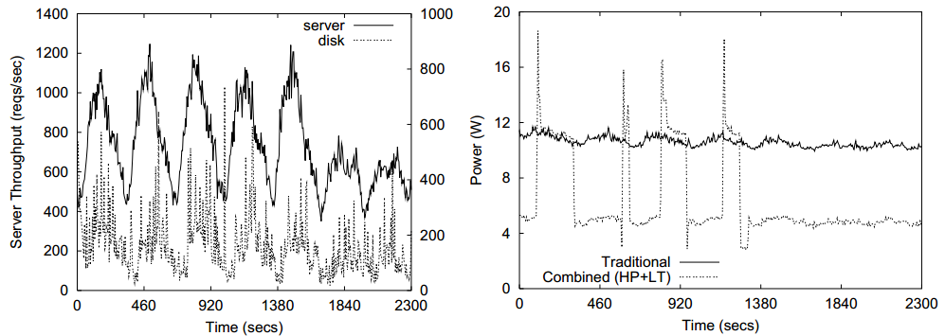
Combined – low load (50%)
41% savings
Combined uses high-performance + laptop disks

Slide 8
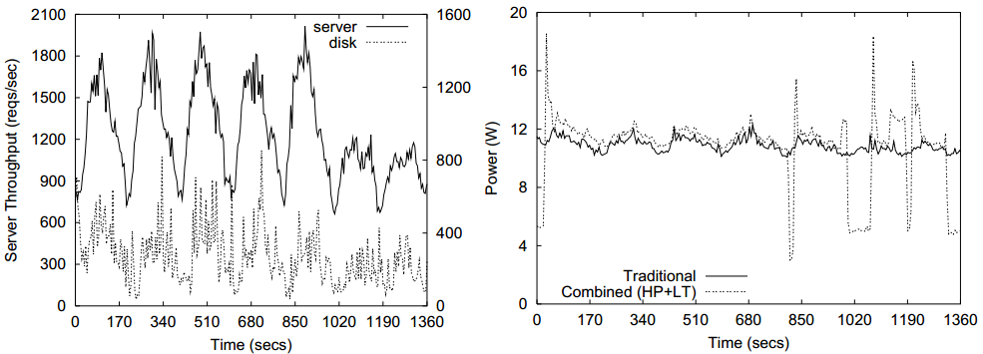
Combined – high load (80%)
1% savings
Energy spent in maintaining coherence is small
Disk demand is typically high

Slide 9
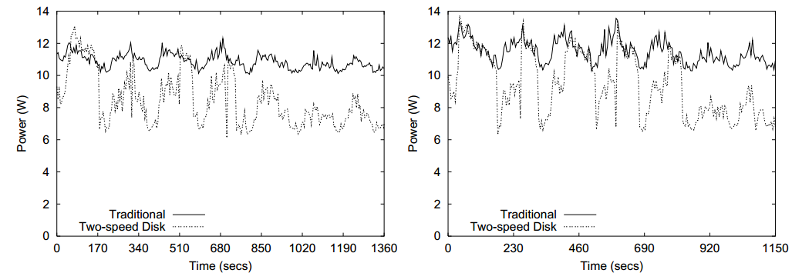
Multi-speed (80% and 90% load)
22% savings
16% savings
Multi-speed uses high-performance + desktop disks

Slide 10
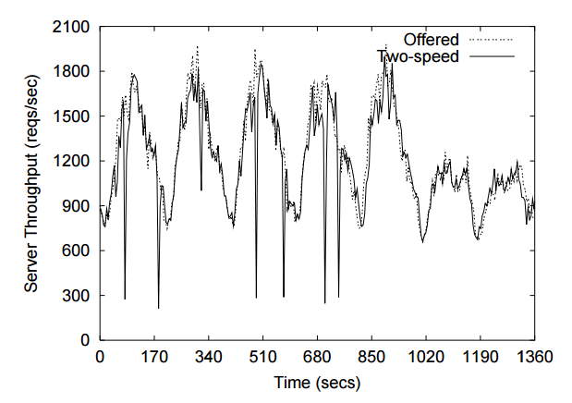
Multi-speed (performance)
3% degradation
Notes:
During disk speed transition.

Slide 11
drmp paper

Slide 12
Power Management approaches
AlwaysOn
TPM (Sleep)
DRPM (Speed)
At high load, all are same (= AlwaysOn)
At low load, TPM is good since high IAT
In between, DRPM is good

Slide 13
Disk power consumption
Many components
Spindle motor (rotations)
Actuator (seeks)
Disk cache
Electrical components
Mechanical components (motor, actuator) are main
Spindle can consume 50-80% power (2/10 disks)

Slide 14
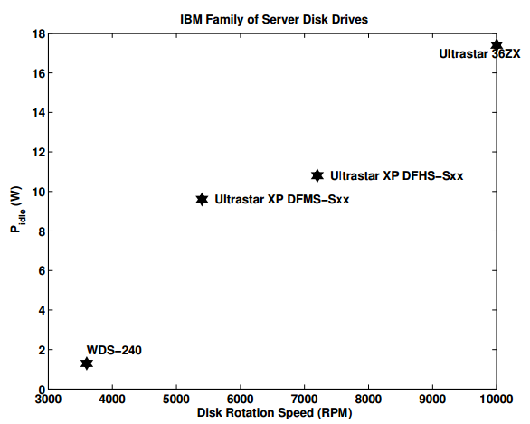
Idle power
Idle = still spinning

Slide 15
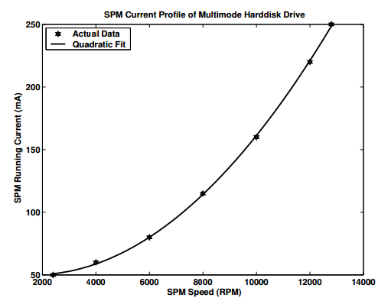
Quadratic power

Slide 16
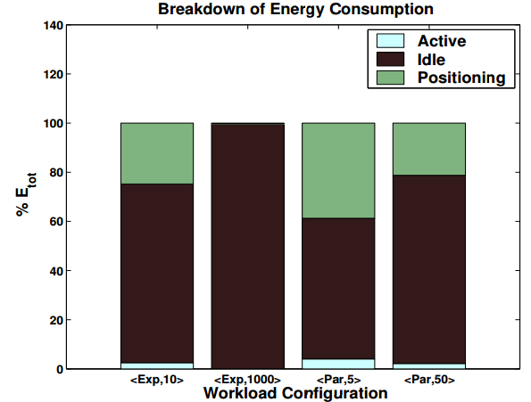
Disk energy usage
Notes:
<Distribution of IAT, E[IAT]>

Slide 17
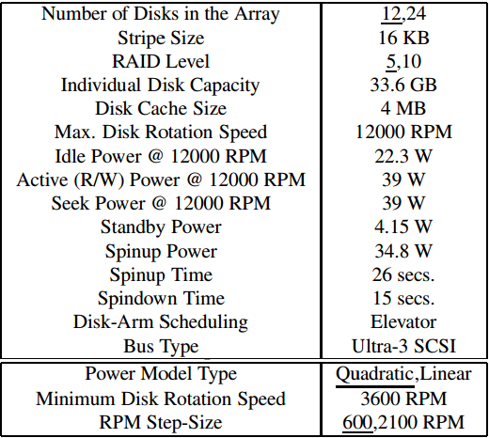
Simulation disk parameters

Slide 18
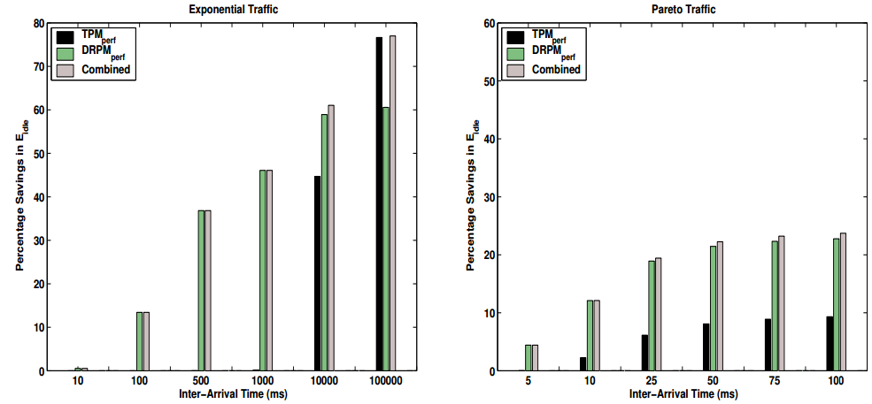
Results
No performance degradation allowed
Notes:
Perfect predictions assumed.
No savings with TPM unless high IAT
Fonts!

