Slide 1
CSE 591: Energy-Efficient Computing Lecture 21 review
Anshul Gandhi
347, CS building
anshul@cs.stonybrook.edu

Slide 2
Lenovo: Laptop-level PM

Slide 3
VMware

Slide 4
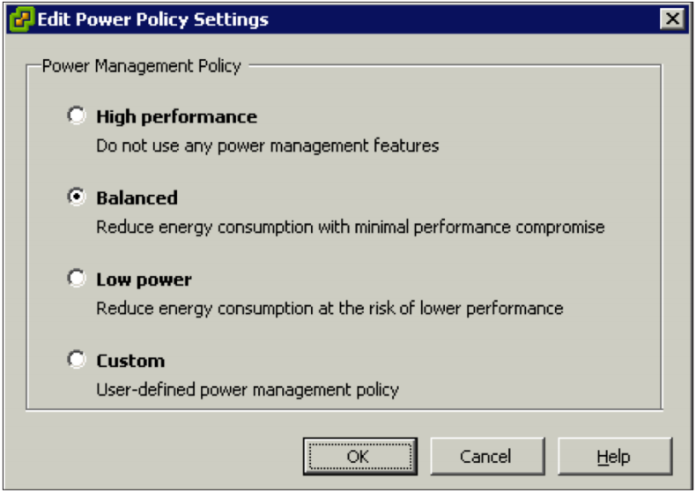
Host Power Management
C-states to lower idle power
P-states to lower active power (+TurboBoost)

Slide 5
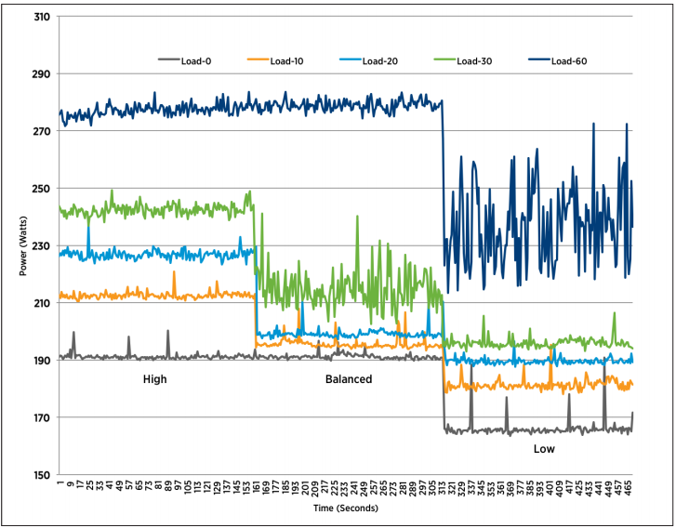
Host Power Management

Slide 6
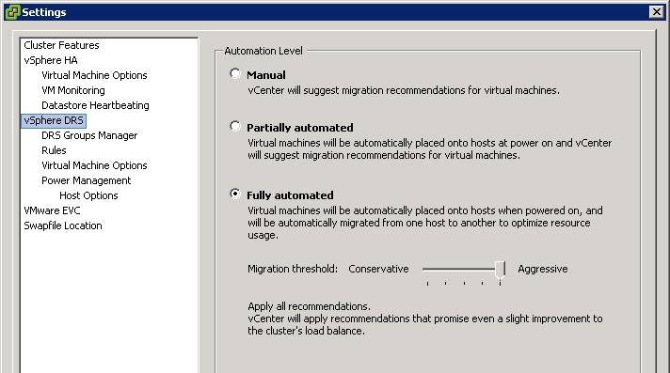
Distributed Resource Scheduler
Migrate VMs for priority and to maintain minimum resource requirements
Notes:
Giving options vs default.

Slide 7
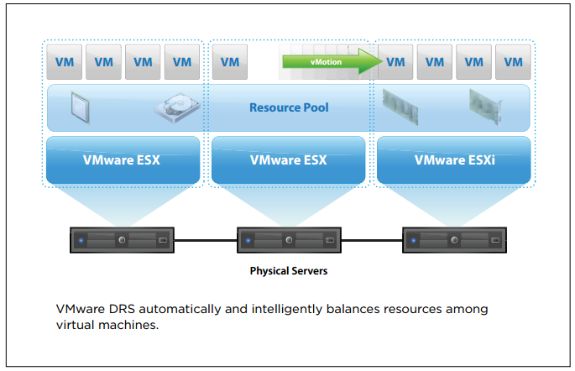
Distributed Resource Scheduler
Notes:
Make more room on congested server or move to less congested server – for priority VMs.

Slide 8
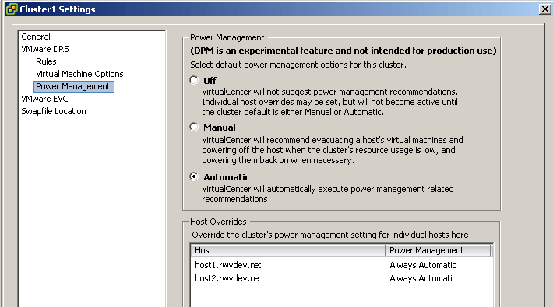
Distributed Power Management
Migrate VMs for host power savings
Requires WOL !
Different from HPM (local vs. distributed)

Slide 9
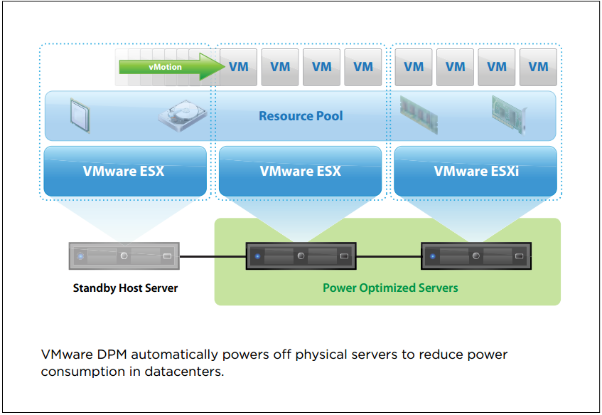
Distributed Power Management
Notes:
Autoscaling.

Slide 10
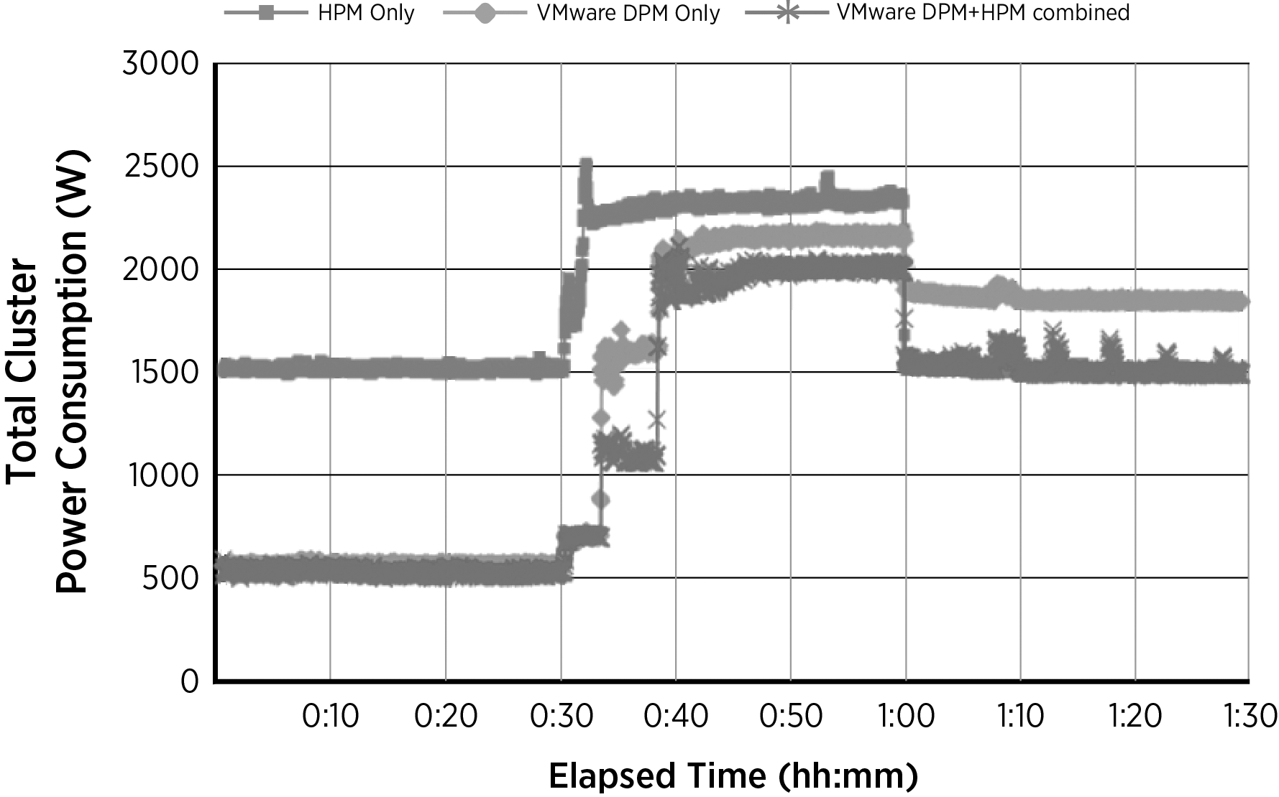
HPM vs. DPM
400VMs @ 8 hosts. 30min idle, 30min load, 30min idle

Slide 11
AutoScaling

Slide 12
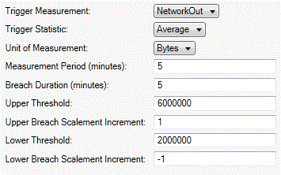
AWS

Slide 13
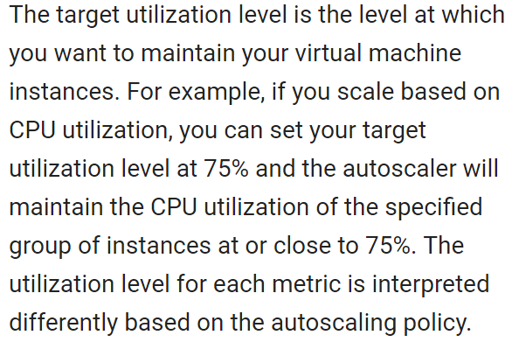
Google Cloud Platform
Notes:
Maintain given utilization level by automatically determining how many VMs to add/remove.

Slide 14
Google: Data center-level PM

Slide 15
Best practices
Thermostat
Airflow
Outside air
Don’t turn off servers – use them somehow.

Slide 16
Natural cooling
Location | Cooling | Companies
Hamina, Finland | Seawater | Google
Dublin, Ireland | Outside air | Amazon, MS, Google
Lulea, Sweden | Outside air + server exhaust + hydro-electricity | FB
Rjukan, Norway | Outside air +hydro-electricity | Telemark
Reykjavik, Iceland | Outside air | Verne Global

Slide 17
power_provisioning paper
(Google)

Slide 18
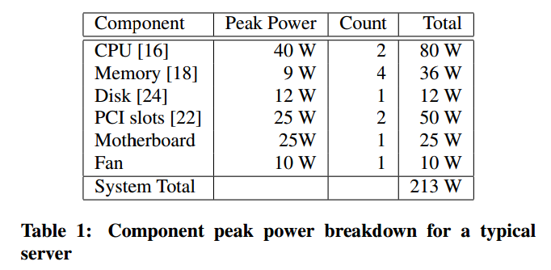
Power breakdown

Slide 19
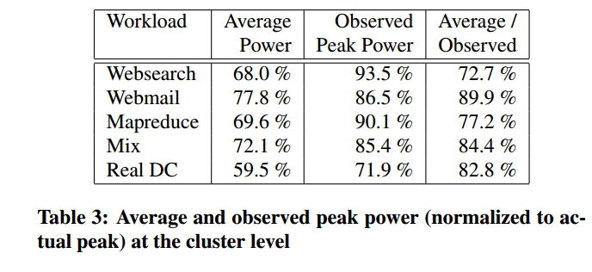
Average vs. Peak vs. Max

Slide 20
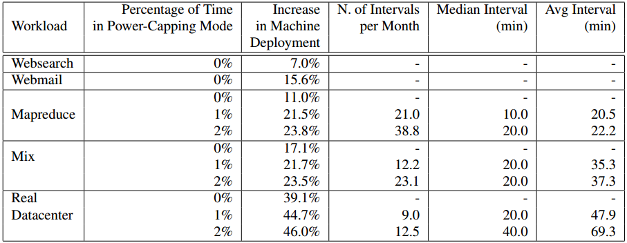
Power capping – extra deployment

Slide 21
DVFS
Simulation results
Latency?
Notes:
Rarely fully idle, so can’t use sleep, etc. Have to reduce idle power.
DVFS not that useful for single machine, but useful to increase density if there are many variably loaded machines.

