Slide 1
CSE 591: Energy-Efficient Computing Lecture 7 SMARTS: custom-made systems
Anshul Gandhi
347, CS building
anshul@cs.stonybrook.edu

Slide 2
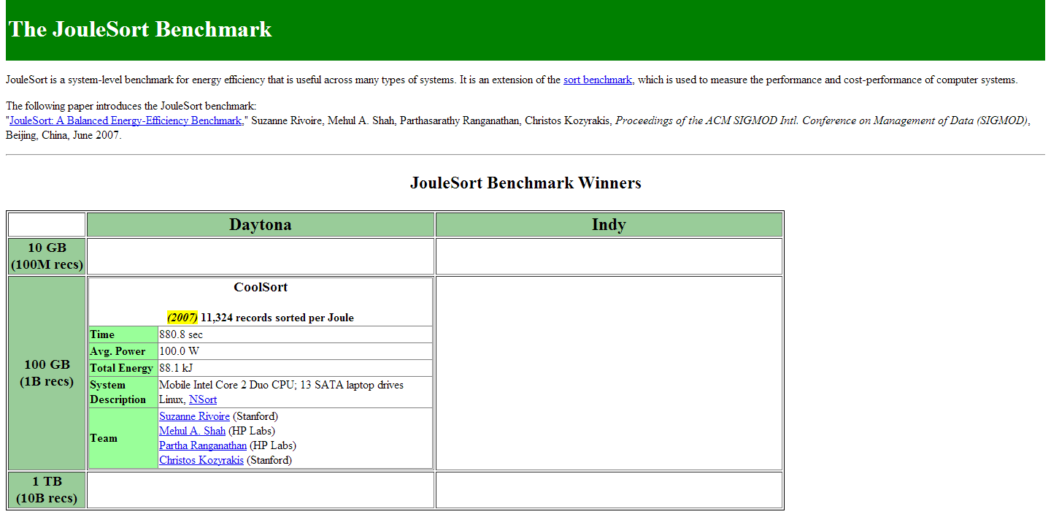
Benchmark competitions

Slide 3
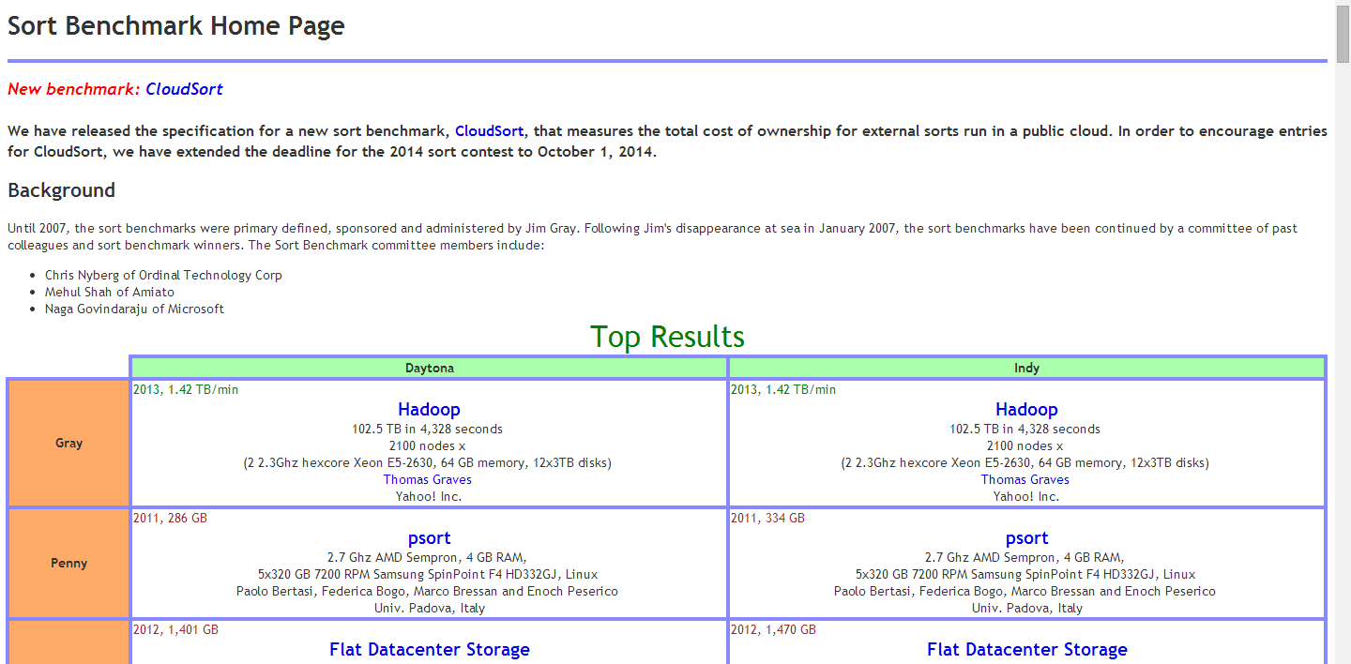
Benchmark competitions

Slide 4
fawn paper

Slide 5
Data-intensive workloads
Seek-bound
small
random
examples?
problems?
Scan-bound
large
sequential
examples?
problems?
Notes:
Examples: random data accesses as in a user and large file reads.
Problems: limited b/w due to disk seeks and low bandwidth due to lots of data and fast CPUs.

Slide 6
FAWN
CPUs are much faster than data delivery
Makes sense to “balance” CPU and data delivery
Use weaker CPUs
Use faster data delivery (Flash vs. HDD)

Slide 7
Why FAWN?
Memory wall (??)
Increased CPU power consumption
DVFS is limited
Modern CPUs operate close to V_{min}
Constant leakage current
Peak power and data center density

Slide 8
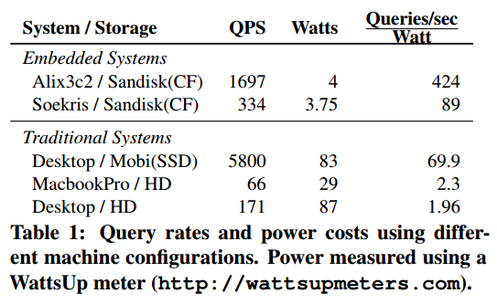
FAWN results

Slide 9
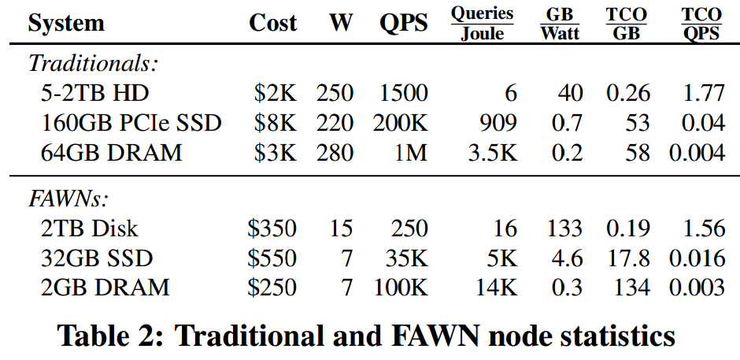
FAWN results
#Nodes dictated by required GB space and QPS performance

Slide 10
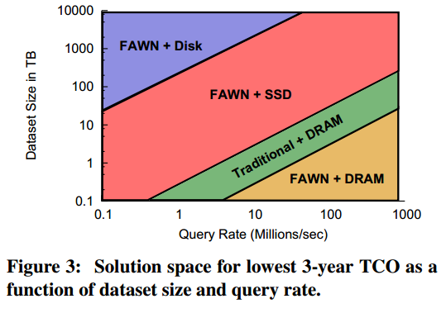
FAWN results

Slide 11
processor scaling trends

Slide 12
Moore’s Law
Moore’s law (observation)
# transistors/chip ↑ 2X/2yr (how?)
Frequency ↑ as transistor size ↓ (max 9GHz)
Leakage current/power ↑ as transistor size ↓
Heat ↑ as frequency ↑

Slide 13
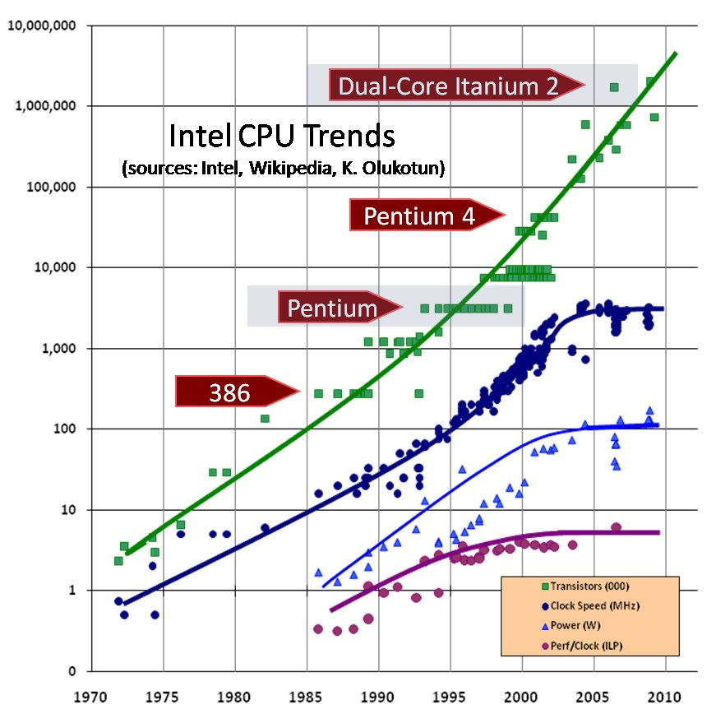
Moore’s Law

Slide 14
Dennard Scaling
Dennard scaling (observation)
Transistor power (V+I) ↓ as transistor size ↓
+ Moore’s law = perf/watt ↑ 2X/2yr (how?)
Koomey’s law
Dennard scaling broke down recently due to leakage current (though Moore’s continued)
Dark Silicon
So we did multicore!
Notes:
Moore’s law continued for a while though Dennard scaling broke down. This led to multicore.
TurboBoost

Slide 15
heteromates paper

Slide 16
Dark silicon
Cannot power on all of the CPU
Result of:
Success of Moore’s law
Failure of Dennard scaling
Turbo boost

Slide 17
Main ideas
Heterogeneous cores
For different performance requirements
Energy considerations (battery vs. plugged)
Thermal considerations
Dark silicon

Slide 18
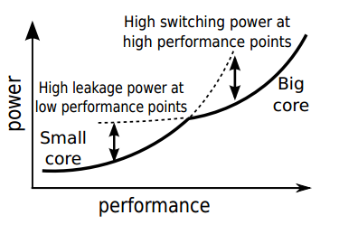
Main ideas

Slide 19
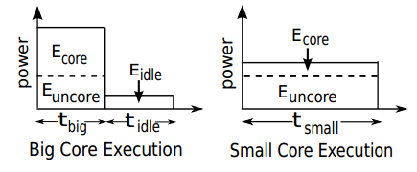
Main ideas

Slide 20
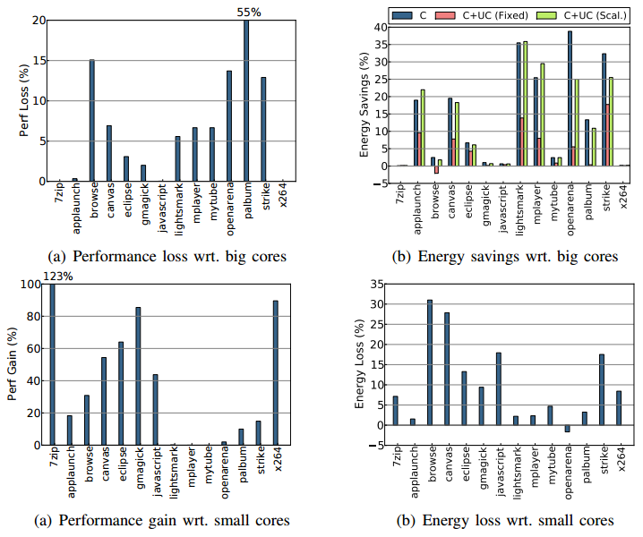
Results

