Slide 1
CSE 591: Energy-Efficient Computing Lecture 8 SOURCE: renewables
Anshul Gandhi
347, CS building
anshul@cs.stonybrook.edu

Slide 2
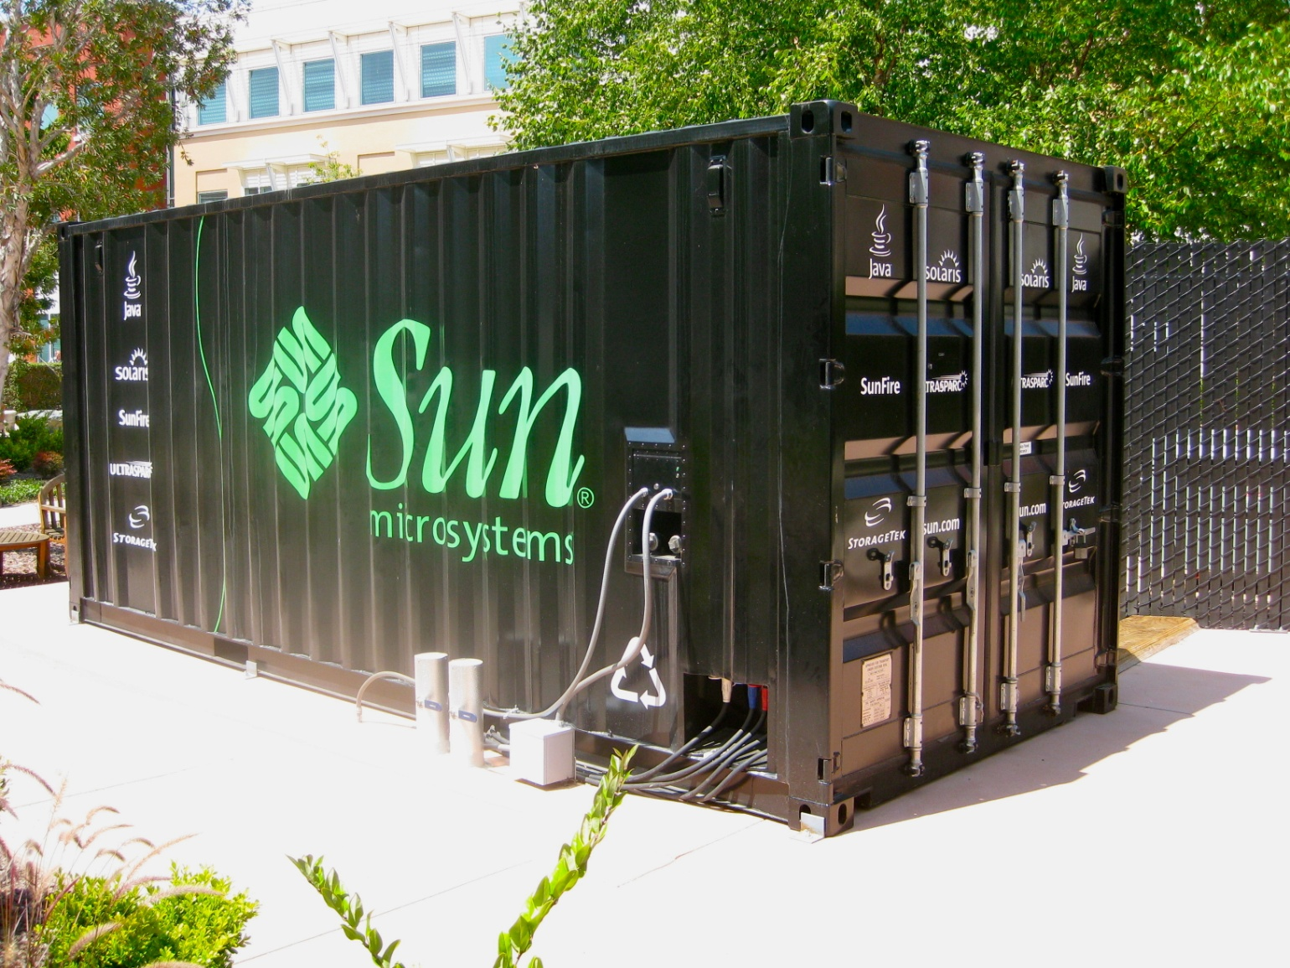
Modular data centers

Slide 3
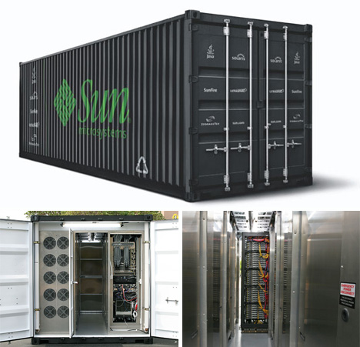
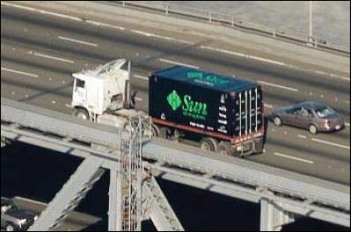
Modular data centers

Slide 4
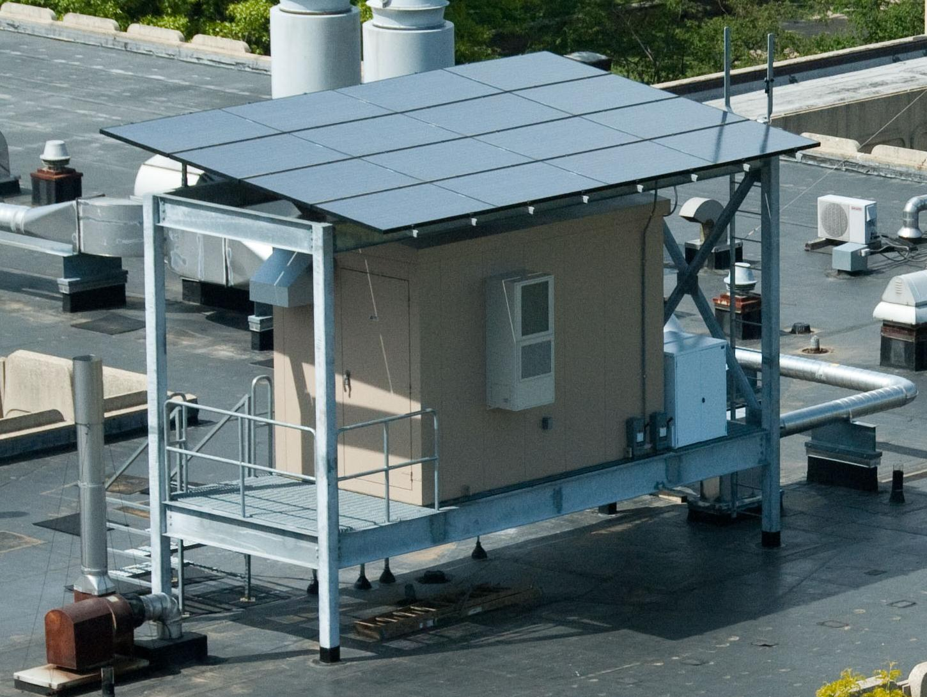
Rutgers parasol DC
Solar, outside air, batteries

Slide 5
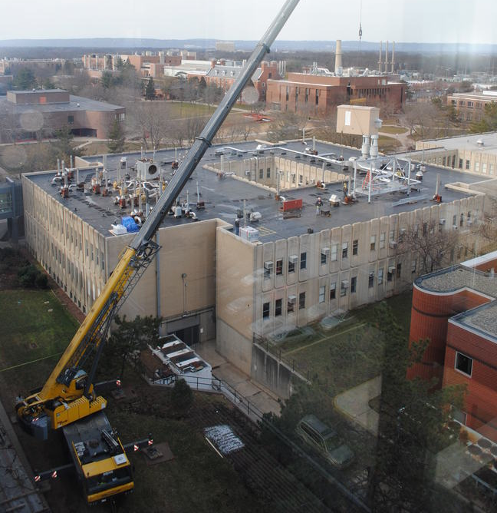
Rutgers parasol DC

Slide 6
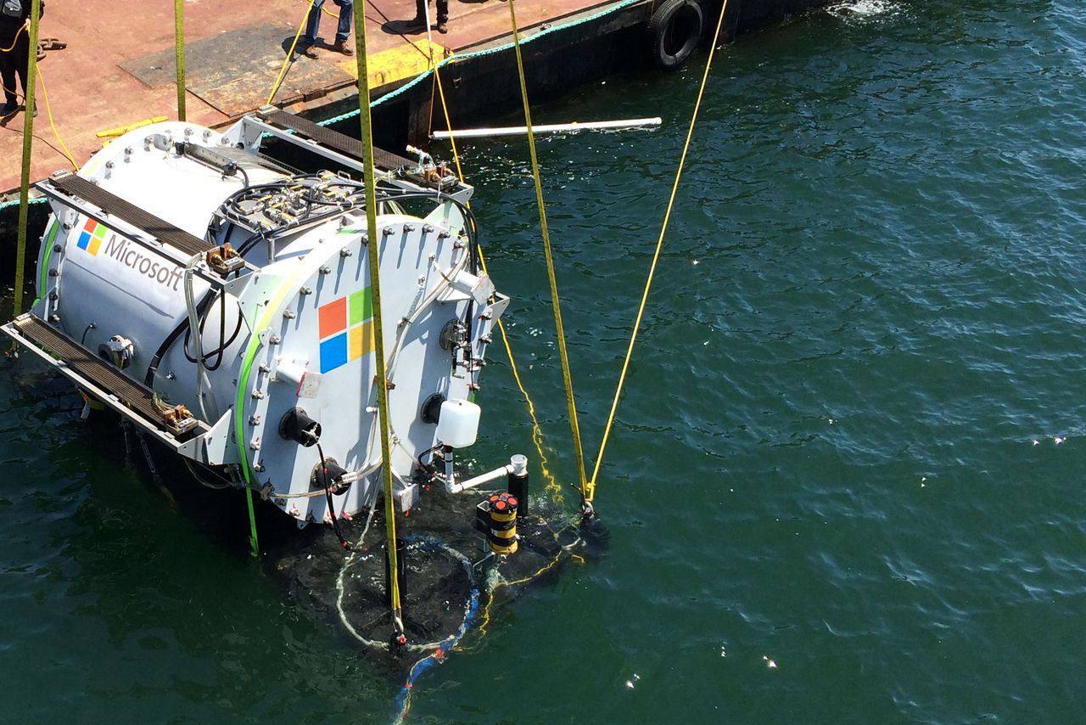
Microsoft’s Project Natick
Notes:
Cooling
Tidal waves energy

Slide 7
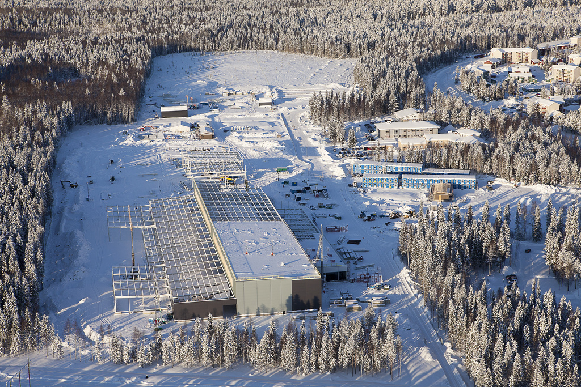
FB’s data center in Sweden
Notes:
Outside air
Hydroelectricity

Slide 8
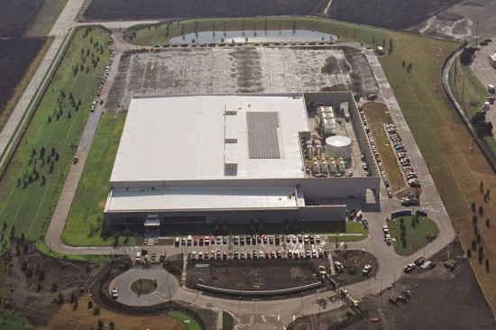
Cisco’s data center in Texas
Notes:
10MW for 5.25MW (redundant power)

Slide 9
sustainable_energy paper

Slide 10
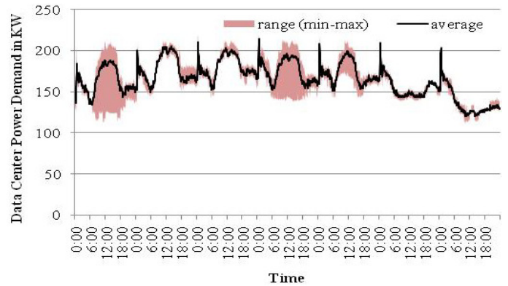
Data center demand

Slide 11
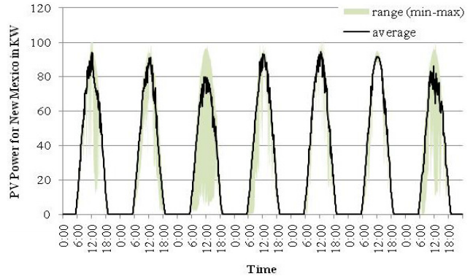
Solar power supply

Slide 12
renewable_cooling paper

Slide 13
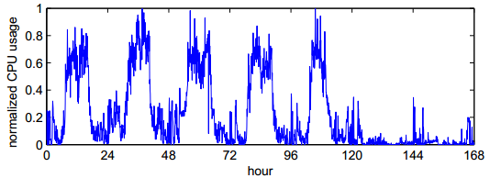
Data center demand

Slide 14
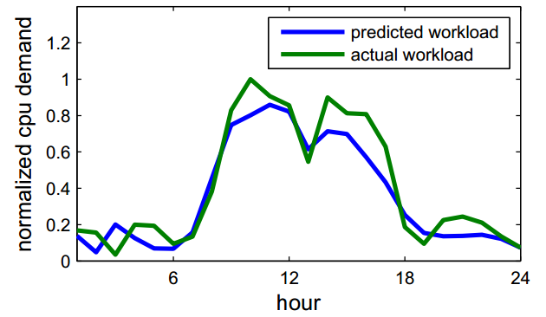
Predicted: Data center demand

Slide 15
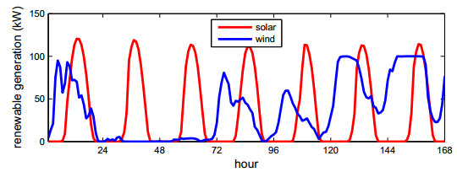
Renewable power supply

Slide 16
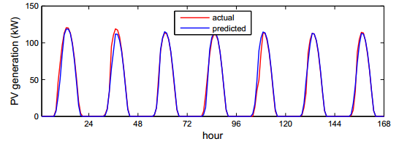
Predicted: Renewable power supply

Slide 17
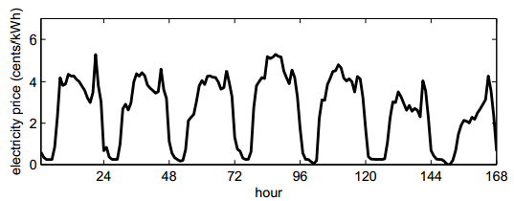
Dynamic electricity prices

