Slide 1
CSE 591: Energy-Efficient Computing Lecture 9 SLEEP: processor
Anshul Gandhi
347, CS building
anshul@cs.stonybrook.edu

Slide 2
dreamweaver paper

Slide 3
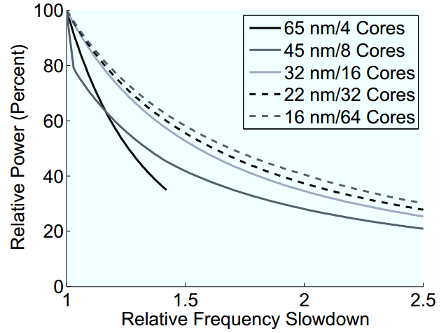
DVFS limitations
Notes:
How to read: if I want 50% power, what frequency slowdown do I need to incur?

Slide 4
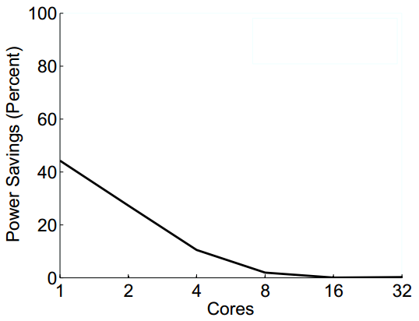
PowerNap limitation
Notes:
(0.3)^n

Slide 5
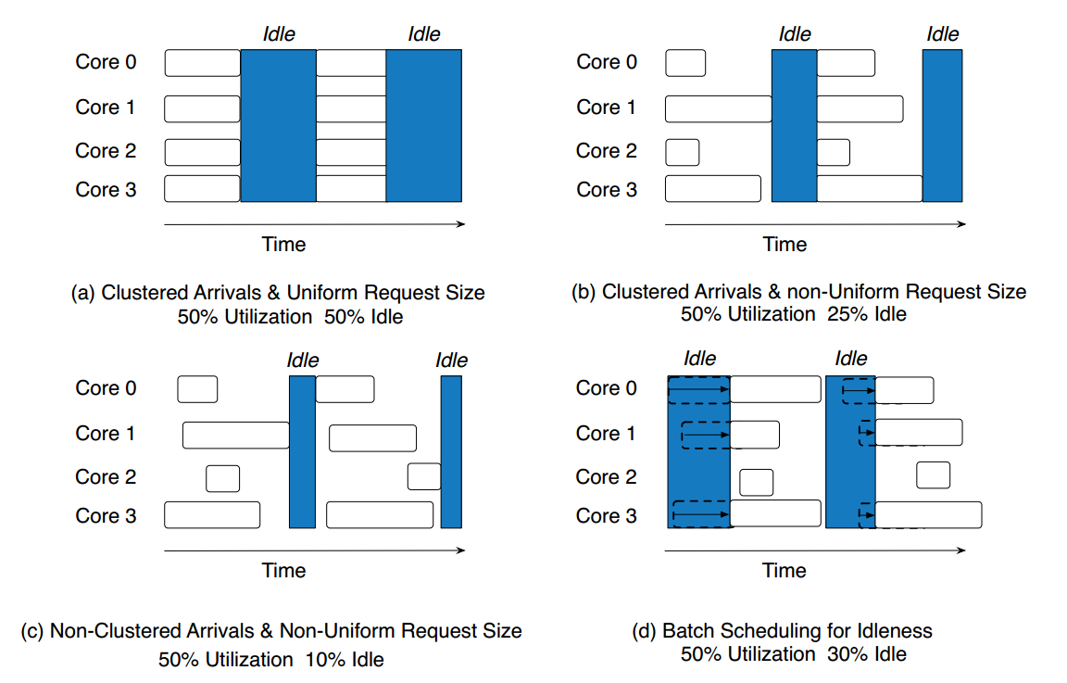
Request batching
Notes:
1. Types of variability: request arrival and service time. This is why we need slack in the first place!
2. pre-empt to sleep even if one core is idle – very aggressive.

Slide 6
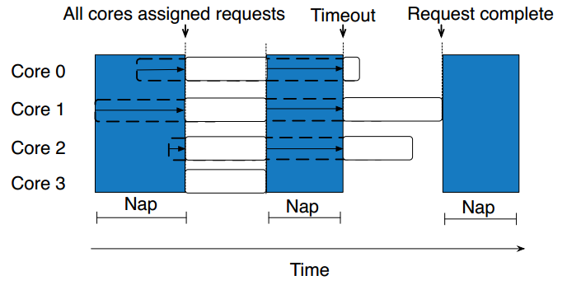
Weave Scheduling

Slide 7
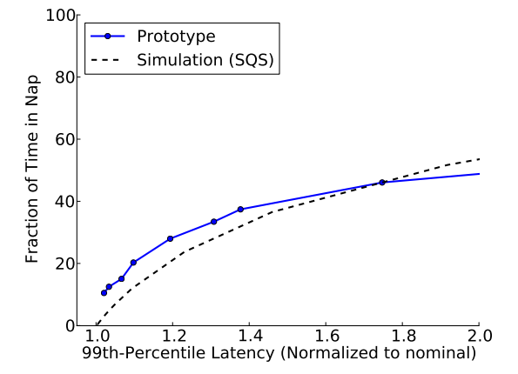
Dream Processor

Slide 8
Server power breakdown

Slide 9
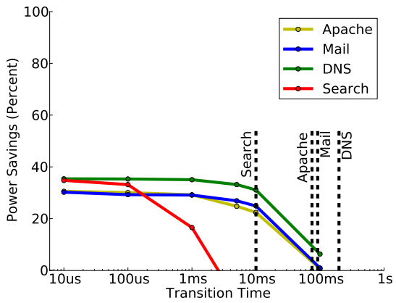
Sensitivity to setup time

Slide 10
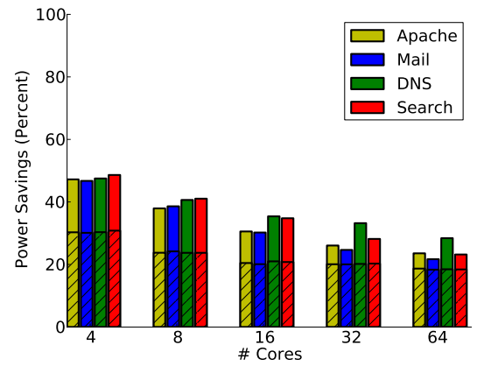
Sensitivity to #cores

Slide 11
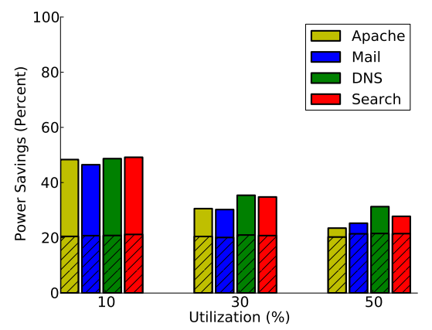
Sensitivity to utilization

Slide 12
barely_alive paper

Slide 13
Motivation
AutoScale for stateful servers is hard
Setup time
Cache servers
Data analytics
“barely alive” states (hypothetical)
Keep memory and/or disk alive
Turn other components off
Useful during load spikes
Notes:
SoftScale load spikes

Slide 14
Barely alive states
State | Components powered off | Components powered on
BA1/2 | All cores, disks, all but one fan, all but one n/w interface | Embedded processor, 1 fan, 1 n/w interface, memory (self-refresh)
BA3 | Same | Multiple n/w interfaces
BA4 | Same + embedded processor | Multiple cores + fans
BA5 | Same + embedded processor | Same + disks

Slide 15
Handling Data Updates
Barely alive states can keep memory active, thus allowing live updates
PowerNap would have to wake up to update, and then go back to sleep
reduces sleep time
Can use an embedded processor with small amount of memory
limited by memory size
increases setup time

