Slide 1
FindAll: A Local Search Engine for Mobile Phones
Aruna Balasubramanian
University of Washington

Slide 2




Co-Authors
Information Retrieval
Systems
Niranjan Balasubramanian, UW
David Wetherall, UW
Don Metzler, USC
(now Google)
Sam Huston, UMass

Slide 3
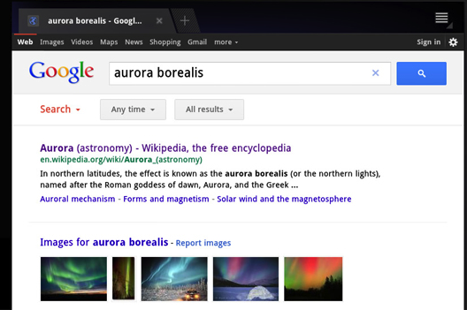
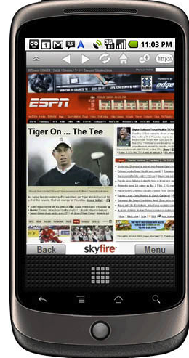

Mobile web search performance poor
Order of magnitude slower on cellular networks
Notes:
Even under normal conditions. Under 1 second vs (3 to 10 seconds depending on location, device and operator used) vs 100 seconds on edge networks

Slide 4
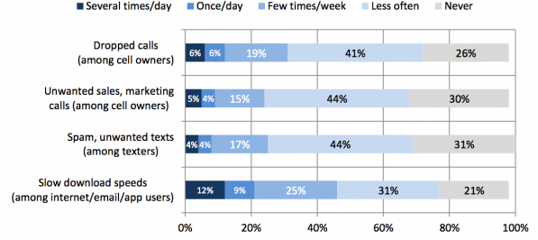


Cellular connectivity is poor
Pew, April 2012
This work: Can we trade storage for connectivity to improve search performance?
Notes:
April 2012, 2200 adults
http://pewinternet.org/Reports/2012/Mobile-phone-problems.aspx?utm_source=Mailing+List&utm_campaign=afe764abfb-Mobile_phone_problems08_02_2012
LTE, Spectral efficiency
Every MB becomes precious, Story is cheaper, 64GB available in most phones, with new storage systems <name>
This is unlikely to go away because of the spetrum pressure, unless we can increase spectral efficiency

Slide 5




Leveraging re-finding.
Searching for a previously viewed page.
  Mobile: 70% of searches for 50% users.
  Non-Mobile: 40% to 60% of all searches.
Notes:
CHANGE THIS PAGE If I store the previoslu viewed web page and retrieve them locally, then I don’t have to use the Internet

Slide 6
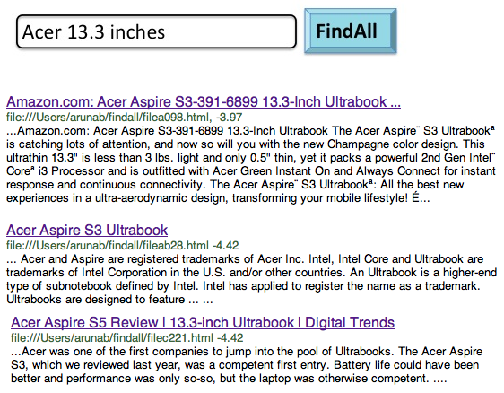
FindAll local search engine
Search interface to search any previously viewed page, on any of your device
Notes:
Google history, Chrome sync

Slide 7
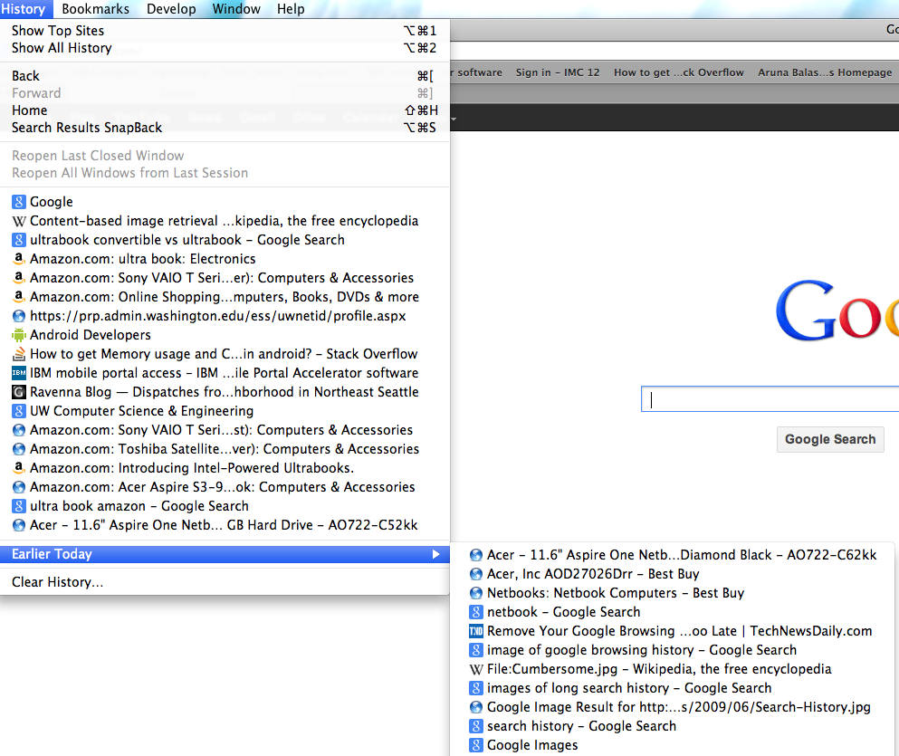
Is this the same as caching/history?
It is a search interface on top of caching: History seldom used
Is this same as Google history or chrome sync?
Notes:
New feature is Google phones called Google Now! But also needs the Internet. Spoke to folks at Google. They agree this will be a good addition, but of course, they are concentrating more on using the cloud. Example, Google now. But I think it is now time to look for solutions that do not always rely on the cloud.

Slide 8
What is a search interface?
Uses indexes and retrieval algorithms for effective search
  Keyword matching is easy but not effective
  Database of search queries miss query changes and non-searched web pages
Challenge: Search engines are memory/energy intensive
Notes:
Powerful. All modern IR systems use it. Even for mobile phone searches, Keyword matching was not effective.
What is Database? On the Internet, lot of re-finding occurs with new queries. Example, ultrea book amazon, Acer 13.4 inches, etc.

Slide 9
Talk outline
User study
  Identifies re-finding behavior
FindAll
  Design of search engine for phones
Evaluation
  Results of tradeoffs in practice

Slide 10
Talk outline
User study
  Identify re-finding behavior
FindAll
  Design of search engine for phones
Evaluation
  Results of tradeoffs in practice
Notes:
we want more day to day fine grained study – how often to index, is this consistent across days, do queries change, cross device refinding.

Slide 11
IR-approved study
Monitored 23 participants for 1 month
  Grad and under-grad students
Collected logs from user’s mobile/desktop
  Visited URL and search query (anonymized)
Mark URL re-found if
  Page revisited via search query, and unchanged
Notes:
Many did not have 3G or had a cap on 3G (what percentage). Many of our results agree with desktop search AOL logs with XXX users
Android exposes bookmark database . Based on sqlite.
We are doing a much larger study

Slide 12
Examples
Notes:
Note that we could search this, but
Since URLs are anonymized, we have to figure out when pages change. We look at the top 500

Slide 13
Re-finding accounts for 52% of search
Cross-device re-finding is 70%
>20% of re-finds have different query
Lots of opportunities to search locally.
Notes:
More than one re-find
Similar search from bing

Slide 14
45% re-finding occurs within 50 minutes
Time between first visit and subsequent re-finding
Need to index when the page is first accessed.
Notes:
Not index in the cloud

Slide 15
User’s show diverse re-finding patterns
Need to adapt to user
Notes:
Make this per month

Slide 16
User’s re-finding fairly constant
This user: Avg re-finding 43%, std deviation 9%
Notes:
What is std deviation

Slide 17
User study summary
Lots of opportunities to leverage re-finding
Need to index near when page is accessed
Need to adapt to users

Slide 18
Talk outline
User study
  Identifies re-finding behavior
FindAll
  Design of search engine for phones
Evaluation
  Results of tradeoffs in practice

Slide 19
Search engine basics
Indexer
  Map of <words>: <list of pages they they occur>
Retriever
  Use index to rank pages in the order of relevance
  A web page is available for search, only if it is indexed
Notes:
Sorted? Adapt search engine.
How exactly does retrieval work
Index is needed near when they are accessed

Slide 20

FindAll architecture
Storage
Partial Indexes
Cache
Notes:
Memory consumption: 800 MB RAM. However, only 240 MB is available for applications. Cannot tell when you are kicked out. In our experiments, indexing
30 web pages and maintaining the index in-memory resulted in the phone running out of memory, sometimes it was 150
Difficult to tell when memory runs out, because of JVM, Galago’s memory acquisition, and the quirks of android.
Retriever

Slide 21
When to index?
Low availability
High
index energy
High
availability
Low index energy

Slide 22
FindAll indexing
Maximize availability, such that total energy consumption is no more than default search
  Expected energy for indexing <=
  Expected energy if indexing not done (default search)
FindAll estimates expectations based on user behavior
Notes:
Refind often, index often. Refind less often, do not index

Slide 23
Predicting user re-finding probability
Online classier: What is the probability of a web page being re-found in the next T minutes.
Classifier features
  1. base re-finding probability of user?
  2. user in a browsing session?
  3. web page been re-found recently?
Notes:
We could do much better with more data.

Slide 24
Expected cost of default search E[~I]
Cost of network download, if a web page is re-found but not indexed

Slide 25
Expected cost of indexing E[I]
Sum of
  Cost of indexing current block of web pages
  A penalty estimated based on future indexing
Build a simple linear model by indexing different block sizes
Notes:
If indexing cost < default search, you index
Re-find often you index often

Slide 26
Prototype on Android
Adapt Galago search engine for phones
  Implement partial indexing and merging
Implement online energy cost estimator
  Train classifier when mobile is charging
  Make an indexing decision every 5 mins

Slide 27
Talk outline
User study
  Identify re-finding behavior
FindAll
  Design of search engine for phones
Evaluation
  Results of tradeoffs in practice

Slide 28
Evaluation goals
Benefits and Costs
  Latency, Availability, 3G data usage
  Energy, Storage
Alternate approaches
  Keyword, Database
Alternate indexing strategies
  Cloud index, Always index, Fixed index
Results based on prototype and user traces

Slide 29
Evaluation goals
Benefits and Costs
  Latency, Availability, 3G data usage
  Energy, Storage
Alternate approaches
  Keyword, Database
Alternate indexing strategies
  Cloud index, Always index, Fixed index

Slide 30
FindAll reduced 3G data usage
Notes:
40% of the users have savings of 60MB or more. Plans for 300MB, this would be a 20% savings

Slide 31
FindAll improves web page latency
3.42
1.82
Notes:
Not so much for low re-find users

Slide 32
FindAll does not increase energy
Notes:
For high refind users, energy reduced by 30%
Absolute: 140J, for desktop increases to 960J
Conservative prediction

Slide 33
Availability under limited connectivity
43%
(Under a random 50% connectivity model)
Notes:
Mention other benefits of using Findall over database: You can search for documents that you only browsed earlier from laptop/desktop, you can search within your searches

Slide 34
FindAll indexing important for energy benefits
Notes:
Block size = 5, Download frequency 30 minutes
Static strategies

Slide 35
Conclusions
FindAll makes a win-win tradeoff for search
  Decrease latency and increase availability, with reduced energy and bandwidth
Future directions
  Search primitive: Integrating re-finding with other mobile apps
  Context-based re-finding: Adding sensor cues to pages

Slide 36
Questions?
Contact: arunab@cs.washington.edu

Slide 37
Other results
Static Indexing strategies
  Increase energy by up to 50% compared to default search for low re-find users
  Decreases availability by up to 39% for high re-find users
Storage requirement less than 1.7GB per month

