Slide 1
Augmenting Mobile 3G Using WiFi
Aruna Balasubramanian
Ratul Mahajan
Arun Venkataramani
University of Massachusetts
Microsoft Research

Slide 2
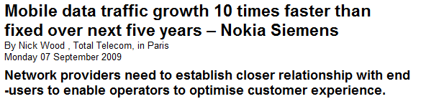
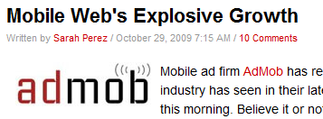
Demand for mobile access growing
www.totaltele.com
http://www.readwriteweb.com
900 million mobile broadband subscriptions today….
www.3gamericas.org
Notes:
Revenue from mobile data will overtake fixed voice in the US in 2011, according to Pyramid Research.
All of this is understandable given the massive adoption of mobile devices such as smartphones.

Slide 3
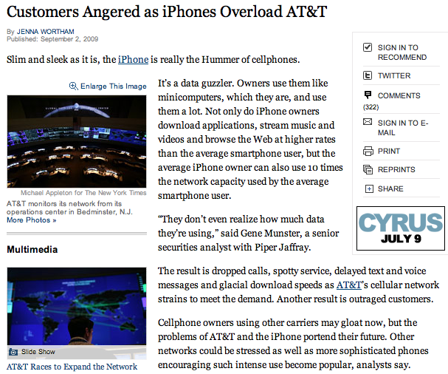
Mobile demand is projected to far exceed capacity
www.nytimes.com
www.rysavy.com
Current spectrum | 409.5 MHz
Unallocated spectrum (including whitespaces) | 230 MHz
Projected demand by 2016 | 800 MHz – 1000 MHz
www.nytimes.com
“In light of the limited natural resource of spectrum, we have to look at the ways of conserving spectrum” -- Mark Siegel (AT&T)
Reducing cellular spectrum utilization is key!
Notes:
Demand can never be met given the drawn out process of reclaiming spectrum.
Carriers understand this and are already looking for other mechanisms.
4G reaches shannon limit with snr. only can do spatial reuse -- reducing radius of a cell,
All projections are based on current networks. But actual demand may be even higher.

Slide 4
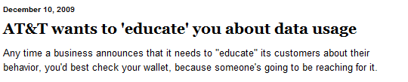
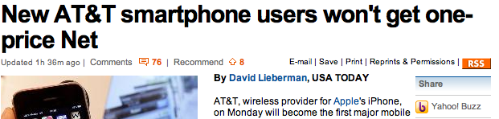
How can we reduce spectrum usage?
blogs.chron.com
1. Behavioral
2. Economic
3. Technical
www.usatoday.com
Notes:
All three are probably needed.
Our focus is on reducing usage.

Slide 5

Augmenting Mobile 3G using WiFi
Offload data to WiFi when possible
Focus on vehicular mobility
Notes:
We are surrounded by WiFi and most devices have multiple interfaces.
Inspired by T-Mobile @ home
Particularly challenging case and increasing demand because of navigation-based applications. Offloading is less of a challenge when you are stationary – you can either do it or not – we wanted to see how much data can you offload when you are out and about.
Agnostic to business model

Slide 6

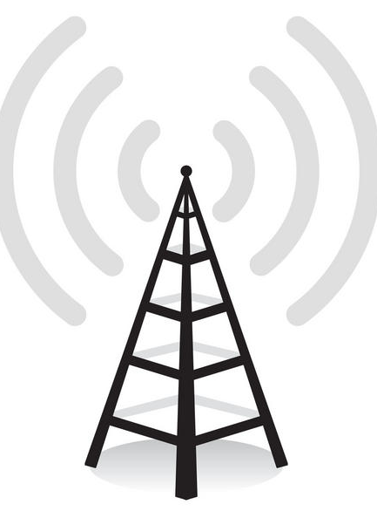

Offloading 3G data to WiFi

Slide 7
Related work on multiple interfaces
Improving performance using handoffs based on current conditions
Reducing power consumption by switching across multiple interfaces
This work:
How much 3G data can be offloaded to WiFi?
How to offload without hurting applications?

Slide 8
Contributions
Measurement: Joint study of 3G and WiFi connectivity
  Across three cities: Amherst, Seattle, SFO
System: Wiffler, to offload 3G data to WiFi while respecting application constraints
  Deployed on 20 vehicles
Notes:
WiFi APs have short range and are typically not deployed to cover roads. Quality might be very poor.
The study shows that WiFi availability is low and its quality is poor.
A simplistic design …………..
With this in mind, we design Wiffler

Slide 9
Measurement setup
Testbed: Vehicles with 3G and WiFi (802.11b) radios
  Amherst: 20 buses + 1 car, Seattle: 1 car, SFO: 1 car
Software: Simultaneously probes 3G and WiFi for
  Availability, loss rate, throughput
Duration: 3000+ hours of data over 12+ days

Slide 10
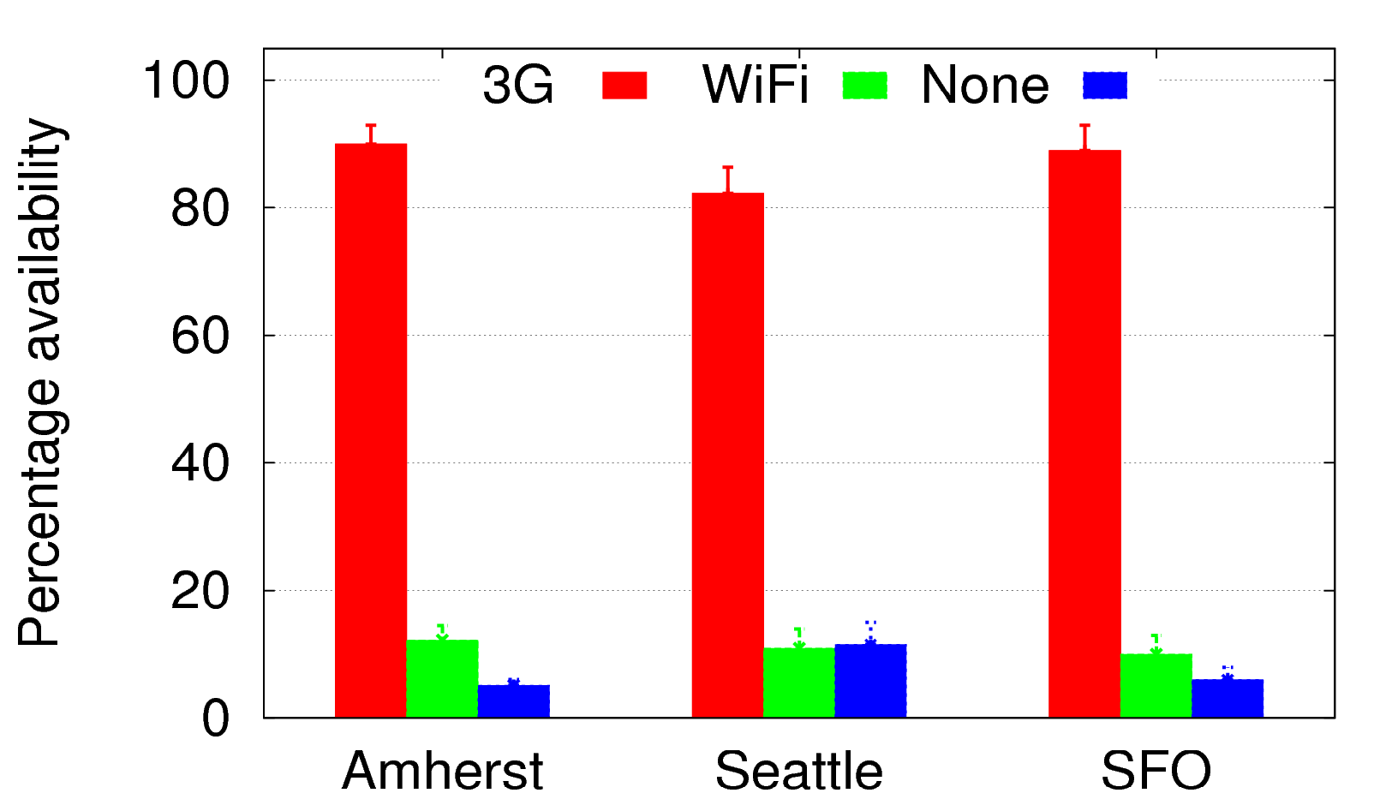
Open WiFi availability low, but useful
Availability = fraction of 1-second intervals when at least one packet received
86%
Availability
(%)
3G+WiFi combination better than sum pf parts
11%
7%

Slide 11
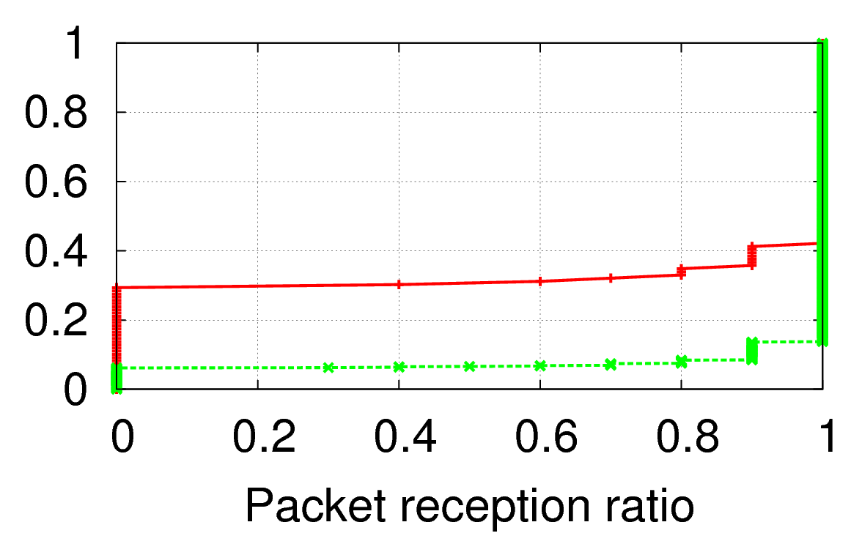
WiFi loss rate is higher
Loss rate = Fraction of packets lost at 10 probes/sec
Cumulative fraction
28%
WiFi
8%
3G

Slide 12
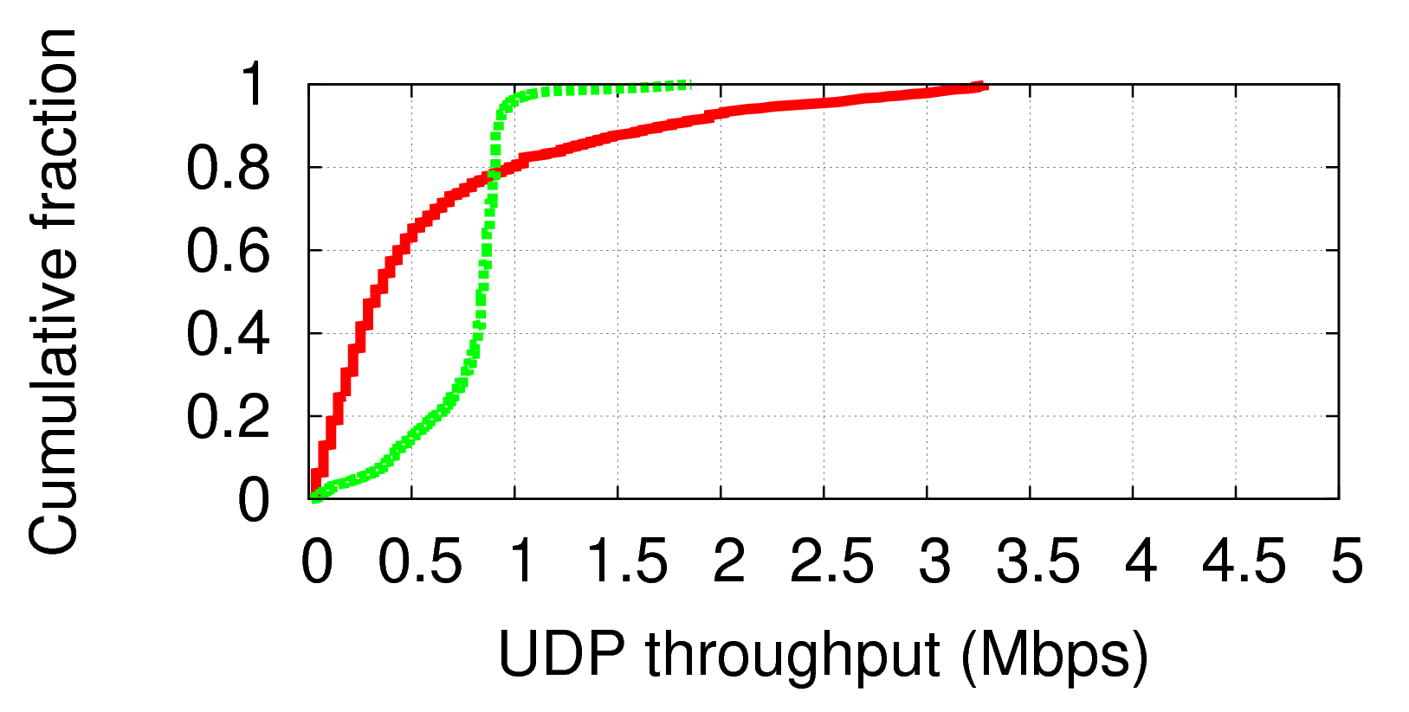
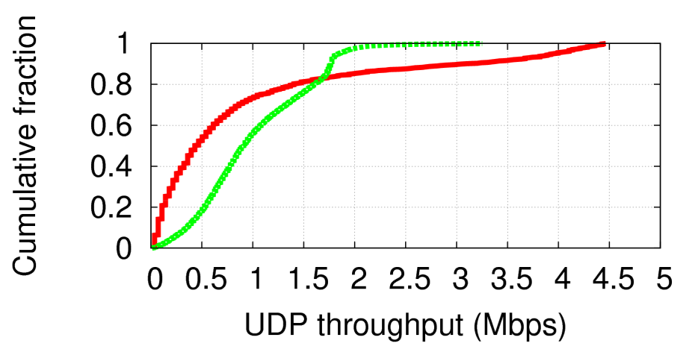
WiFi (802.11b) throughput is lower
Throughput = Total data received per second
Cumulative fraction
WiFi
3G
Upstream
0.35
0.72
Cumulative fraction
WiFi
3G
Downstream

Slide 13
Implications of measurement study
Strawman augmentation: Use WiFi when available
  Can offload only ~11% of the time
  Can hurt applications because of WiFi’s higher loss rate and lower throughput

Slide 14
Key ideas in Wiffler
Increase savings for delay-tolerant applications
Problem: Using WiFi only when available saves little 3G usage
Solution: Exploit delay-tolerance to wait to offload to WiFi when availability predicted
Reduce damage for delay-sensitive applications
Problem: Using WiFi whenever available can hurt application quality
Solution: Fast switch to 3G when WiFi delays exceed threshold
Notes:
Not worrying about energy for now.
These techniques are very simple and yet close to optimal for what they do. In the beginning, we played with some more complicated versions but found them to not worth it.

Slide 15
Prediction-based offloading
D = Delay-tolerance threshold (seconds)
S = Data remaining to be sent (bytes)
Each second,
  If (WiFi available), send data on WiFi
  Else if (W(D) < S), send data on 3G
  Else wait for WiFi.
Predicted WiFi transfer size in next D seconds

Slide 16
Predicting WiFi capacity
History-based prediction of # of APs using last few AP encounters
  WiFi capacity = (expected #APs) x (capacity per AP)
Simple predictor yields low error both in Amherst and Seattle
Negligible benefits with more sophisticated prediction, eg future location prediction + AP location database

Slide 17
Fast switching to 3G
Problem:
  WiFi losses bursty => high retransmission delay
Approach:
  If no WiFi link-layer ACK within 50ms, switch to 3G
  Else, continue sending on WiFi
Notes:
A different way of bonding multiple interfaces

Slide 18

Wiffler implementation
Wiffler proxy
Prediction-based offloading upstream + downstream
Fast switching only upstream
  Implemented using signal-upon-ACK in driver
Notes:
A proxy is coming for a host of other reasons as well.

Slide 19
Evaluation Roadmap
Prediction-based offloading
  Deployment on 20 DieselNet buses in 150 sq. mi region around Amherst
  Trace-driven evaluation using throughput data
Fast switching
  Deployment on 1 car in Amherst town center
  Trace-driven evaluation using measured loss/delay trace using VoIP-like probe traffic

Slide 20
Deployment results
 | Data offloaded to WiFi
Wiffler’s prediction-based offloading | 30%
WiFi when available | 10%
File transfer size: 5MB; Delay tolerance: 60 secs;
Inter-transfer gap: random with mean 100 secs
 | % time good voice quality
Wiffler’s fast switching | 68%
WiFi when available (no switching) | 42%
VoIP-like traffic: 20-byte packet every 20 ms

Slide 21
Trace-driven evaluation
Parameters varied
  Workload, AP density, delay-tolerance, switching threshold
Strategies compared to prediction-based offloading:
  WiFi when available
  Adapted-Breadcrumbs: Future location prediction + AP location database
  Oracle (Impractical): Perfect prediction w/ future knowledge

Slide 22
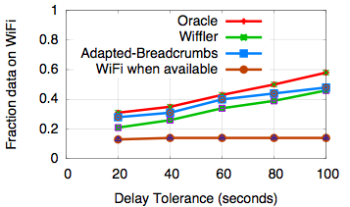
Wiffler increases data offloaded to WiFi
Workload: Web traces obtained from commuters
Wiffler close to Oracle
42%
Sophisticated prediction yields negligible benefit
14%
WiFi when available yields little savings
Wiffler increases delay by 10 seconds over Oracle.

Slide 23
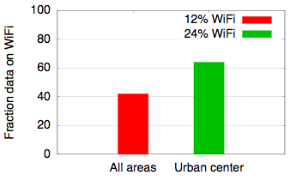
Even more savings in urban centers

Slide 24
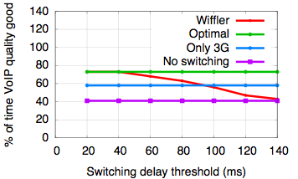
Fast switching improves quality of delay-sensitive applications
73%
58%
40%
30% data offloaded to WiFi with 40ms switching threshold

Slide 25
Future work
Reduce energy to search for usable WiFi
Improve performance/usage by predicting user accesses to prefetch over WiFi
Incorporate evolving metrics of cost for 3G and WiFi usage

Slide 26
Summary
Questions?
Augmenting 3G with WiFi can reduce pressure on cellular spectrum
Measurement in 3 cities confirms WiFi availability and performance poorer, but potentially useful
Wiffler: Prediction-based offloading and fast switching to offload without hurting applications

Slide 28
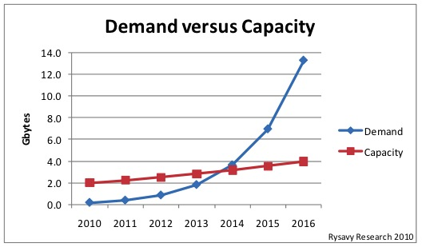
Demand projected to outstrip capacity
http://www.nytimes.com
Notes:
Per person estimate by Peter Rysavy, based on allocated and allocated but unused capacity
In our smartphone measurements, some users are already consuming about 0.5GB a day.

Slide 29
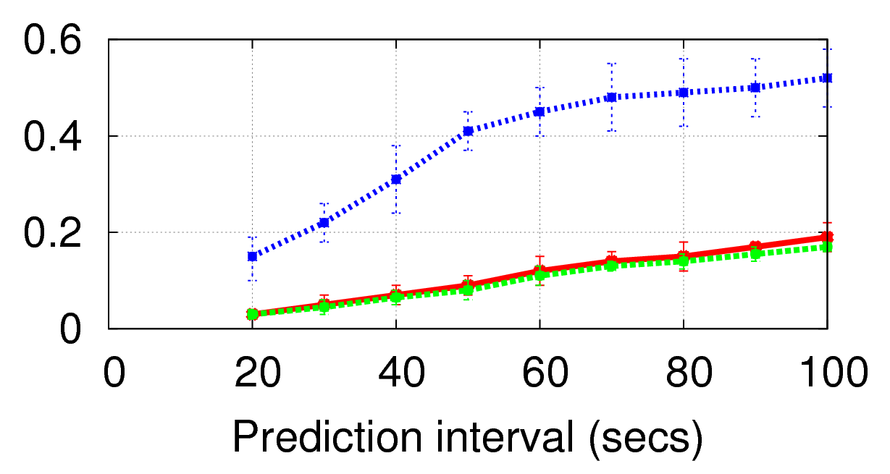
Error in predicting # of APs
N=1
Relative error
N=4
N=8

Slide 30
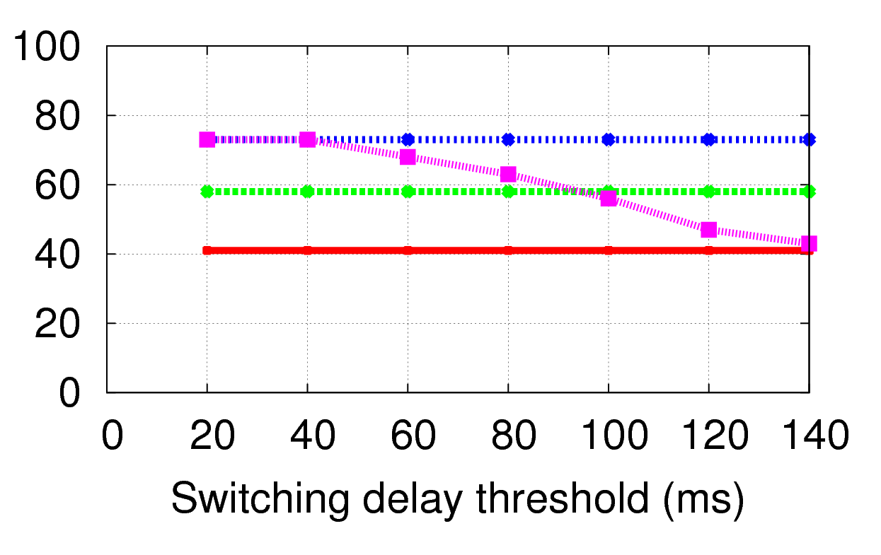
Fast switching improves performance of demanding applications
Oracle
Only 3G
Wiffler
No switching
% time with good voice quality

