Slide 1

Demystifying Page Load Performance with WProf
Aruna Balasubramanian
With Xiao (Sophia) Wang,
Arvind Krishnamurthy, and David Wetherall
University of Washington

Slide 2
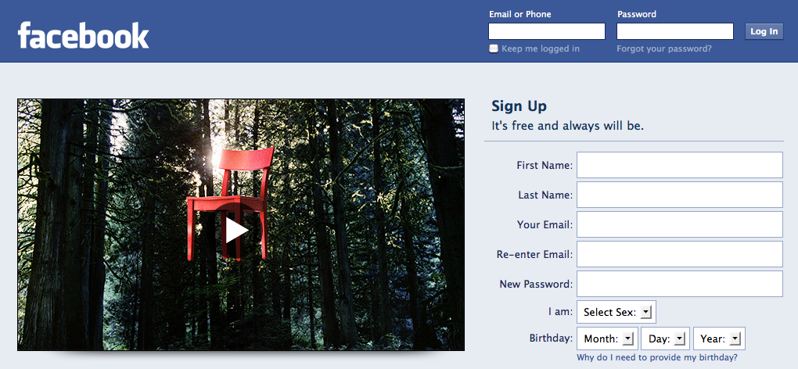
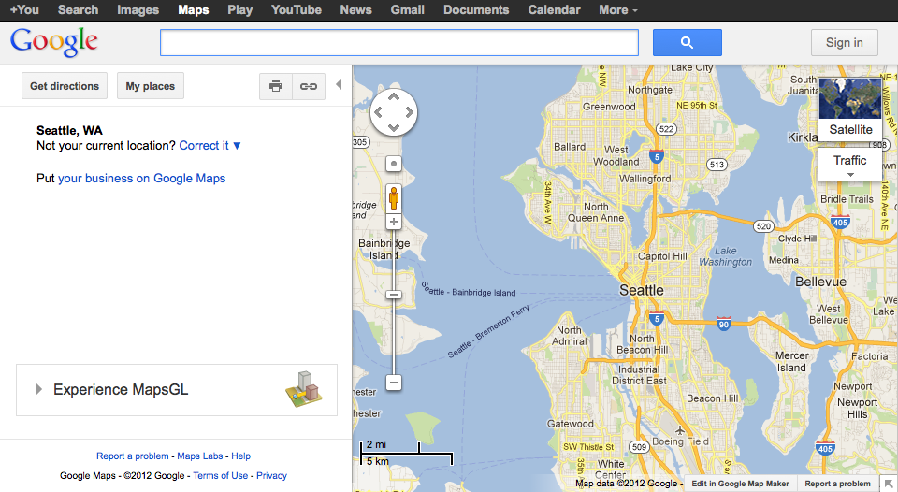
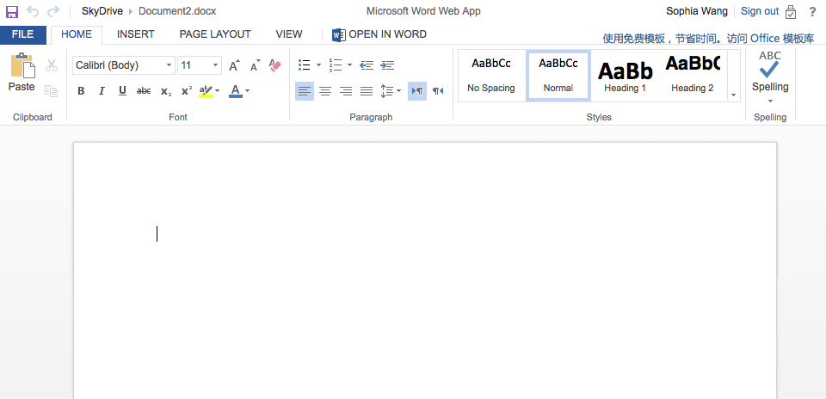
Web page loads are extremely critical
Example: Amazon can increase 1% revenue by decreasing page load time by 0.1s.
…but page load is often very slow
Notes:
Just say the Web is everywhere

Slide 3
Web browsers are the de-facto standard of accessing the Internet
Notes:
Just say the Web is everywhere

Slide 4
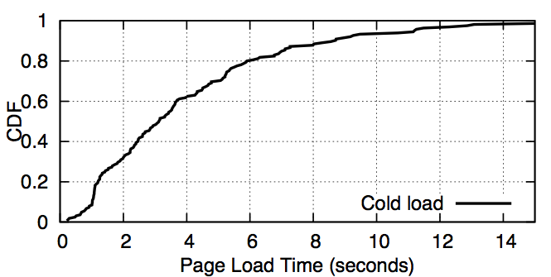
Page load is critical, but often slow
Amazon can increase 1% revenue by decreasing page load time by 0.1s.
A few top pages take more than 10 seconds to load.
Median page load time is 3 seconds.
Notes:
this is how long the spinner is.
unclear what the graph (across multiple runs on a single page?)
not surprisingly, page load is critical
minimum of 5 runs

Slide 5
Many techniques aim to optimize page load time
Best practices: JaveScript/CSS placement, Image minification, …
Server placement: CDNs
Web pages and cache: mod_pagespeed, Silo
TCP/DNS: TCP fast open, ASAP, DNS pre-resolution, TCP pre-connect
Application level: SPDY
…, but optimizations don’t always work.

Slide 6
…because , page load bottlenecks are not well understood.
Page load process is not strictly streamlined
Page load activities are inter-dependent, leading to bottlenecks
Notes:
Browser specific policies. Example of page structure complexity

Slide 7
Dependency example
<html>
<script src="b.js"></script>
<img src="c.png"/>
</html>
<html>
<img src="c.png"/>
<script src="b.js"></script>
</html>
html
HTML depends on JS completion
b.js
c.png
html
HTML does not depend on image loads
c.png
b.js
Notes:
ignore preloading;
mention that js evaluation stops the parser but image doesn't
say "for the 1st page, all objects are the bottlenecks, but for the 2nd page, only two objects are the bottlenecks. This suggests that the dependency is important here. Understanding ..."

Slide 8
Example: Dependency and bottleneck
Possible optimization: Make JS loads faster
<html>
<script src="b.js"></script>
<img src="c.png"/>
</html>
html
b.js
c.png
<html>
<img src="c.png"/>
<script src="b.js"></script>
</html>
html
c.png
b.js
b.js
Dependency and page structure key are the key
to identifying bottlenecks

Slide 9
Talk Overview
Extract dependency policies
WProf: Compute bottleneck for a given page structure
Study page load on real pages
Notes:
have a sense of what people get out of WProf: figure out the bottlenecks of plt
bring the notion of critical path analysis to the front
* Identifying bottlenecks with WProf --> automating ...

Slide 10
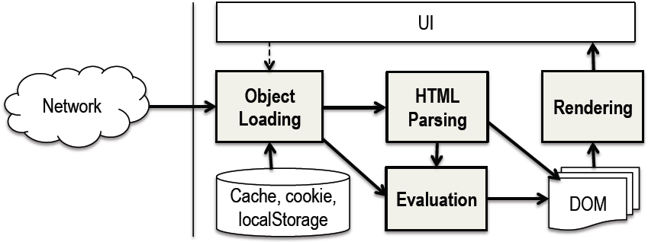
Page load primer
http://www.example.com/

Slide 11
Page load primer
index.html
1 <html>
2 <script src="main.js"/>
3 </html>

Slide 12
Page load primer
index.html
1 <html>
2 <script src="main.js"/>
3 </html>
Notes:
What is DOM? A DOM tree is an intermediate
representation of a Web page; the nodes in
the DOM tree represent HTML tags, and each node is
associated with a set of attributes. The DOM tree representation
provides a common interface for programs to
manipulate the page.

Slide 13
Page load primer
index.html
1 <html>
2 <script src="main.js"/>
3 </html>

Slide 14
Page load primer
index.html
1 <html>
2 <script src="main.js"/>
3 </html>
Shared
object

Slide 15
Page load primer
index.html
1 <html>
2 <script src="main.js"/>
3 </html>

Slide 16
Page load primer
index.html
1 <html>
2 <script src="main.js"/>
3 </html>
http://www.example.com/
Notes:
Resource dependency, Output dependency

Slide 17
Methodology to infer dependencies
Design test pages
Examine documententation
Inspect browser code
Notes:
explain why the standards alone aren't enough. they underspecify, so implementation strategies matter greatly for performance. and the strategies are mostly common across browsers (you found), so we are not modelling nitty-gritty detail of a particualr browser.
if you want to optimize the web page, why each source is not enough.

Slide 18
Test pages (1 of 2)
HTML
html
js
img
JS
IMG
Insert delays
html
js
img
Suggests the JS loads affects image load
Notes:
Show that we test across browsers
make the delay bigger, we inject the delay, say the order of js/img

Slide 19
Test pages (2 of 2)
HTML
html
img
js
IMG
JS
Insert delays
html
img
js
Suggests image loads *does not* affect JS load
Notes:
Show that we test across browsers
make the delay bigger, we inject the delay, say the order of js/img

Slide 20
Reverse engineer page loads with test pages
Use developer tools to measure timing
HTML
JS
IMG
CSS
IMG
HTML
IMG
An example Web page
8
Notes:
We design test pages to systematically uncover dependencies across browsers.
We start with thinking about how Web objects are assembled on Web pages.
In any pages, you'll find either one object follows another or one embeds another.
Let's look at an example. This page embeds ...
This represents the relationship that one object follows another; and this represents one embeds another.
Any web pages can be assembled with the two elements.
For our test pages, we look at all pairwise objects of any different kinds that represent both relationships.

Slide 21
Reverse engineer page loads with test pages
Use developer tools to measure timing
  An object follows another
HTML
JS
IMG
CSS
IMG
HTML
IMG
An example Web page
8
Notes:
We design test pages to systematically uncover dependencies across browsers.
We start with thinking about how Web objects are assembled on Web pages.
In any pages, you'll find either one object follows another or one embeds another.
Let's look at an example. This page embeds ...
This represents the relationship that one object follows another; and this represents one embeds another.
Any web pages can be assembled with the two elements.
For our test pages, we look at all pairwise objects of any different kinds that represent both relationships.

Slide 22
Reverse engineer page loads with test pages
Use developer tools to measure timing
  An object follows another
  An object embeds another
HTML
JS
IMG
CSS
IMG
HTML
IMG
An example Web page
8
Notes:
We design test pages to systematically uncover dependencies across browsers.
We start with thinking about how Web objects are assembled on Web pages.
In any pages, you'll find either one object follows another or one embeds another.
Let's look at an example. This page embeds ...
This represents the relationship that one object follows another; and this represents one embeds another.
Any web pages can be assembled with the two elements.
For our test pages, we look at all pairwise objects of any different kinds that represent both relationships.

Slide 23
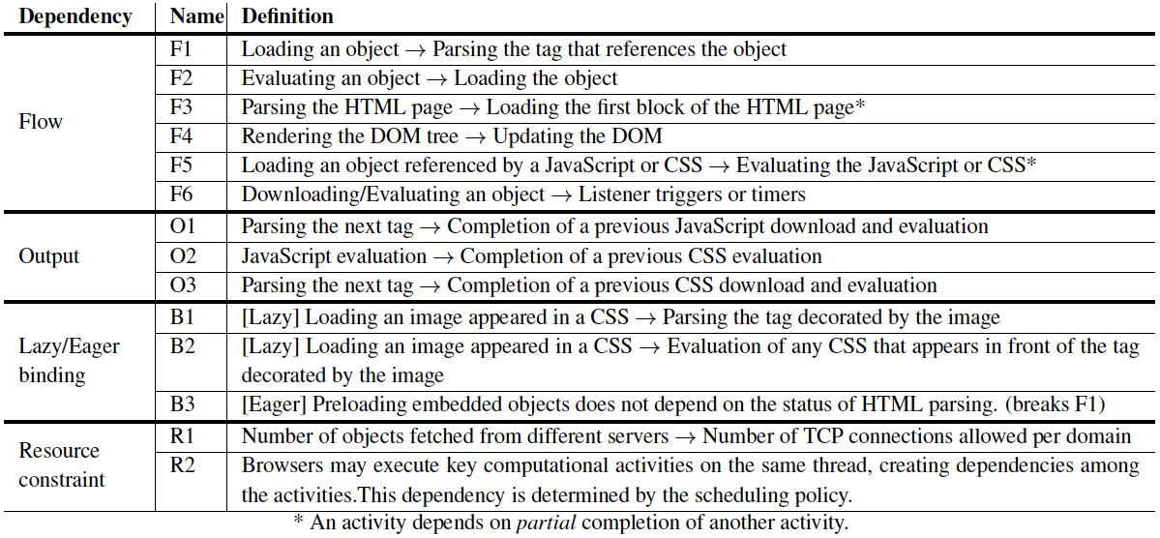
Dependency policies
Notes:
Just flash
any way to summarize it? category + number

Slide 24
Dependency policies across browsers
Dependency | IE | Firefox | WebKit
Output | all | no O3 | no O3
Late binding | all | all | all
Eager binding | Preloads img, js, css | Preloads img, js, css | Preloads css, js
Net resource | 6 conn. | 6 conn. | 6 conn.
O3: CSS downloads and evaluation block HTML parsing.
Notes:
explicitly say other browsers don't do this...

Slide 25
Overview
Extract dependency policies
WProf: Compute bottleneck for a given page structure
Study page load on real pages
Notes:
have a sense of what people get out of WProf: figure out the bottlenecks of plt
bring the notion of critical path analysis to the front
* Identifying bottlenecks with WProf --> automating ...

Slide 26
WProf architecture
Browser Stack
Web page instances
Browser extension/plug-in framework
Native browser
Notes:
rather than doing it in portable ... we decide to do it in the native browser. the tradeoff
say on webkit when we mention native app

Slide 27
WProf architecture
Browser Stack
Web page instances
Browser extension/plug-in framework
Native browser
WProf profiler
Object Loader
HTML Parser
CSS Engine
JavaScript Engine
Rendering Engine

Slide 28
WProf architecture
Browser Stack
Web page instances
Browser extension/plug-in framework
Native browser
WProf profiler
Object Loader
HTML Parser
CSS Engine
JavaScript Engine
Rendering Engine
Activity timing
Dependencies

Slide 29
WProf architecture
Browser Stack
Web page instances
Implementation
- Built on WebKit
- Extended in Chrome and Safari
- Written in C++
Browser extension/plug-in framework
Native browser
WProf profiler
Object Loader
HTML Parser
CSS Engine
JavaScript Engine
Rendering Engine
Activity timing
Dependencies

Slide 30
WProf architecture
Browser Stack
Web page instances
Bottleneck paths
Browser extension/plug-in framework
Native browser
Dependency graphs
WProf profiler
Object Loader
HTML Parser
CSS Engine
JavaScript Engine
Rendering Engine
Activity timing
Dependencies

Slide 31
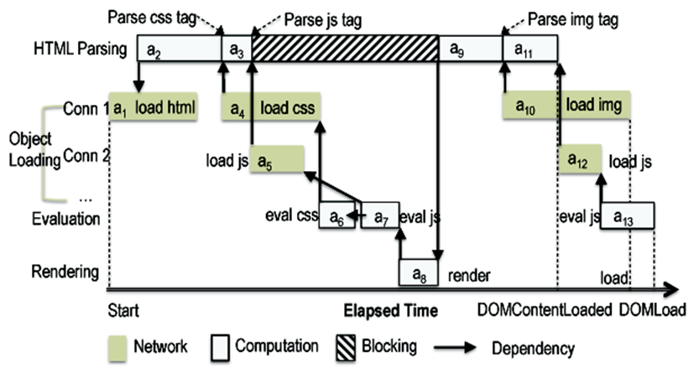
Dependency graph
<html>
<head>
<link rel="stylesheet" src="./main.css">
<script src="./main.js" />
</head>
<!--request a JS-->
<body onload="...">
<img src="test.png" />
</body>
</html>
Notes:
Just flash
say whether it's mockup or real.

Slide 32
Critical path analysis
Critical path: the longest bottleneck path.
Notes:
say what is not a bottleneck (animate) -> why CPA is important
increase an activity off the CP could change the CP
hear about non-determinism of network. CP is load-dependent, graph is page-dependent.

Slide 33
Critical path analysis
Critical path: the longest bottleneck path.
Notes:
say what is not a bottleneck (animate) -> why CPA is important
increase an activity off the CP could change the CP
hear about non-determinism of network. CP is load-dependent, graph is page-dependent.

Slide 34
Critical path analysis
Critical path: the longest bottleneck path.
Notes:
say what is not a bottleneck (animate) -> why CPA is important
increase an activity off the CP could change the CP
hear about non-determinism of network. CP is load-dependent, graph is page-dependent.

Slide 35
Critical path analysis
Critical path: the longest bottleneck path.
Notes:
say what is not a bottleneck (animate) -> why CPA is important
increase an activity off the CP could change the CP
hear about non-determinism of network. CP is load-dependent, graph is page-dependent.

Slide 36
Critical path analysis
Critical path: the longest bottleneck path.
Notes:
say what is not a bottleneck (animate) -> why CPA is important
increase an activity off the CP could change the CP
hear about non-determinism of network. CP is load-dependent, graph is page-dependent.

Slide 37
Critical path analysis
Critical path: the longest bottleneck path.
Notes:
say what is not a bottleneck (animate) -> why CPA is important
increase an activity off the CP could change the CP
hear about non-determinism of network. CP is load-dependent, graph is page-dependent.

Slide 38
Critical path analysis
Critical path: the longest bottleneck path.
Notes:
say what is not a bottleneck (animate) -> why CPA is important
increase an activity off the CP could change the CP
hear about non-determinism of network. CP is load-dependent, graph is page-dependent.

Slide 39
Critical path analysis
Critical path: the longest bottleneck path.
Notes:
say what is not a bottleneck (animate) -> why CPA is important
increase an activity off the CP could change the CP
hear about non-determinism of network. CP is load-dependent, graph is page-dependent.

Slide 40
Critical path analysis
Critical path: the longest bottleneck path.
Notes:
say what is not a bottleneck (animate) -> why CPA is important
increase an activity off the CP could change the CP
hear about non-determinism of network. CP is load-dependent, graph is page-dependent.

Slide 41
Critical path analysis
Critical path: the longest bottleneck path.
Improving activities off the critical path doesn't help page load.
Notes:
say what is not a bottleneck (animate) -> why CPA is important
increase an activity off the CP could change the CP
hear about non-determinism of network. CP is load-dependent, graph is page-dependent.

Slide 42
Overview
Extract dependency policies
WProf: Compute bottleneck of page structure
Study page load on real pages
Notes:
have a sense of what people get out of WProf: figure out the bottlenecks of plt
bring the notion of critical path analysis to the front
* Identifying bottlenecks with WProf --> automating ...

Slide 43
Experimental setup
Locations
  UW campus, DSL home, UMass campus
Browser
  WProf-instrumented Chrome
Web pages
  150 out of top 200 Alexa pages
Page load time
  Minimum out of 5 repeats
Notes:
no need to mention DOMLoad
Other settings:
Locations:
Seattle residential area
UMass campus network
Web pages: 200 random from top 1 million home pages

Slide 44
How much does the network contribute to page load time?
Notes:
As we see the in beginning of the talk that lots of optimization techniques are about improving the network, we are curious that "are we solving the right problem?"

Slide 45
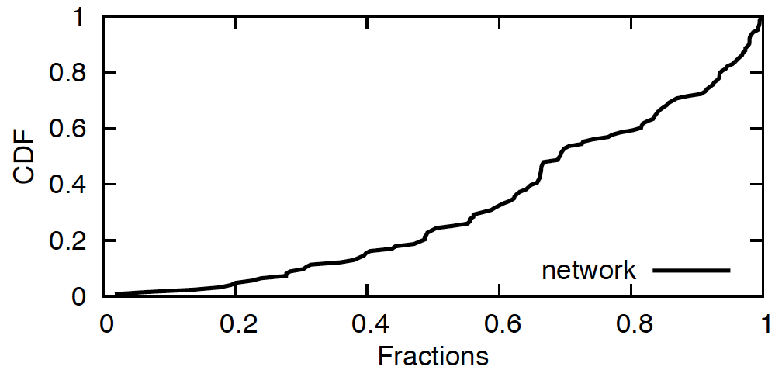
Computation is significant
Network
Computation
Network/Computation as a fraction of page load time
Notes:
Just one line.

Slide 46
Computation is significant
Network
Computation
Computation is ~35% of page load time (median) on the critical path.
Notes:
Just one line.

Slide 47
How much does caching help page load performance?
Notes:
reduces 80% of downloads
how much it helps performance xxx%
We use our WProf tool... 40% on CP

Slide 48
How much does caching help?
Caching eliminates 80% Web object loads
It doesn't reduce page load time as much
Caching only eliminates 40% Web object loads on the critical path
Notes:
reduces 80% of downloads
how much it helps performance xxx%
We use our WProf tool... 40% on CP

Slide 49
Conclusion
Understanding bottleneck is key to improving the page load process
WProf extracts page load bottlenecks at scale
WProf has potential to improve existing page load optimization techniques
Website: wprof.cs.washington.edu
Notes:
Page load is a complex process, is a result of ...
Our contribution is ...
Make the findings more surprising.

Slide 50
Overview
Extract dependency policies
Compute bottleneck performance path
Study page load on real pages
What next?
Notes:
have a sense of what people get out of WProf: figure out the bottlenecks of plt
bring the notion of critical path analysis to the front
* Identifying bottlenecks with WProf --> automating ...

Slide 51
What next with WProf?
How speedy is SPDY?
What about mobile browsers?

Slide 52
What is SPDY?
Replacement HTTP protocol by Google
  Adopted by Twitter, Amazon, Facebook,…
  Basis for HTTP/2
Key ideas:
  Multiplex HTTP over a single TCP
  Header compression
  Server push*

Slide 53
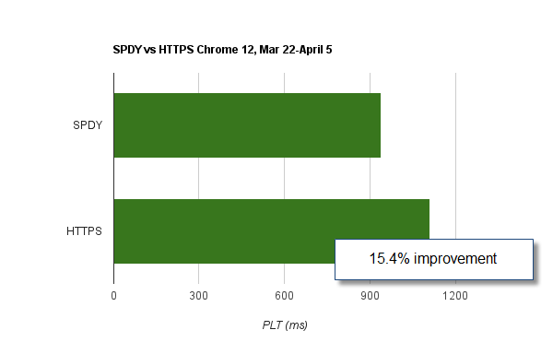
Is SPDY really speedy?
SPDY on Google’s production server
Our lab experiments

Slide 54
Where we wrong?
SPDY performance depends on many factors
  Google tunes many many parameters.
Comparing CDF across web pages insufficient
  Need to compare load times per web page
…, but there is too much variation in page load time

Slide 55
SPDY performance can vary across pages (and is variable)
Twitter
Flag page

Slide 56
Reduce variability using WProf
Epload tool
  Emulate page load process
  Include dependencies, but keep computation constant.
  Systematically experiment under varying conditions.

Slide 57
SPDY helps a lot, but can also hurt. Performance varies with network.
10ms RTT, 100 Mbps bandwidth
SPDY hurts
SPDY helps
100ms RTT, 100 Mbps bandwidth
SPDY hurts
SPDY helps

Slide 58
How to make SPDY better?
Align TCP behavior with SPDY
Use server push feature with WProf dependencies

Slide 59
Backup slides
Notes:
What to keep?

Slide 60
Does computation (e.g., HTML parsing, JavaScript evaluation) continuously happen?

Slide 61
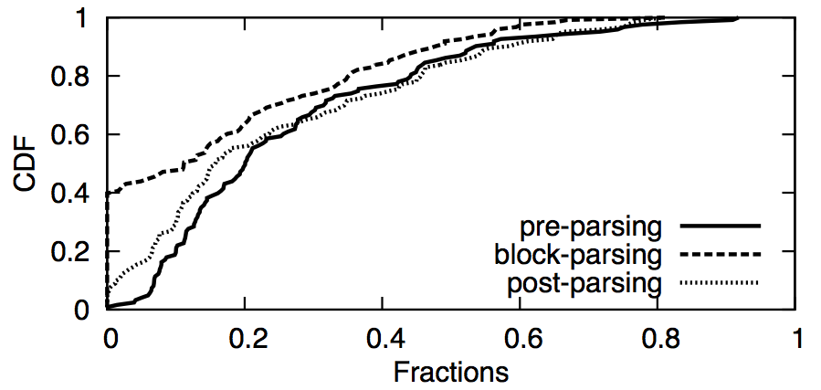
Network downloads often block parsing
60% top pages have parsing-blocking JavaScript.
Fractions of network time to total page load time
Notes:
x title

Slide 62
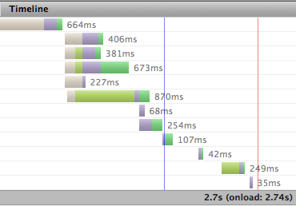
Tools to understand page load
Firebug: a "waterfall" graph of twitter.com
Other tools
  WebProphet, Google Pagespeed Insights
What is the composition of page load time?
Why is the request made at this time, not earlier?
Notes:
WebProphet, etc.

Slide 63
Many techniques aim to optimize page load time
Example: CSS image sprites
  Merging small images into a big one
  Unclear how much it helps because images are fetched in parallel
A big image
Many small images
Elapsed time
Elapsed time
...
Page load time using a big image
Page load time using small images
3
Notes:
[note] save for later
Simpler example: just two image
There are cases where sprite can be good and sprite can be bad.

Slide 64
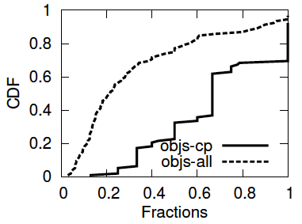
Caching doesn't help performance as much as # reduced objects
# objects reduced due to hot loads
Caching reduced 80% Web objects in overall, but only 40% on the critical path.
23
Notes:
change the key

