Slide 1
Architecting Protocols to Improve Connectivity in Diverse Mobile Networks
Aruna Balasubramanian
Department of Computer Science
University of Massachusetts Amherst
www.cs.umass.edu/~arunab

Slide 2

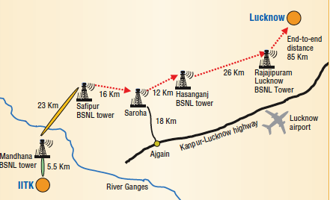
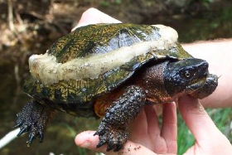
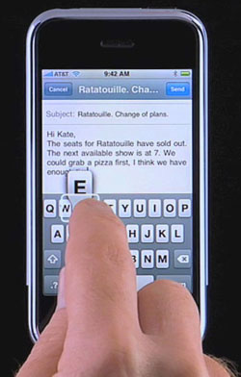

More than 3 billion mobile devices worldwide
Mobile networking supports a diverse range of applications
Extend the reach of the Internet to rural areas
Connectivity on the go
Animal monitoring
Unreliable connectivity and frequent disruptions
Notes:
Mobile devices and support for mobile access is becoming extremely common these days. More …
Mobile access is not yet ubiquious and mobile networking has not reached its potential because of a fundamental challenge in mobile network – unreliable connectivity and frequent disruptions. For example, most of us have had problems connectivity to the Internet from our cell phones. And these probalems extend to other kinds of non-cellular mobile access as well.

Slide 3
Thesis goal
Extreme uncertainty due to mobility, channel…
Architect robust protocols that overcome disruptions and enable applications in diverse mobile networks.
Each network present unique disruption and uncertainty challenge

Slide 4

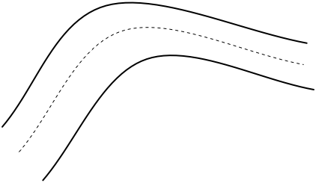

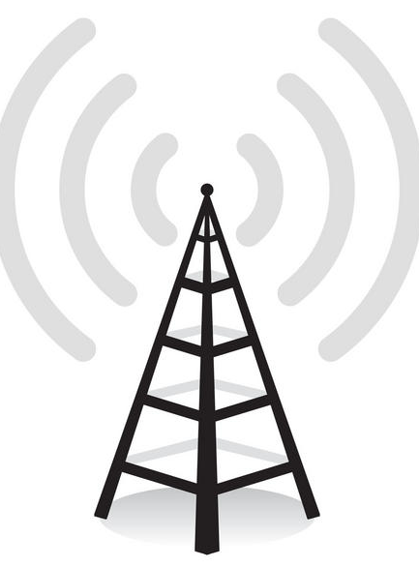



Mobile networks considered in this thesis
Mostly connected cellular
Mostly connected WiFi mesh
Intermittently
connected
Mostly
disconnected

Slide 5
Why the four networks?
Spans the connectivity spectrum
~hours
~minutes
~seconds
Disruption length
Mostly disconnected
Intermittently
connected
Mostly connected
WiFi Mesh
Cellular

Slide 6
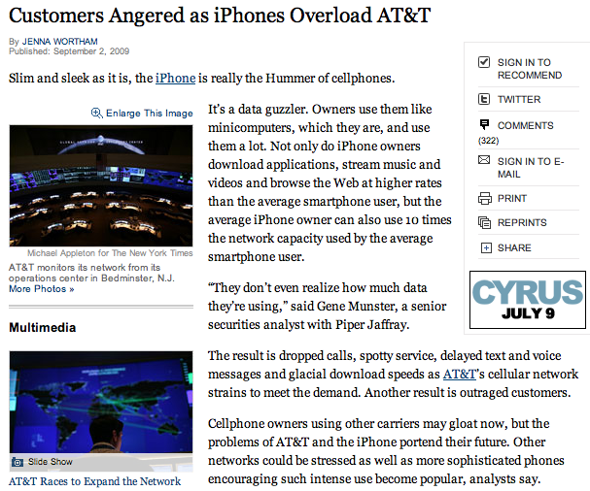
Mostly connected cellular
www.nytimes.com
Challenge: Limited spectrum
Notes:
Wy bother. Why do I want to solve the spectrum problem. Because there are millions of subscribers and this number is only increasing. They expect to get ubiquitous coverage, but because of spectrum pressure there are going to face frequent disruptions and poor application performance.

Slide 7

Mostly connected mesh
Challenge: Unpredictable channel conditions
Why bother?
  Connects entire towns with no per-user cost
  GoogleWiFi, Houston TFA, Amherst Mesh
Notes:
Disrupted for a few seconds. VoIP. The disruptions can be caused because of several reasons scuh as multipathfading, shadowing, may be there is a tree etc. The challenge is that the channel conditions are unpredictable. It is possible that an AP slightly farther has a better channel than the current AP, but it is difficult to predict this.

Slide 8
Intermittently connected network
Challenge: Uncertain connectivity and bandwidth, Application intolerance.
Why bother?
  Enable apps without a mesh or cellular infrastructure investment
  Pothole patrol, Traffic portal

Slide 9

Mostly disconnected networks (DTNs)
Challenge: Uncertain topology, no end-to-end path
Why bother?
  Enables connectivity when infrastructure is expensive
  TurtleNet, Kiosknet
Mobile users operate in diverse networks that support varied applications.
But disruptions and uncertainty are common across the networks

Slide 10
Research questions
What are the underlying reasons for disruptions and uncertainty?
What protocol design works well under uncertainty and can best overcome disruptions?

Slide 11
Thesis statement
Disruptions in diverse mobile environments can be overcome by exploiting resources opportunistically using utility-driven, probabilistic protocols.

Slide 12
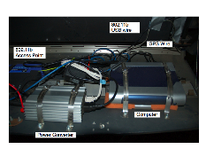
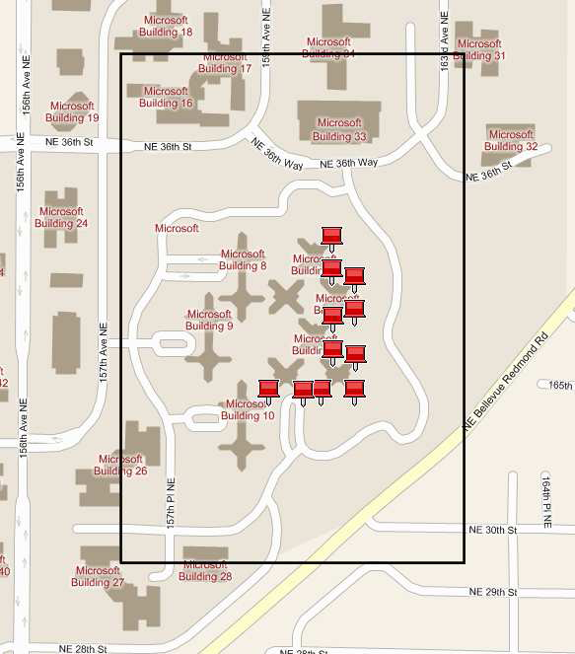
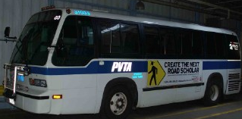
Research Methodology (1 of 2)
1. Measurement: Over two vehicular testbeds
Dome testbed: Amherst, MA
VanLAN: Redmond, WA
Dome-DTN, Dome-Intermittent, Dome-Mesh and Dome-Cellular
Spans 150 sq. mile area, operational since 2004

Slide 13
Research Methodology (2 of 2)
2. Opportunistic protocol design
3. Evaluation: Using implementation and real deployment
a. Augmented with analysis and trace-driven simulations

Slide 14
Talk outline
~hours
~minutes
~seconds
Disruption length
Mostly disconnected
Intermittently
connected
Mostly connected
WiFi Mesh
Cellular
Rapid: Opportunistic
replication
Thedu:
Aggresive
Prefetching
ViFi:
Opportunistic forwarding
Wiffler: Opportunistic augmentation

Slide 15
Wiffler [MobiSys 2010]
Problem: Spectrum pressure in cellular networks
www.nytimes.com
www.rysavy.com
Current spectrum | 409.5 MHz
Unallocated spectrum (including whitespaces) | 230 MHz
Projected demand by 2016 | 800 MHz – 1000 MHz

Slide 16
Augment 3G (cellular) with WiFi opportunistically
How much data can be offloaded to WiFi from a vehicle?
Notes:
3G is deployed to provide continous coverage. But WiFi is opportunistically available in coffee shops etc. Does a vehicle have enough WiFi access to be able to reduce the spectrum usage on 3G.

Slide 17
Joint measurement study
Measurement conducted in 3 cities: Amherst: 20 buses, Seattle: 1 car, SFO: 1 car
Vehicular nodes with 3G and WiFi (802.11b) radios
Software simultaneously sends data on 3G and WiFi
Collected more than 3000 hours of data for over 10 days
Notes:
In 3 different cities to studyWiFi availability is different environmetns

Slide 18
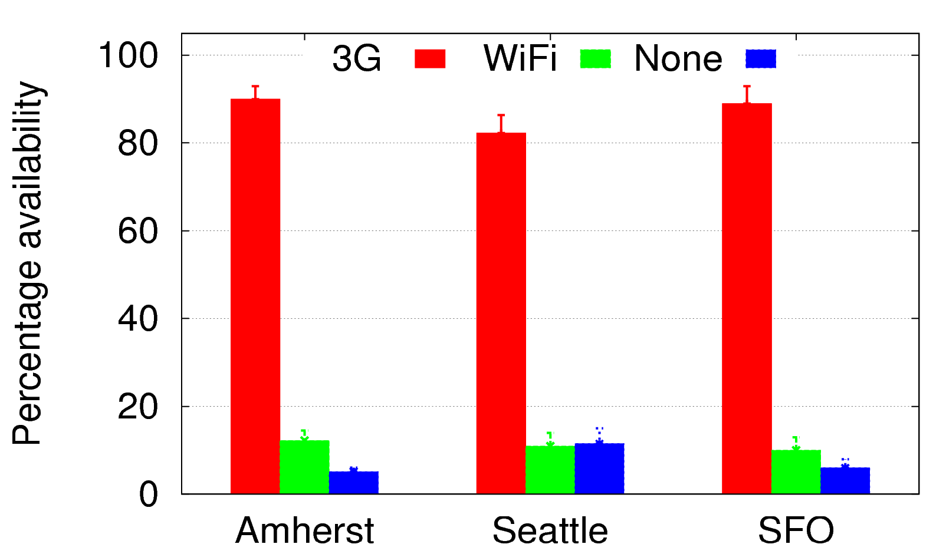
Open WiFi availability is low
Availability = # seconds when at least one packet received
/ total # seconds
85%
Availability
(%)
11%

Slide 19
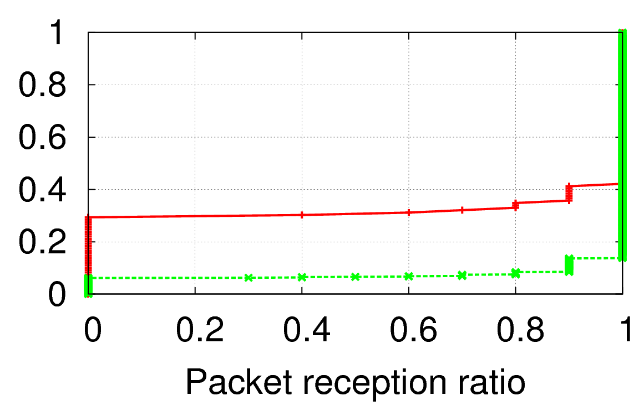
WiFi loss rate is higher
Loss rate = Number of packets lost per second out of 10 packets sent
Cumulative fraction
28%
WiFi
8%
3G
WiFi upstream and downstream throughput poorer than 3G

Slide 20
Question: When should you offload to WiFi?
Straightforward approach: Use WiFi when available
  Offloads only ~11% of the data
  Can hurt application performance because of higher loss rate and lower throughput
Goal: Maximize data offload without affecting app performance

Slide 21
Key ideas in Wiffler
Using WiFi only when available is not effective
Exploit app delay tolerance and wait to offload on WiFi
Prediction-based offloading: Wait for WiFi only when there is utility in terms of 3G savings
Using WiFi whenever available can affect applications
Fast switch to 3G when WiFi performance is poor
Related work: Vertical handoff strategies[Budhikot03, Stemm97] assume that the best performing interface is known a priori
Notes:
Utility-driven
Not worrying about energy for now.
These techniques are very simple and yet close to optimal for what they do. In the beginning, we played with some more complicated versions but found them to not worth it.

Slide 22
Prediction-based offloading (for delay tolerant applications)
D = Delay tolerance threshold (seconds)
S = Remaining data to be sent
At each second,
  If (WiFi available), send data on WiFi
  Else,
  If (W < S), send data on 3G; Else wait for WiFi.
Predicted WiFi capacity
in next D seconds

Slide 23
WiFi capacity prediction
Predict AP meetings using a simple history-based prediction
  future AP encounters depend on recent past
WiFi capacity = (expected # of APs) x (capacity per AP)
The simple prediction yields low prediction errors both in Amherst and Seattle
Related work: Breadcrumbs[Nicholson08] uses sophisticated prediction based on mobility prediction + a AP location database

Slide 24
Fast switching to 3G (for performance sensitive applications)
1. If no WiFi link-layer acknowledgment within 50ms
- Send data on 3G
2. Else, continue sending on WiFi
Motivation: WiFi link layer retransmissions causes delay and WiFi losses are bursty
Notes:
A different way of bonding multiple interfaces

Slide 25
Evaluation Roadmap
Prediction-based offloading (file transfer application)
- Deployment on 20 vehicular nodes
- Trace driven evaluation using Amherst and Seattle data
Fast switching (VoIP application)
- Deployment on 1 vehicle; in Amherst town center
- Trace driven evaluation using data collected when vehicle sends/receives VoIP-like traffic

Slide 26
Deployment results
 | Data offloaded to WiFi
Wiffler’s prediction-based offloading | 30%
WiFi when available | 10%
File transfer size: 5MB; Delay tolerance: 60 secs
 | % time good voice quality
Wiffler’s fast switching | 68%
WiFi when available (no switching) | 42%
VoIP-like traffic: 20-byte packet every 20 ms

Slide 27
Trace-driven evaluation of prediction-based offloading
Validate simulator by comparing with deployment results
Vary workload, AP density, delay tolerance
Alternate strategies to prediction-based offloading:
  Wifi when available
  Breadcrumbs: Sophisticated prediction using mobility prediction + AP location database
  Oracle (Impractical): Perfect prediction with future knowledge

Slide 28
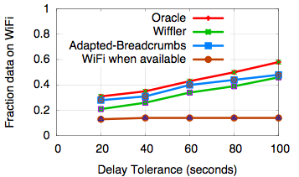
Wiffler increases data offloaded to WiFi
Workload: Web traces obtained from commuters
Web browsing workload obtained from real vehicular users
Wiffler close to oracle
Sophisticated prediction does not help
42%
14%
Wiffler increased app delay by 10 seconds over oracle.

Slide 29
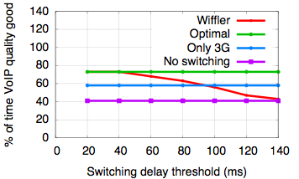
Trace-driven evaluation of fast switching
20 bytes packets every 20 ms, based on G.729 codec
73%
58%
40%
  Wiffler opportunistically augments 3G with WiFi without affecting apps using (1) prediction-based offloading and(2) fast switching
30% of data was offloaded to WiFi for 40 ms switching threshold

Slide 30
Talk outline
~hours
~minutes
~seconds
Disruption length
Mostly disconnected
Intermittently
connected
Mostly connected
WiFi Mesh
Cellular
Rapid: Opportunistic
replication
Thedu:
Aggresive
Prefetching
ViFi:
Opportunistic forwarding
Wiffler: Opportunistic augmentation

Slide 31
ViFi [Sigcomm 08]
Challenge: Unpredictable channel conditions
Idea: Leverage opportunistic forwarding

Slide 32
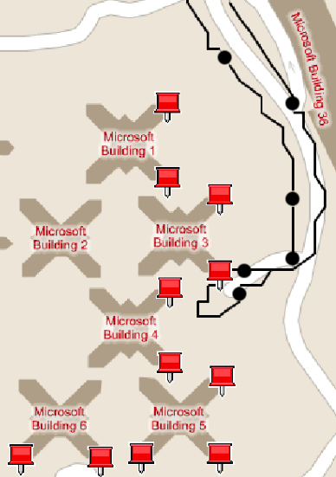
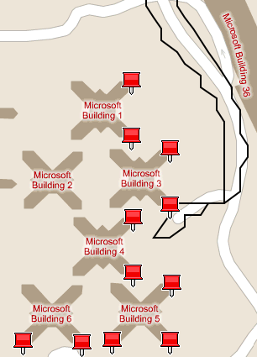
Measurement study on VanLAN and Dome
Disruption
Today’s WiFi
Opportunistic forwarding (ideal)

Slide 33
Opportunistic forwarding in practice
Resource management question: Which APs should forward the packets?
Goal : Fast coordination
Related work
  Divert [Miu05] assumes unlimited bandwidth
  ExOR [Biswas05], MORE [Chachulski07] that batch packets
Internet
ViFi solution: Use probabilistic forwarding

Slide 34
ViFi’s probabilistic forwarding
A
Probabilistic forwarding:
A and B forward packets with probabilities R_{A} and R_{B}
Source
Dest
B
No ack
C
    Estimate forwarding probabilities is a tradeoff between
    Having too many forwarders: overload the network
    Having too few forwarders: no forwarding
Notes:
Utility-driven sender prioritization

Slide 35
ViFi problem formulation
    Guidelines
    Account for forwarding decisions made by other neighbors.
    Prefer APs with better connectivity to the destination.
    Limit the expected number of forwarded transmissions.
Objective: Each individual AP forwards such that
Collectively, the expected number of forwarders is 1, and
Forwarding probability is weighted according to AP connectivity

Slide 36
    How does B compute its forwarding probability R_{B}?
    Step 1:
    (a) Estimate prob that A is considering forwarding
      C_{A} = P(A overheard packet) . P(A did not overhear ack from dest)
    (b) Expected relays: E(A) = C_{A} . R_{A}
    Step 2:
    Solve the equation ∑ E(X) = 1, for all neighbors
    Step 3:
    Set R_{x} proportional to P(X can deliver the packet)
C_{A}.R_{A} + C_{B}.R_{B} + C_{c}.R_{C} = 1 where R_{A}, R_{B} are R_{c} unknowns

Slide 37
ViFi deployment and evaluation
Implemented and deployed ViFi in VanLAN
  Trace-driven simulations in Dome
Evaluation criteria
  Does ViFi reduce disruptions?
  Does ViFi improve performance of interactive applications?
  Is ViFi’s probabilistic forwarding efficient?

Slide 38
ViFi improves VoIP performance
20 byte packets every 20ms according to G.279 codec
Average length of call before disruption (sec)
> 100%
ViFi
Today’s WiFi
  ViFi enables interactive applications using a probabilistic algorithm to implement opportunistic forwarding

Slide 39
Talk outline
~hours
~minutes
~seconds
Disruption length
Mostly disconnected
Intermittently
connected
Mostly connected
WiFi Mesh
Cellular
Rapid: Opportunistic
replication
Thedu:
Aggresive
Prefetching
ViFi:
Opportunistic forwarding
Wiffler: Opportunistic augmentation

Slide 40
Thedu [Mobicom 2008]
Problem : Intermittent connectivity due to coverage holes; lack of application support

Slide 41
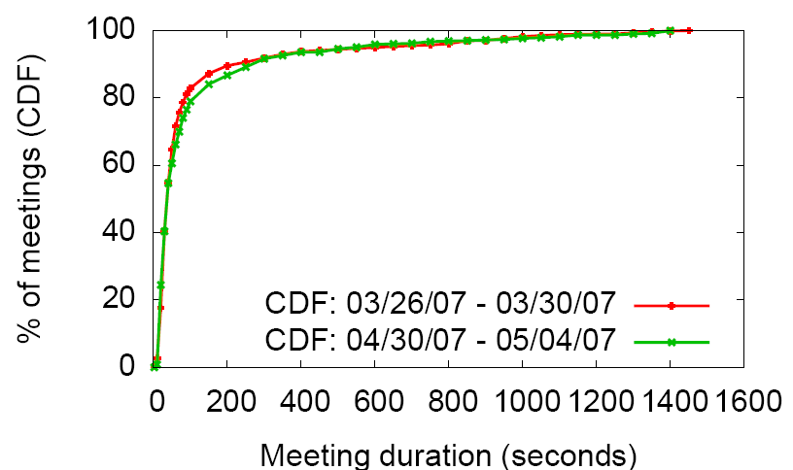
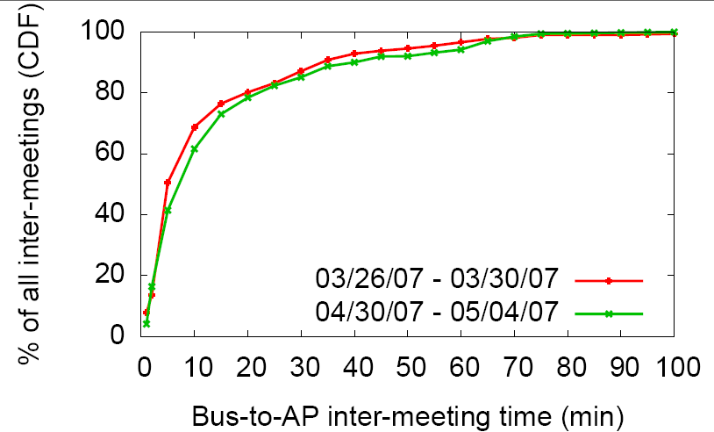
Measurement over Dome testbed
30 sec
  Goal: To enable web search in Intermittently connected networks
8 mins

Slide 42



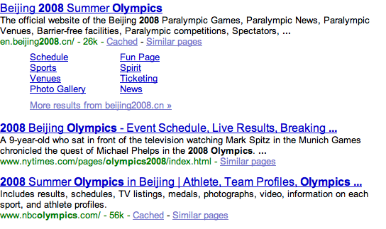
Web search process
<your favorite search engine>
Retrieving….
Retrieving….

Slide 43
Adapting web search
Key idea: Aggressively prefetch web pages
Resource management question: How to prioritize web pages during short bandwidth opportunity?
  Is the 7th web page retrieved for query q1 more important than the 5th web page retrieved for query q2?
Notes:
This is opportunistic mechanism is that whenever the vehicle does not know when it will get connectivity, but when it does, it downloads the prefetched web pages.

Slide 44
Thedu’s utility-driven prioritization
Use query-type classification to remove web pages that are not useful
For the remaining web pages
  Estimate probability that a web page is relevant to a query using IR techniques
  (Vehicles) Download web pages according to the probabilities

Slide 45
Deployment on Dome
  Queries generated at the rate of 10/hour/bus
Relevant
Web pages
Thedu
Today’s web
search
  Mean delay in receiving relevant web pages = 2.3 min
  Mean delay in Amherst town center = 33 seconds
  Thedu enables web search using a utility-driven prioritization algorithm to implement aggressive prefetching

Slide 46
Talk outline
~hours
~minutes
~seconds
Disruption length
Mostly disconnected
Intermittently
connected
Mostly connected
WiFi Mesh
Cellular
Rapid: Opportunistic
replication
Thedu:
Aggresive
Prefetching
ViFi:
Opportunistic forwarding
Wiffler: Opportunistic augmentation

Slide 47

RAPID [Sigcomm 07, ToN 10]
  Challenge: Uncertain topology, Lack of end-to-end path
  Idea: Opportunistic replication
City
Village
How to control replication in a resource-constrained environment?
Notes:
Indiscriminate replication can waste bandwidth and hurt performance.

Slide 48
DTN routing as a resource allocation problem
Resource: Bandwidth during a transfer opportunity
How to allocate the limited bandwidth resource to packets to optimize a routing metric?
OR
Resource management question: What subset of packets to replicate to optimize a specified routing metric?
Y
X
X
Notes:
User vs System-wide metric.
Organizational.

Slide 49
How to optimize a specified routing metric?
Using a utility-driven algorithm
Translate routing metric to per-packet utility function
Replicate packet with highest improvement in utility
  RAPID is instantiated for three routing metrics: Avg delay, Worse case delay, and Delivery within a deadline.
  RAPID can be implemented in a decentralized environment.

Slide 50
Fundamental results in DTN routing
Computation hardness result: With complete knowledge
  DTN routing is NP Hard
  Lower bound on approximability √n
Competitive hardness result: With partial knowledge
  Any DTN routing protocol can perform arbitrarily far from optimal
Empirically, RAPID is within 10% of optimal for low load for which we could compute optimal

Slide 51
Evaluation
Deployed RAPID on the Dome testbed for 58 days
  Validated trace-driven simulator using deployment results
Trace-driven experiments
  RAPID outperforms state-of-the-art DTN routing protocols for three different metrics
RAPID is a DTN routing protocol that uses an utility-driven algorithm to implement opportunistic replication.

Slide 52
Summary
Goal: Reduce disruptions and enable applications in diverse networks
Mostly disconnected
Intermittently
connected
Mostly connected
WiFi Mesh
Cellular
Rapid:
Bulk transfer/ Email using
replication
Thedu:
Web search using aggressive prefetching
ViFi:
VoIP using opportunistic forwarding
Wiffler: Reduces cellular load using augmentation
Deployment/Evaluation shows that the protocols can be implemented in realistic usage environments

Slide 53
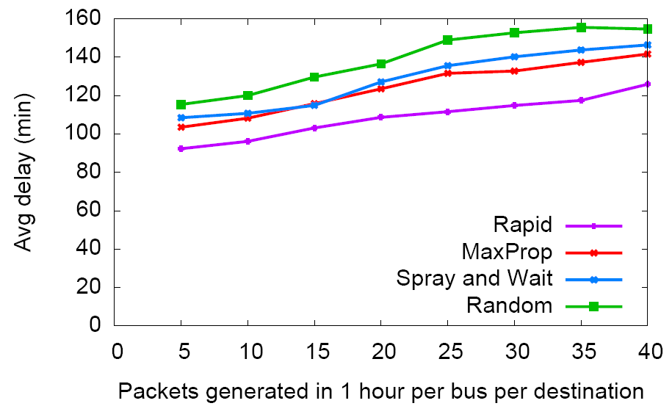
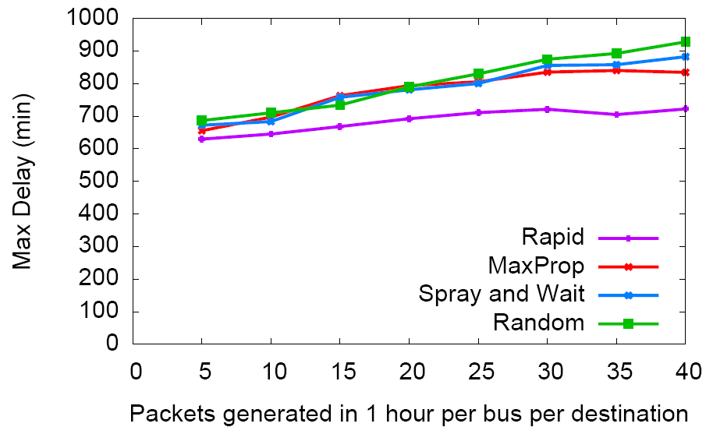
Trace-driven simulation results
Metric: Minimizing average delay
Metric: Minimizing max delay
Utility-driven resource allocation protocol that can be tuned according to a given metric

Slide 54

Wiffler Implementation
Wiffler proxy
Offloading in upstream and downstream, but fast switching only upstream
Implemented using a low level signaling mechanism
Notes:
A proxy is coming for a host of other reasons as well.

Slide 55
Why is relaying is effective?
Bursty losses: Source retransmissions may not be effective
Most losses are path dependant, not receiver dependant
A
Source
Dest
B
C

Slide 56
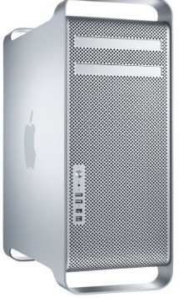
Query normalization
Search engine often rank web page for a single query using relevance scores
  Scores not comparable across queries
q2
…
Queries q1, q2
q1
…
…
Thedu’s query normalization technique:using Kullback Leibler divergence

Slide 57
Query-type classification
Query types
  Homepage query: “cnn”, “chants 2007”
  Non-homepage query: “Harry potter review”
Classification
  Using URL and snippets of retrieved documents
  Classification algorithm trains on certain features
  Classification accuracy: 88%

Slide 58
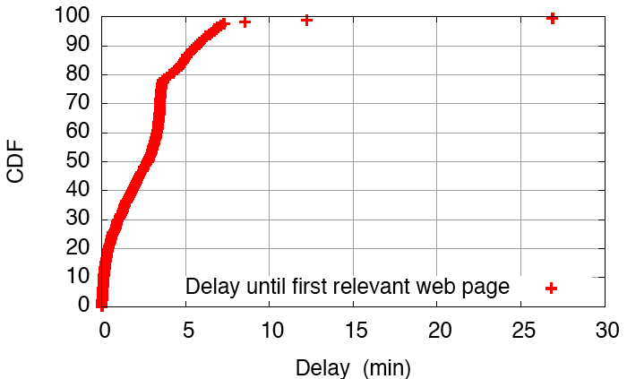
Delay in receiving relevant web page

