Slide 1
Predicting Emergent Behavior in
Cardiac Tissue: A Grand Challenge
Radu Grosu SUNY at Stony Brook
Joint work with
Ezio Bartocci, Gregory Batt, Flavio H. Fenton,
James Glimm, Colas Le Guernic, and Scott A. Smolka

Slide 2
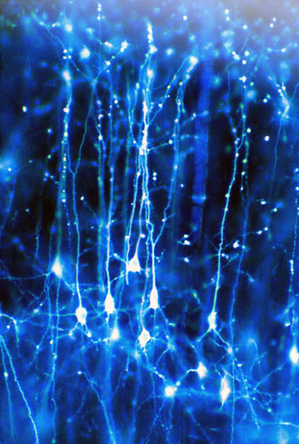
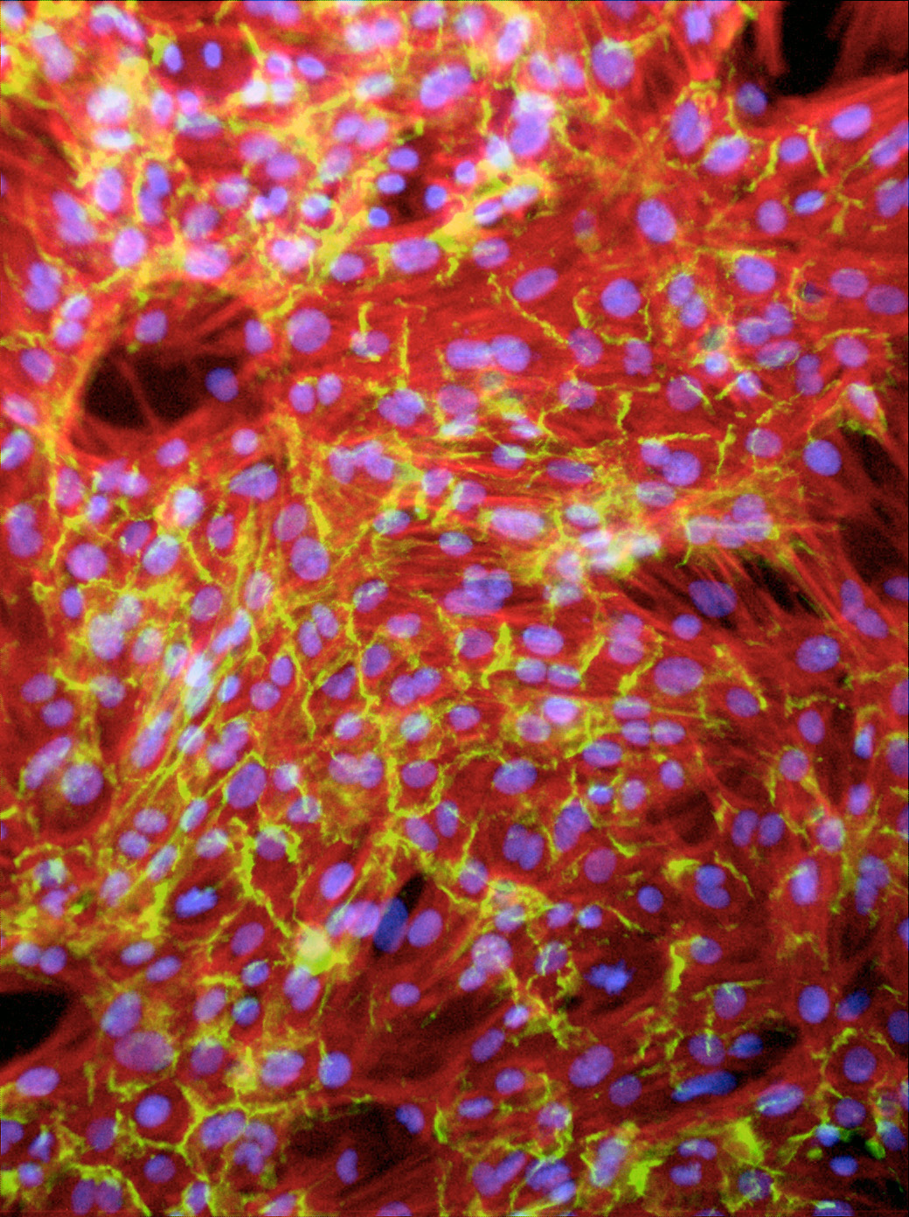
Excitable Cells
Generate action potentials (elec. pulses) in response to electrical stimulation
Examples: neurons, cardiac cells, etc.
Local regeneration allows electric signal propagation without damping
Building block for electrical signaling in brain, heart, and muscles
Neurons of a squirrel
University College London
Artificial cardiac tissue
University of Washington
Notes:
Excitable cells are cells that generate electrical pulses,
called Action Potentials in response to electrical stimulation.
- Examples are neurons, cardiac muscle cells.
It's currently possible to grow cardiac cells in the laboratory, but the result is random and disordered. To be useful, the cells must be organized so they can work together as functioning tissue.
This photograph shows the neurons of a ground squirrel. The specimen was prepared by Professor Brian Boycott using the Golgi technique and was photographed by Dr Jonathan Clarke of UCL Anatomy and Developmental Biology. The department uses sophisticated imaging techniques and molecular genetics to study the development of the brain in vertebrate embryos.

Slide 3
Single Cell Reaction: Action Potential
Membrane’s AP depends on:
Stimulus (voltage or current):
External / Neighboring cells
Cell itself (excitable or not):
State / Parameters value
Schematic Action Potential
nonlinear
voltage
Tissue: Reaction / diffusion
Threshold
Stimulus
failed initiation
Resting potential
Behavior
In time
Reaction
Diffusion
time

Slide 4
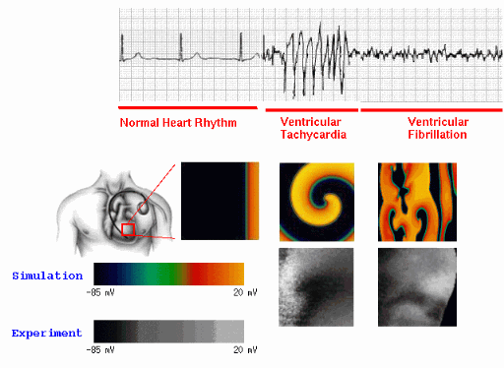
Emergent Behavior in Cardiac Cells
EKG
Normal Heart Rhythm
Ventricular
Tachycardia
Ventricular
Fibrillation
Surface
Simulation
Optical
Mapping
Arrhythmia afflicts more than 3 million Americans alone
Notes:
The particular topic I will address, is Learning and
Detecting Emergent Behavior in Cardiac Cells.
The five videos above show Normal Heart Rhythm,
Tachycardia and Fibrillation. Captured either through
Simulation or with Optical Mapping. The top Figure
shows the corresponding Electro Cardiogram.

Slide 5
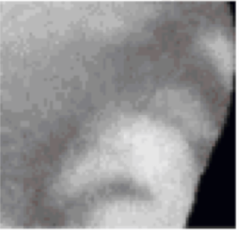
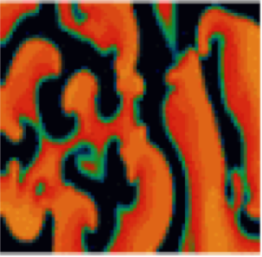
The Grand SB-Challenge
Identify (Learn)
Model Parameters
PersonalOptical
Map
Faithful
Simulation
Control / Change
Model Parameters
PersonalOptical
Map
Faithful
Simulation
Control / Cure
Disorder
Notes:
The particular topic I will address, is Learning and
Detecting Emergent Behavior in Cardiac Cells.
The five videos above show Normal Heart Rhythm,
Tachycardia and Fibrillation. Captured either through
Simulation or with Optical Mapping. The top Figure
shows the corresponding Electro Cardiogram.

Slide 6
Human Cardiac-Cell Models
Orovio-Cherry-Fenton-08
Minimal Ionic Model
Variables: 4
Parameters: 27
Maesoscopic behavior
Sigmoidal ODE (Luo-Rudi)
reaction abstraction
Tusscher-Noble²-Panfilov-03
Less Detailed Ionic Model
Variables: 17
Parameters: 44
Recent experimental data
Sigmoidal ODE (Luo-Rudi)
reaction abstraction
Iyer-Mazhari-Winslow-04
Most Detailed Ionic Model
Variables: 67
Parameters: 94
Latest experimental data
Multi-affine ODE (MA law)
Notes:
The particular topic I will address, is Learning and
Detecting Emergent Behavior in Cardiac Cells.
The five videos above show Normal Heart Rhythm,
Tachycardia and Fibrillation. Captured either through
Simulation or with Optical Mapping. The top Figure
shows the corresponding Electro Cardiogram.

Slide 7
Reaction Abstraction (SPT)
Orovio-Cherry-Fenton-08
Variables: 4
Parameters: 27
reaction abstraction
Tusscher-Noble²-Panfilov-03
Variables: 17
Parameters: 44
reaction abstraction
Iyer-Mazhari-Winslow-04
Variables: 67
Parameters: 94
Notes:
The particular topic I will address, is Learning and
Detecting Emergent Behavior in Cardiac Cells.
The five videos above show Normal Heart Rhythm,
Tachycardia and Fibrillation. Captured either through
Simulation or with Optical Mapping. The top Figure
shows the corresponding Electro Cardiogram.

Slide 8
Simulation: Hardware and Dimension
Multi-Core
Orovio-Cherry-Fenton-08
Variables: 4
Parameters: 27
1s – ?s
reaction abstraction
Tusscher-Noble²-Panfilov-03
Variables: 17
Parameters: 44
NVIDIA GPU
reaction abstraction
Iyer-Mazhari-Winslow-04
Variables: 67
Parameters: 94
1s – 1s
Notes:
The particular topic I will address, is Learning and
Detecting Emergent Behavior in Cardiac Cells.
The five videos above show Normal Heart Rhythm,
Tachycardia and Fibrillation. Captured either through
Simulation or with Optical Mapping. The top Figure
shows the corresponding Electro Cardiogram.

Slide 9
Simulation: Hardware and Dimension
Orovio-Cherry-Fenton-08
Variables: 4
Parameters: 27
NVIDIA GPU
reaction abstraction
Tusscher-Noble²-Panfilov-03
Variables: 17
Parameters: 44
reaction abstraction
Iyer-Mazhari-Winslow-04
1s – 20s
Variables: 67
Parameters: 94
Notes:
The particular topic I will address, is Learning and
Detecting Emergent Behavior in Cardiac Cells.
The five videos above show Normal Heart Rhythm,
Tachycardia and Fibrillation. Captured either through
Simulation or with Optical Mapping. The top Figure
shows the corresponding Electro Cardiogram.

Slide 10
Simulation: Hardware and Dimension
Orovio-Cherry-Fenton-08
NVIDIA GPU
Variables: 4
Parameters: 27
reaction abstraction
Tusscher-Noble²-Panfilov-03
Variables: 17
Parameters: 44
reaction abstraction
Iyer-Mazhari-Winslow-04
1s – 40s
Variables: 67
Parameters: 94
Wrong Behavior!
Notes:
The particular topic I will address, is Learning and
Detecting Emergent Behavior in Cardiac Cells.
The five videos above show Normal Heart Rhythm,
Tachycardia and Fibrillation. Captured either through
Simulation or with Optical Mapping. The top Figure
shows the corresponding Electro Cardiogram.

Slide 11
Param. Estim: Hardware and Dimension
Orovio-Cherry-Fenton-08
Variables: 4
Parameters: 27
Hardware matters:
reaction abstraction
?
Implem. SpaceEx in CUDA
Extend SpaceEx to MA ODE
Tusscher-Noble²-Panfilov-03
Variables: 17
Parameters: 44
Dimension matters:
Work on OCF model (MRM)
MRM still intractable
Will talk about our approach
reaction abstraction
?
Iyer-Mazhari-Winslow-04
Variables: 67
Parameters: 94
Notes:
The particular topic I will address, is Learning and
Detecting Emergent Behavior in Cardiac Cells.
The five videos above show Normal Heart Rhythm,
Tachycardia and Fibrillation. Captured either through
Simulation or with Optical Mapping. The top Figure
shows the corresponding Electro Cardiogram.

Slide 12
Lack of Excitability: Implications
Stimulus: bottom row, every 300ms
No Obstacle
Obstacle of UT

Slide 13
Problem to Solve
What circumstances lead to a loss of excitability?
What parameter ranges reproduce loss of excitability?
Experimental
Data
Minimal
Resistor Model
Minimal Conductor Model
RoverGene
Analysis Tool
Minimal
Multi-Affine Model
Notes:
Excitable cells are cells that generate electrical pulses,
called Action Potentials in response to electrical stimulation.
- Examples are neurons, cardiac muscle cells.
It's currently possible to grow cardiac cells in the laboratory, but the result is random and disordered. To be useful, the cells must be organized so they can work together as functioning tissue.
This photograph shows the neurons of a ground squirrel. The specimen was prepared by Professor Brian Boycott using the Golgi technique and was photographed by Dr Jonathan Clarke of UCL Anatomy and Developmental Biology. The department uses sophisticated imaging techniques and molecular genetics to study the development of the brain in vertebrate embryos.

Slide 14
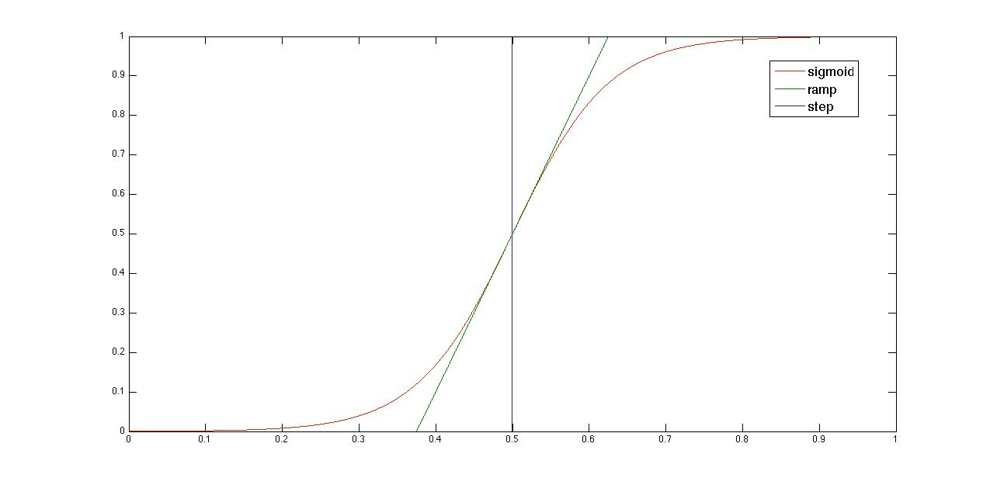
Biological Switching

Slide 15
Minimal Resistor Model: Voltage ODE
Voltage
Rate
Diffusion
Laplacian
Fast input
current
Slow input
current
Slow output
current

Slide 16
MRM: Currents Equations
Heaviside
(step)
Constant
Resistance
Piecewise
Nonlinear
Piecewise
Bilinear
Piecewise
Resistance
Sigmoidal
Resistance
Piecewise
Nonlinear

Slide 17
MRM: Gates ODEs
Piecewise
Resistance
Sigmoidal
Resistance
Sigmoid
Piecewise
Resistance

Slide 18
MRM: Voltage-Controlled Resistances/SSV
Piecewise
Constant
Sigmoidal
Piecewise
Constant
Piecewise
Linear

Slide 19
MRM: Scaled Steps and Sigmoids
Piecewise
Constant
Sigmoidal

Slide 20
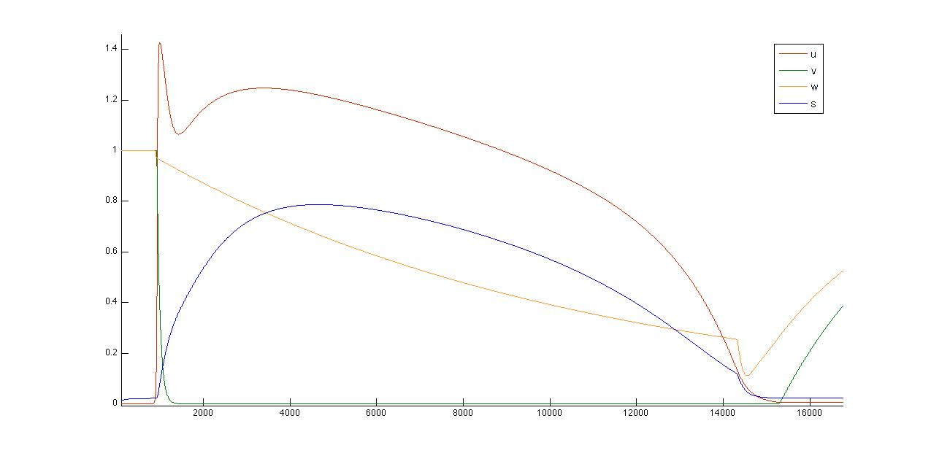
Minimal Resistance Model (MRM)

Slide 21
Sigmoid Closure Property
Theorem: For ab > 0, scaled sigmoids are closed
under the reciprocal operation:
Proof:
b
b-a
a

Slide 22
Sigmoid Reciprocal Closure
Theorem: For a*b > 0, scaled sigmoids are closed
under the reciprocal operation:
Proof:

Slide 23
From Resistances to Conductances
Removing Divisions using Sigmoid Reciprocal:
Removing Divisions using Step Reciprocal:

Slide 24
Minimal Conductance Model (MCM)

Slide 25
Gene Regulatory Networks (GRN)
GRN canonical sigmoidal form:
where:
Note: steps and ramps are sigmoid approximations

Slide 26
Optimal Polygonal Approximation
Given: One nonlinear curve and desired # segments
Find: Optimal polygonal approximation
Example: What is the optimal polygonal approxima-
tion of the blue curve with 3 segments ?
Dynamic Programming Algorithm
Complexity: O(P²)
P: # points of the curve
M. Salotti, Pattern Recognition Letters 22 (2001), Pag 215-221

Slide 27
Globally-Optimal Polygonal Approximation
Given: Set of nonlinear curves and desired # of segments
Find: Globally optimal polygonal approximation
Example: What is the optimal polygonal approxima-
tion of the curves below with 5 segments ?
Combining the two we obtain 8 segments and not 5 segments
Solution: modify the OPAA to minimize the maximum
error of a set of curves simultaneously.

Slide 28
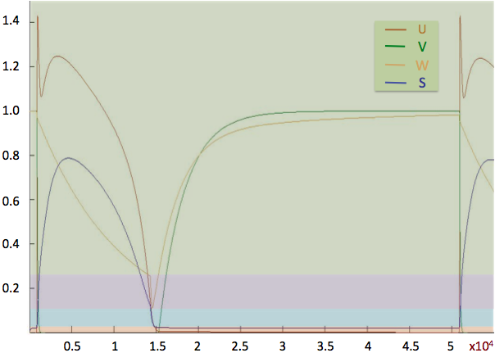
Deriving the Piecewise Multi-Affine Model

Slide 29
Deriving the Piecewise Multi-Affine Model

Slide 30
Deriving the Piecewise Multi-Affine Model

Slide 31
Deriving the Piecewise Multi-Affine Model

Slide 32
Deriving the Piecewise Multi-Affine Model

Slide 33
Deriving the Piecewise Multi-Affine Model

Slide 34
2D Comparison

Slide 35
Analysis Problem
Find parameter ranges reproducing non-excitability:
Restated as an LTL formula:
Initial region:
Uncertain parameter ranges:
Stimulus:
Notes:
Excitable cells are cells that generate electrical pulses,
called Action Potentials in response to electrical stimulation.
- Examples are neurons, cardiac muscle cells.
It's currently possible to grow cardiac cells in the laboratory, but the result is random and disordered. To be useful, the cells must be organized so they can work together as functioning tissue.
This photograph shows the neurons of a ground squirrel. The specimen was prepared by Professor Brian Boycott using the Golgi technique and was photographed by Dr Jonathan Clarke of UCL Anatomy and Developmental Biology. The department uses sophisticated imaging techniques and molecular genetics to study the development of the brain in vertebrate embryos.

Slide 36
State Space Partition
Hyperrectangles: 4 dimensional (uv-projection)
Arrows: indicate the vector field
Notes:
Excitable cells are cells that generate electrical pulses,
called Action Potentials in response to electrical stimulation.
- Examples are neurons, cardiac muscle cells.
It's currently possible to grow cardiac cells in the laboratory, but the result is random and disordered. To be useful, the cells must be organized so they can work together as functioning tissue.
This photograph shows the neurons of a ground squirrel. The specimen was prepared by Professor Brian Boycott using the Golgi technique and was photographed by Dr Jonathan Clarke of UCL Anatomy and Developmental Biology. The department uses sophisticated imaging techniques and molecular genetics to study the development of the brain in vertebrate embryos.

Slide 37
Embedding Transition System T_{X}(p)
Notes:
Excitable cells are cells that generate electrical pulses,
called Action Potentials in response to electrical stimulation.
- Examples are neurons, cardiac muscle cells.
It's currently possible to grow cardiac cells in the laboratory, but the result is random and disordered. To be useful, the cells must be organized so they can work together as functioning tissue.
This photograph shows the neurons of a ground squirrel. The specimen was prepared by Professor Brian Boycott using the Golgi technique and was photographed by Dr Jonathan Clarke of UCL Anatomy and Developmental Biology. The department uses sophisticated imaging techniques and molecular genetics to study the development of the brain in vertebrate embryos.

Slide 38
The Discrete Abstraction T_{R}(p)
Notes:
Excitable cells are cells that generate electrical pulses,
called Action Potentials in response to electrical stimulation.
- Examples are neurons, cardiac muscle cells.
It's currently possible to grow cardiac cells in the laboratory, but the result is random and disordered. To be useful, the cells must be organized so they can work together as functioning tissue.
This photograph shows the neurons of a ground squirrel. The specimen was prepared by Professor Brian Boycott using the Golgi technique and was photographed by Dr Jonathan Clarke of UCL Anatomy and Developmental Biology. The department uses sophisticated imaging techniques and molecular genetics to study the development of the brain in vertebrate embryos.

Slide 39
Computing T_{R}(p)
Theorem: If f is multi-affine then
Corollary:

Slide 40
Partitioning the Parameter Space
In each vertex: affine equation in the parameters
Parameter space: 4 dimensional (g_{o1}/g_{o2} projection)
Each rectangle: a different transition system

Slide 41
Results
Rovergene: intelligently explores the PS rectangles
independent
linearly dependent
simulation

Slide 42
Conclusions and Outlook
First automatic parameter-range identification for CC
Validated both in MCM and MRM
Can be validated experimentally as for ischemia
Currently work on time-dependent properties of CC
Extend SpaceEx with RoverGene MA-techniques
Moving towards 2D/3D parameter-range identification
Use PS partitioning, simulation and curvature analysis
Derive the MRM from Iyer model through TS abstraction

