Slide 1


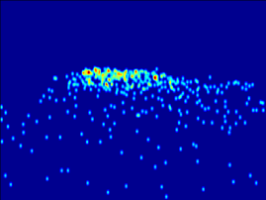
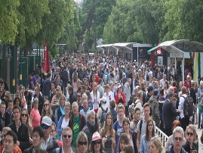
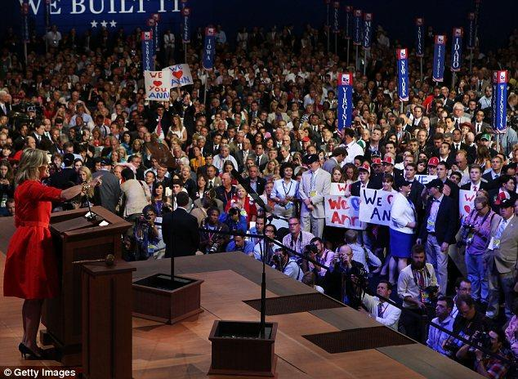
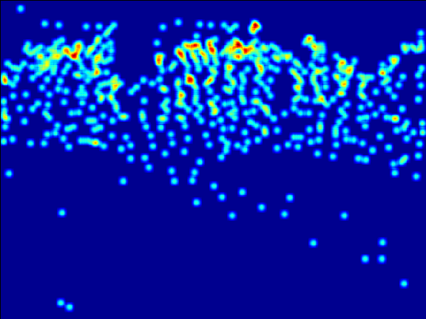
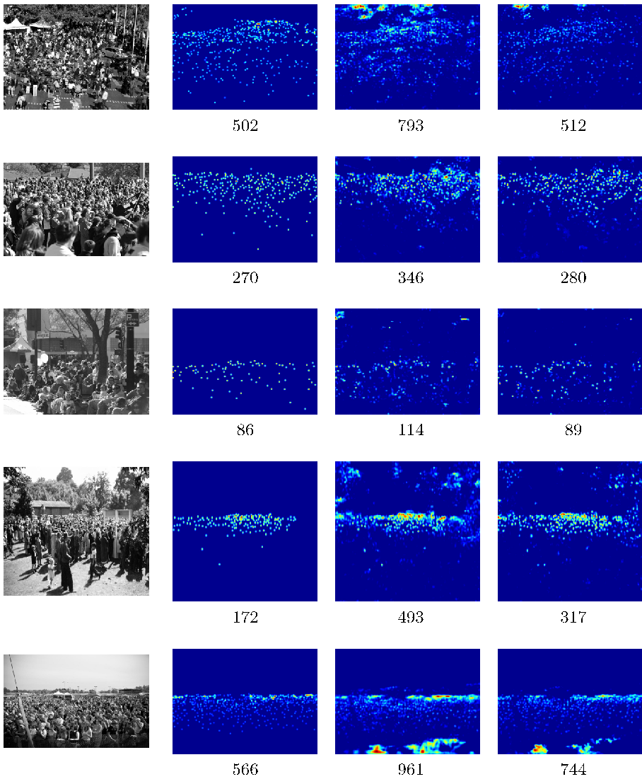
Iterative Crowd Counting
Viresh Ranjan, Hieu Le, Minh Hoai
Department of Computer Science, Stony Brook University
Introduction
Iterative Counting CNN
Results
We present a method for crowd counting via density estimation
Datasets
  ShanghaiTech [2], UCF CC [5], World Expo [11]
Evaluation metrics
  Mean Absolute Error (MAE), Root Mean Squared Error (RMSE)
Results on ShanghaiTech Part A & Part B
Ablation study on ShanghaiTech Part A
512 people
Approach | Part A |  | Part B
 | MAE | RMSE | MAE | RMSE
Crowd CNN [9] | 181.8 | 277.7 | 32.0 | 49.8
MCNN [2] | 110.2 | 173.2 | 26.4 | 41.3
Switch CNN [3] | 90.4 | 135.0 | 21.6 | 33.4
CP-CNN [4] | 73.6 | 106.4 | 20.1 | 30.1
Semi-supervised [6] | 73.6 | 112.0 | 13.7 | 21.4
DecideNet [7] | -- | -- | 20.7 | 29.4
ic-CNN (1 stage) | 69.8 | 117.3 | 10.4 | 16.7
ic-CNN (2 stages) | 68.5 | 116.2 | 10.7 | 16.0
Approach | MAE | RMSE
LR-CNN alone | 78.5 | 133.2
HR-CNN alone | 136.2 | 204.0
HR-CNN + low res prediction | 75.1 | 129.0
HR-CNN + low res features | 77.4 | 130.4
ic-CNN | 69.8 | 117.3
Loss:
We propose iterative counting CNN (ic-CNN), a two branch architecture for coarse-to-fine estimation of crowd density maps
ic-CNN estimates a high resolution crowd density map in two stages
  A low resolution density map at ¼ the size of
  the original image is predicted first.
  Low resolution density map is refined, and transformed into the final high resolution crowd density map.
Highlights of ic-CNN architecture:
  Achieve state-of-the-art performance
  Can be trained end-to-end
  Has significantly fewer parameters than previous
  approaches
  Faster training
We also present a multi-stage extension of ic-CNN which refines its prediction across multiple stages
Low Resolution CNN (LR-CNN)
  fully convolutional branch with 11 conv layers.
  Max-pooling layers for down-sampling feature maps
  Density map is ¼ in size of the original image
High Resolution CNN (HR-CNN)
  fully convolutional branch with 9 conv layers, max-pooling layers for down-sampling
  Bilinear interpolation for up sampling
  To handle variations in crowd density, high resolution branch incorporates features from the low resolution branch
  Low res prediction passed as feature map to HR-CNN
Separate weighted mean squared loss terms for the two
branches.
Comparing model complexity, training time
Approach | Training time | # Parameters | MAE
MCNN [2] | unknown | .12 million | 110.2
Switch CNN [3] | 22 hrs | 12 million | 90.4
CP-CNN [4] | unknown | 63 million | 73.6
ic-CNN | 10 hrs | 7.9 million | 69.8
Results on UCF CC dataset
Approach | MAE | RMSE
Zisserman et al [1] | 493.4 | 487.1
Idrees et al [8] | 419.5 | 541.6
Crowd CNN [9] | 467.0 | 498.5
MCNN [2] | 377.6 | 509.1
Hydra-2s [10] | 333.7 | 425.2
Switching CNN [3] | 318.1 | 439.2
CP-CNN [4] | 295.8 | 320.9
Semi-supervised [7] | 279.6 | 388.9
ic-CNN | 260.9 | 365.5
Results on World Expo dataset
Approach | S1 | S2 | S3 | S4 | S5 | Avg
MCNN[2] | 3.4 | 20.6 | 12.9 | 13.0 | 8.1 | 11.6
Switch CNN[3] | 4.2 | 14.9 | 14.2 | 18.7 | 4.3 | 11.2
CP-CNN[4] | 2.9 | 14.7 | 10.5 | 10.4 | 5.8 | 8.8
ic-CNN | 17.0 | 12.3 | 9.2 | 8.1 | 4.7 | 10.3
References
Image GT Low Res High Res
[1] Lempitsky, V. & Zisserman, A. Learning to count objects in images, NIPS10
[2] Zhang, Y., Zhou, D., Chen, S., Gao, S., & Ma, Y., Single-image crowd counting via multi-column convolutional neural network, CVPR15
[3] Sam, D. B., Surya, S., & Babu, R. V., Switching convolutional neural network for crowd counting, CVPR17
[4] Sindagi, V. A. & Patel, V. M. Generating High-Quality Crowd Density Maps using Contextual Pyramid CNNs, ICCV17
[5] Saad, A. and Shah, M., A Lagrangian particle dynamics approach for crowd flow segmentation and stability analysis, CVPR07
[6] Liu, X., van de Weijer, J., & Bagdanov, A. D. Leveraging Unlabeled Data for Crowd Counting by Learning to Rank, CVPR18
[7] Liu, J., Gao, C., Meng, D., & Hauptmann, A. G. Decidenet: Counting varying density crowds through attention guided detection and density estimation, CVPR18
[8] Idrees, Haroon and Saleemi, Imran and Seibert, Cody and Shah, Mubarak, Multi-source multi-scale counting in extremely dense crowd images, CVPR13
[9] Zhang, C., Li, H., Wang, X., and Yang, X., Cross-scene crowd counting via deep convolutional neural networks, CVPR15
[10 Onoro-Rubio, Daniel and Lopez-Sastre, Roberto J, Towards perspective-free object counting with deep learning, ECCV16
[11] Zhang, Cong and Li, Hongsheng and Wang, Xiaogang and Yang, Xiaokang, Cross-scene crowd counting via deep convolutional neural networks, CVPR15
Multi-stage extension
  Multiple ic-CNN blocks
  Each block uses the
  predictions from all
  previous blocks
Acknowledgements. This work was supported by SUNY2020 Infrastructure Transportation Security Center. The authors would like to thank Boyu Wang for participating on the discussions and experiments related to an earlier version of the proposed technique.
Contemporary Crowd Counting papers at ECCV 18.
[a] Idrees, Haroon and Tayyab, Muhmmad and Athrey, Kishan and Zhang, Dong and Al-Maadeed, Somaya and Rajpoot, Nasir and Shah, Mubarak, Composition Loss for Counting, Density Map Estimation and Localization in Dense Crowds
[b] Cao, Xinkun and Wang, Zhipeng and Zhao, Yanyun and Su, Fei, Scale Aggregation Network for Accurate and Efficient Crowd Counting

