Slide 1
HUMAN COMPUTATION IN VISUALIZATION: USING PURPOSE DRIVEN GAMES FOR ROBUST EVALUATION OF VISUALIZATION ALGORITHMS
NAFEES AHMED, ZIYI ZHENG, KLAUS MUELLER
VISUAL ANALYTICS AND IMAGING LAB
DEPT OF COMPUTER SCIENCE
Notes:
Hello, I’m Nafees Ahmed from Stony Brook University and welcome to the presentation of our work on adapting Human Computation for visualization research.

Slide 2
HUMAN COMPUTATION
Relevance in visualization
AN Example: Disguise
Findings
Future thoughts
Notes:
In this presentation, the things I will discuss is
- What exactly we mean when we say Human Computation.
- Why people in visualization research should be interested in this topic.
- A demonstration of a Purpose Driven Game for evaluation
- What we observed
- And finally finish with a look into the future.

Slide 3
human Computation
WHAT & WHY?
Notes:
The core essence behind Human Computation, as you may have already guessed, is to have a real person do the computational task -
provided that he is good at it.
But why humans?

Slide 4
?
Notes:
Computers have always been great in solving numerical problems. But, when it comes to understanding pictures, music or patterns, human brain still outperforms most of the known AI algorithms.

Slide 5
?
Notes:
To make the best of the both worlds, we can think of a hybrid computer where a real person is helping the machine to solve the problem in hand.

Slide 6
?
Crowd sourcing
VizWiz
Soylent
Notes:
It can be done through a crow-sourced platform like Mechanical Turk. But, Human Computation thinks even beyond that…

Slide 7
?
PURPOSE DRIVEN games
ESP Game
Tag a tune
verbosity
fold.it
Ete-RNA
Phylo
Eye-wire
Notes:
The most common mechanism is to have a purpose driven game for solving things computer are troubled with. This idea has been particularly successful in solving problems Vision, Computational Biology and AI.

Slide 8
HUMAN COMPUTERS in VISUALIZATION
WHY DOES IT MAKE SENSE?
Notes:
So, how does it really help visualization?

Slide 9
VISUALIZATION
Creates Understandable and Meaningful pictures from data
Human brain and vision
In analyzing pictures and patterns
still far better than any computers
Notes:
Visualization, as we all know, is all about making meaningful and understandable pictures from data.
And human brain and vision is much faster and more accurate than most known algorithms.
Since this seems like an useful technique to try, we looked into the visualization pipeline to understand where it can be handy.

Slide 10
VISUALIZATION rendering
RAW Data
Prepared Data
Focus Data
Geometric Data
Image Data
Data Analysis
Filtering
Mapping
Rendering
VISUALIZATION DESIGN
RAW Data
Design/Select Candidate
Visualize Data
Image
Data
Finalized Method
Not Satisfactory
Evaluate
Satisfactory
Notes:
Visualization pipeline can be approached from two different angles – rendering & design. One immediate candidate of human involvement is evaluation of algorithms.

Slide 11
Evaluation of visualization
User evaluation
controlled environment
Cost
Small number of samples
Crowd sourced
Noisy data
Cost
Notes:
Significance of having a proper study for true evaluation visualization methods is well accepted.
But if we do it in the controlled environment, we suffer from it’s cost and lack of participants.
Crowd sourcing alleviates the issue of doing a large study to some extent, but the data we gather is always going to be noisy.

Slide 12
evaluation: using an online game
Design, implementation and findings
Notes:
In our work, we wanted to see if a purpose driven game can be a better platform for evaluation..

Slide 13
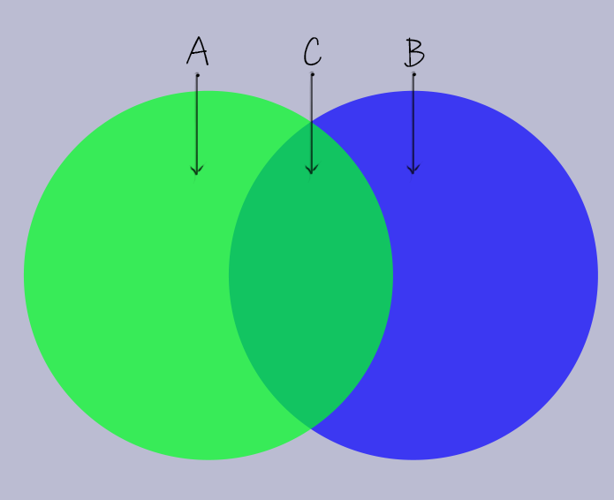
problem
Disc A has color $A_{RGBα}$
Disc B has color $B_{RGBα}$
When A is on top of B we perceive a blend $C_{RGBα}$
Transparency perception ability to perceive the ordering given the blended color
Evaluate blending algorithm
In terms of transparency perception
Notes:
The problem we considered is rather a simple one, evaluate the performance of color blending algorithms in terms of transparency perception.
And transparency perception is the ability to guess the ordering between two layers given the blended color.

Slide 14
Algorithms
Porter & Duff
Hue Preserving
Local blending
Local blending with blurring
[Porter 84]
[Chuang 09]
[Wang 09]
Notes:
We considered evaluating the classic porter and duff alpha blending. And also few of the newer ones.
[For evaluation of an algorithm, we decided to take a brute force approach of have user evaluation of the whole color space of foreground, background and transparency levels.]

Slide 15
ARCADE | survival
Notes:
To achieve such big data collection, we created a game titled disguise.
It can be thought of as an arcade game, where the player has to survive the attacks from “intruders”
The intruders are floating semitransparent circles that blow up eventually.

Slide 16
ARCADE | survival
Notes:
Intruders can float over the collectors or under the collectors. The players can guess the ordering only by looking at the composite color when they are on top of each other.

Slide 17
correctness
SCORE
SCORE
INTRUDER OVER COLLECTOR
HIT INTRUDER
NO
ACTION
INTRUDER
EXPLODES
ANY STATE
HEALTH
HEALTH
SCORE
SCORE
COLLECTOR OVER INTRUDER
HIT INTRUDER
CLICK
EMPTY
SPACE
ANY STATE
HEALTH
HEALTH
SCORE
ANY
STATE
HIT COLLECTOR
HEALTH

Slide 18
correctness
PLAYERS try to Optimize score
Score only improves with correct guessing of order
Each click gives us feedback about human perception of transparency ordering

Slide 19
observations
Playability within 15 days of launch… 261 players 30,000+ data-points generated.

Slide 20
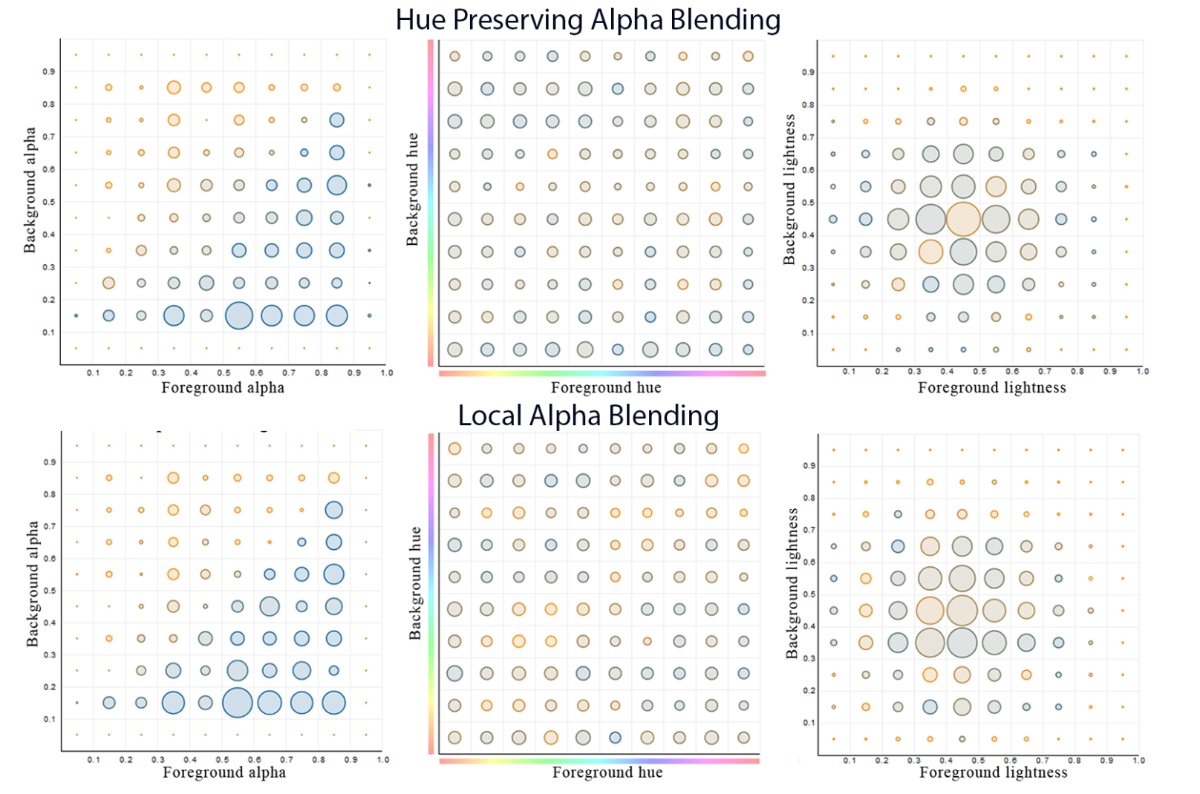

Slide 21
observations
Data collection speed 14.6 clicks per minute 1000 players x 24hr playtime = 21 million data points!

Slide 22
observations
cost once developed and deployed almost FREE!

Slide 23
observations
Data quality Provides much less noisy data than other web-based methods.
trying to optimize score, not earning!
Extent of data-points collected

Slide 24
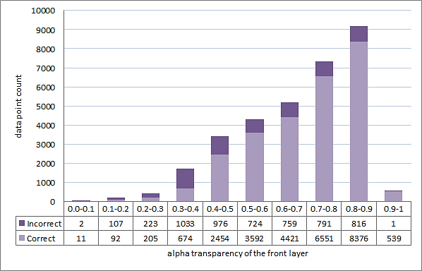
observations

Slide 25
observations
limitations TIME TO DEVELOP ensuring correctness and fun MAKING IT POPULAR

Slide 26
Future thoughts
Ideas, motivations

Slide 27
Future thoughts
INTEGRATION WITH A LEARNING AGENT FOR ADAPTIVE DESIGN OF NEW ALGORITHMS

Slide 28
Future thoughts
OPTIMIZATION OF VISUALIZATION PARAMETERS (transfer functions/ view angles)

Slide 29
THANK you
http://vail.cewit.stonybrook.edu/Projects/HPU/Disguise
NAFEES AHMED nuahmed@cs.stonybrook.edu www.kuntal.name
Ziyi zheng zizhen@cs.stonybrook.edu
www.cs.sunysb.edu/~zizhen/
Klaus mueller mueller@cs.stonybrook.edu
www.cs.sunysb.edu/~mueller/
VISUAL ANALYTICS AND IMAGING LAB
DEPT OF COMPUTER SCIENCE

