Slide 1
WELCOME
Start of Semester Meeting Spring 2021
Computer Science Department
Stony Brook University
Systems Staff

Slide 2
You do not need to take notes!
You only need to remember two things.
  How to get this presentation?
    Entire presentation is available on our website at http://www.cs.stonybrook.edu
    Under “About Us/CS Intranet ➔ Start of Semester Information” link.
  What is RT?
    Request Tracker system. More to follow.

Slide 3
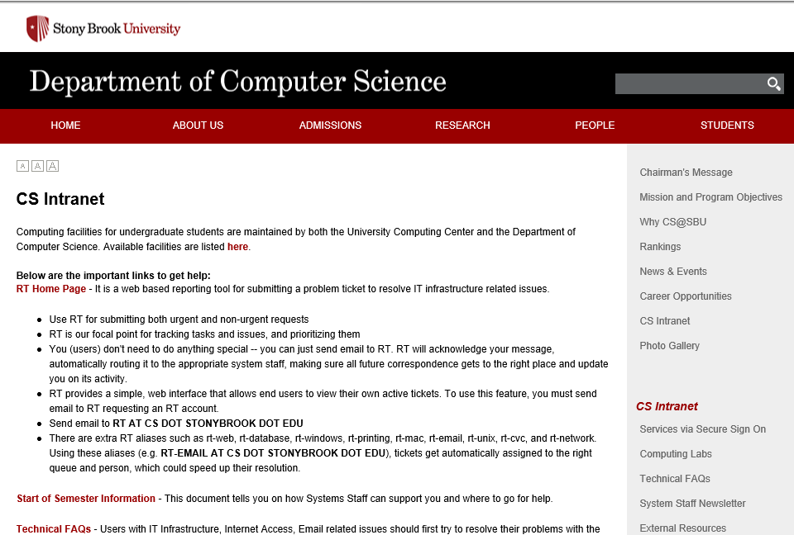

Slide 4




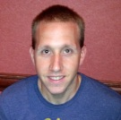

1. Who we are and what we do
 | Ken Gladky | Director of Operations
 | Peter Ruland | Associate Director of Operations
 | Brian Tria | Unix and Networking Manager
 | David Cajigas | Unix and Network Administrator
 | Michael Delgrosso | Client and Lab Administrator
 | Vibha Mullick | Database and Web Administrator

Slide 5
2. Where to get help
RT
Send email to RT (preferably from an campus email address ending in cs.stonybrook.edu or stonybrook.edu).
All System staff members and requesters get a copy.
rt@cs.stonybrook.edu

Slide 6
2. Where to get help
Department Website
http://www.cs.stonybrook.edu
  About Us ➔ CS Intranet
    Technical FAQ’s
  People ➔Staff (contact information)
  Admissions
    Documents,Forms and other information
  CS Intranet ➔Secure Sign-On area
  Downloads.
  Department specific information
  Lab access code combinations

Slide 7
3. Department Facilities
Purpose of Policies and Quotas
Manage resources to conserve research $$$.
Provide a better working environment for all members
If you need more resources for your department related work, ASK!

Slide 8
3. Department Facilities
Accounts
Policies – no sharing, cheating, etc.
Storage Quota (Windows) = 2GB
Printing Quota (Windows) = 500 pages/month
Separate Windows and Unix accounts (email sent when activated to your SOLAR
registered address)
Use Gmail/Yahoo for
personal emails
  Note: Gmail conflicts with
  FERPA regulation (TAs)
Alumni account upon graduation
Windows Account | Unix Account
Email Access | Compute hosts
Windows Labs | Web site
Wireless Access | Secure Sign-on

Slide 9
3. Department Facilities
Publishing on WWW
Edit your website directly by logging into UNIX workstations.
Use for department related purposes.
Submit RT request for more quota.
See FAQ for more details.

Slide 10
3. Department Facilities
Printing
Printer accounting and quotas.
Value your department resources.
No books, copyrighted or personal material, etc.

Slide 11
3. Department Facilities
Email system
G-Suite for Education
Web interface at http://www.gmail.com Email address is <CSid>@cs.stonybrook.edu
Users get Unlimited shared storage between all enabled apps storage
Enabled core apps are: Mail,Calendar,Sites,Drive,Contacts,Hangouts.

Slide 12
3. Departmental Facilities
Email Usage
Grads Alias: Don’t sell things on the alias. Don’t Cc all grads unless the email concerns all grads. Be polite.
Students are encouraged to obscure email addresses on www and not use name@cs.stonybrook.edu as text on their webpage's (See Technical FAQs).

Slide 13
3. Department Facilities
Public Labs
Windows Lab (Room 106)
Remote Desktop Services
  Web based access to applications and Virtual Windows Hosts

Slide 14
3. Department Facilities
Public Hosts
compute1 – compute2 (Public Linux compute servers)
Do not try to login to “cs.sunysb.edu” or “cs.stonybrook.edu”
Use ssh/sftp v2+ only (port 130).
See FAQs for more details.

Slide 15
3. Department Facilities
Miscellaneous
Graduate Offices: Don’t bring fridges, microwaves, coffee pots or furniture to offices.

Slide 16




3. Department Facilities
Miscellaneous
DoIT website http://it.stonybrook.edu
Free and Discounted Software
  Windows 10, Servers available for download, Office at Marketplace
  Apple software
  Adobe software
Hardware purchases (EDU discounts)
Campus Accounts
  NetID, Solar, SINC

Slide 17
4. Final Thoughts
Check the Technical FAQs.
If you have a problem, ASK!
If you need resources, ASK!
Submit RT request.
Stop by the System Staff Suite. (9am-5pm)
In case of Emergency, call the STAFF Hotline at 2-2772 (on campus) or 631-632-2772 (off campus)

