Slide 1
WELCOME
Start of Semester Meeting Fall 2017
Computer Science Department
Stony Brook University
Systems Staff

Slide 2
Don’t need to take NOTES!
Lot of information presented here.
You only need to remember two things.
How to get this presentation?
Entire presentation is available on our website at http://www.cs.stonybrook.edu
Under “About Us/CS Intranet ➔ Start of Semester Information” link.
What is RT?
Request Tracker system. More to follow.

Slide 3
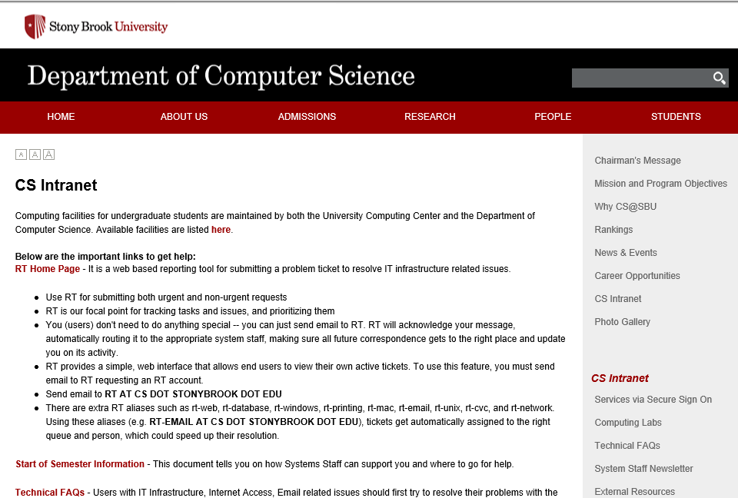

Slide 4
Agenda
Who we are and what we do
Where to get help
Department facilities
Final thoughts
Questions?

Slide 5
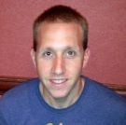
1. Who we are and what we do
 | Ken Gladky | Director of Operations
 | Peter Ruland | Associate Director of Operations
 | Brian Tria | Unix and Networking Manager
 | David Cajigas | Unix and Network Administrator
 | Michael Delgrosso | Client and Lab Administrator
 | Vibha Mullick | Database and Web Administrator

Slide 6
2. Where to get help RT
Send email to RT (preferably from an campus email address ending in cs.stonybrook.edu or stonybrook.edu).
All System staff members and requesters get a copy.
rt@cs.stonybrook.edu

Slide 7
2. Where to get help Department Website
http://www.cs.stonybrook.edu
About Us ➔ CS Intranet
Technical FAQ’s
People ➔Staff (contact information)
Admissions
Documents,Forms and other information
CS Intranet ➔Secure Sign-On area
Downloads.
Department specific information (e.g., Wireless connection information)
Lab access code combinations

Slide 8
3. Department Facilities
Purpose of Policies and Quotas
Accounts
Email
Newsletters
Publishing on WWW
Printing
Public Labs
Public Hosts
Miscellaneous

Slide 9
3. Department Facilities Purpose of Policies and Quotas
Manage resources to conserve research $$$.
Provide a better working environment for all members
If you need more resources for your department related work, ASK!

Slide 10
3. Department Facilities Accounts
Policies – no sharing, cheating, etc.
Storage Quota (Windows) = 2GB
Printing Quota (Windows) = 500 pages/month
Separate Windows and Unix accounts (email sent when activated to your SOLAR registered address)
Use Gmail/Yahoo for personal emails
Note: Gmail conflicts with FERPA regulation (TAs)
Alumni account upon graduation
Windows Account | Unix Account
Email Access | Compute hosts
Windows Labs | Web site
Wireless Access | Secure Sign-on

Slide 11
3. Department Facilities Accounts
Passwords – choose a good one and change within 2 weeks (inactive accounts or accounts with bad passwords are turned off).
Simple and secure password examples
Password | Description
March1995 | Any month and year combo
Computer+Java | Two words plus special character “+”
My 1st pet | Passphrase with a number
I l0ve F00tball | Replace “o” with “0”

Slide 12
3. Department Facilities Publishing on WWW
Edit your website directly by logging into UNIX workstations.
Use for department related purposes.
Submit RT request for more quota.
See FAQ for more details.

Slide 13
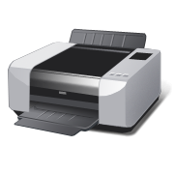
3. Department Facilities Printing
Printers in Public Labs(2126,106).
Printer accounting and quotas.
Value your department resources.
No books, copyrighted or personal material, etc.

Slide 14
3. Department Facilities Email system
Google Apps for Education
Web interface at http://www.gmail.com Email address is <CSid>@cs.stonybrook.edu
Users get Unlimited shared storage between all enabled apps storage
Enabled core apps are: Mail,Calendar,Sites,Drive,Contacts,Hangouts.

Slide 15
3. Departmental Facilities Email Usage
Grads Alias: Don’t sell things on the alias. Don’t Cc all grads unless the email concerns all grads. Be polite.
Students are encouraged to obscure email addresses on www and not use name@cs.stonybrook.edu as text on their webpage's (See Technical FAQs).

Slide 16
3. Department Facilities Public Labs
Windows Lab (Rooms 106 and 2126)
Mac Lab (Room 106)
Remote Desktop Services
Web based access to applications and Virtual Windows Hosts

Slide 17
3. Department Facilities Public Hosts
compute1 – compute2 (Public Linux compute servers)
Minix (Linux + Vmware)
Do not try to login to “cs.sunysb.edu” or “cs.stonybrook.edu”
Use ssh/sftp v2+ only (port 130).
See FAQs for more details.

Slide 18
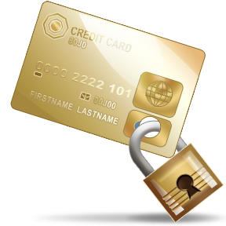
3. Department Facilities Miscellaneous
Graduate Offices: Don’t bring fridges, microwaves, coffee pots or furniture to offices.
Three basic steps to securing your computer
Antivirus and Antispyware software
Firewall
Update software patches

Slide 19
3. Department Facilities Miscellaneous
DoIT website http://it.cc.stonybrook.edu
Free and Discounted Software
Windows 7, Servers available for download, Office at Marketplace
Apple software
Adobe software
Hardware purchases (Edu discounts)
Campus Accounts
NetID, Solar, SINC

Slide 20
4. Final Thoughts
Check the Technical FAQs.
If you have a problem, ASK!
If you need resources, ASK!
Submit RT request.
Stop by the System Staff Suite. (9am-5pm)
In case of Emergency, call the STAFF Hotline at 2-2772 (on campus) or 631-632-2772 (off campus)

Slide 21
5. Questions?

